Slide 1
Scientific show and tell
Beth Schachter, PhD
Beth Schachter Consulting
www.bethschachterconsulting
drbethie@rcn.com

Slide 2
Recall a scientific talk that wowed you
What did you like about it?
Did it change how you give your own talks? Tell us about it
Tell us in chat box
Or ask other questions
drbethie@rcn.com

Slide 3
Engage the audience from the outset
Ask a question
Give them a problem to ponder
Challenge them emotionally
Notes:
Here’s a good question: Most virologists, as you’ve heard, thought that the SARS CoV-2 is not a human-made virus. Do you actually know the reasoning behind this opinion? Well, today I am going to discuss that as part of my presentation about the evolution of RNA viruses.
Or, here’s a problem for them to ponder Imagine being a parent of a child who couldn’t sleep because, when they fell asleep, they stopped breathing. This is the question that has motivated my research, which I will tell you about today.

Slide 4
Now that I have your attention
Let’s talk about good presentations

Slide 5
For science talks as well as papers, use the three communication pillars
Message Audience
Objective

Slide 6
Use these pillars to build effective presentations
Message
Audience
Objective
Notes:
I call them pillars because they are all important and I could present them to you in any order.

Slide 7
Remember: Use these pillars to build effective presentations
Message
Audience
Duration and Venue
Objective
Notes:
Today, for the discussion on presentations, I want to throw a fourth pillar, that of duration, because a 10-minute talk at a conference needs to be different than an invited departmental seminar.
And a presentation on Zoom is different than an in-person one.

Slide 8
Make a mind-map to you shape your presentation

Slide 9
Make a mind-map to you shape your presentation

Slide 10
Do you use the framework of your recent paper(s) to shape your presentation?
Introduction (Problem)
Methods (Approach)
Results Fig 1
Fig 2
Fig etc.
Discussion

Slide 11
When creating your presentation, play to the strengths and opportunities of the show-&-tell format

Slide 12
Contrast presentations and manuscripts
Presentations
Concept-rich: Good for sharing the process of doing science as well as the research findings
Manuscripts
Data-rich: Good for presenting experimental and quantitative details
Notes:
Because you all spend lots of time writing about your work and because there’s the strong tendency to adapt the story-telling style from writing into presentation, I thought it would be useful to look in detail at how presentations and manuscripts differ.
First of all, presentations are really good for presenting concepts and for sharing the process of doing science. You have the opportunity to tell the “real” story, including your thoughts about how your work addresses a particular problem as well as some of the hurdles that you may have encountered and how you overcame them, how collaborations began, etc. By contrast, manuscripts are great for giving lots of results and presenting complex experimental design and quantitative detail. Scientists often forget that it’s difficult to present complex experimental concepts and particularly lots of complex quantitative information in talks. So you want to think about what your intended message really is in your talk since your audience can’t carefully scrutinize the details of your work in that venue.

Slide 13
Contrast presentations and manuscripts
Presentations
Good for story-telling, giving commentary about each finding as it’s presented.
Can highlight work and interactions of individuals
Manuscripts
Components of the story much more compartmentalized
Show the collective effort of the group
Notes:
Another big difference between papers and presentations is the structure of the storytelling. For example, in papers, the “what’s new” (i.e., the Results) is separated from the how (the Methods). And Results are also separated from the Discussion (the So What). In a presentation, you have the opportunity to tell the story in a completely different way, a way that may engage your audience by including a discussion of the process of doing science. Who did what when and why, and some of that narrative might include talking about aspects of the process that were not discussed at all, or at least not highlighted, in the paper you just published. So, we’ll talk more about that when we discuss the planning of the paper.

Slide 14
Contrast presentations and manuscripts
Presentations
Opportunities for subjective impressions and opinions
Unidirectional and discrete in time
Manuscripts
Impersonal, objective
Readers can loop back to reread
Notes:
Presentations, even formal ones, are opportunities for sharing subjective impressions and opinions much more than are manuscripts where much more objectivity and impersonals thoughts are the norm.
Also

Slide 15
Contrast presentations and manuscripts
Presentations Presenter can include unpublished work
Presenter can get immediate feedback
Manuscripts Peer-reviewed content must meet minimum standards of reproducibility
Little opportunity for quick feedback

Slide 16
Contrast presentations and manuscripts
Presentations
Audio and visual parts should complement each other
Manuscripts
Visual information has no competition from audio
Notes:
This final point in the comparison is really important. In presentations we’ve got both the audio and visual components whereas in manuscripts, there’s only visual information to give to the audience. So, it’s really important in presentations to have the audio and visual components work together rather than compete.

Slide 17
In your presentation, play to the strengths and opportunities of that format
Notes:
I just noted a bunch of strengths and opportunities that you get in giving presentations, so remember to take advantage of them rather than falling back on communication techniques that are best suited for written manuscripts.

Slide 18
Now let’s expand the mind-map

Slide 19
Your message (the substance) includes relevant context, questions, results AND other interesting aspects of your story

Slide 20
Message also includes an interesting ending, tying the story back to the beginning and looking forward

Slide 21
Connect all parts of your message
Notes:
People often show results without putting them into context. Don’t do that; remember that all your messages should fit into the overall story. Make sure your audience knows why you are telling them something when you tell it and how it connects to the other parts. Not connecting parts of your story happens often when the story you are telling deals with work done at the same time by different people in your group. Make sure all the parts explicitly fit together.

Slide 22
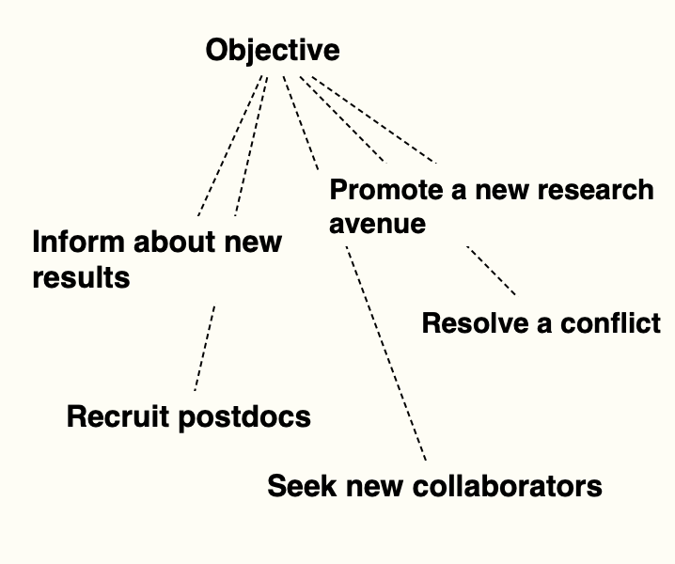
Expand the specifics of the other pillars

Slide 23
Use audience, objectives, and duration/venue mind-maps to prune and organize your messages
Notes:
So, for example, if you are seeking a new collaboration, you might emphasize that in presenting some finding or discussing the next step. If your objective includes emphasizing how your work relates to the research of someone in the audience, you might emphasize that part of the story more than you would in a different setting. And, of course, the length of the talk will heavily influence how much content you can include. But, remember that even short stories need good beginnings and endings, so don’t eliminate the context, questions, connectors and conclusions just because you only have 10 minutes.

Slide 24
How to show and tell together
Notes:
For scientific presentations about original research, we typically have as the major focus of the presentation the presentation of the new findings. So much effort and time in science gets devoted to doing the hands-on work, analyzing the results of that effort and then figuring out how to visually display those results that we want to maximize our opportunities to show our results. The problem is that often even senior scientists try to cram in too many new findings at the expense of explaining the context and at the expense of good descriptions of the slides, so the audience knows what they are seeing. So, I want to spend some time talking about ways to do this effectively.
We’ve all gotten accustomed to using watching and giving presentations where too much detail obscures our messages. By that I am referring to slides with too many words per slide, too much data per slide and not enough explanation about what the details on the slides may be.

Slide 25
Our brains get overloaded when we try to digest lots of spoken and written words at the same time*
*https://www.assertion-evidence.com/

Slide 26
PowerPoint “topic-style” presentations often overload the audience
Notes:
For scientific presentations about original research, we typically have as the major focus of the presentation the presentation of the new findings. So much effort and time in science gets devoted to doing the hands-on work, analyzing the results of that effort and then figuring out how to visually display those results that we want to maximize our opportunities to show our results. The problem is that often even senior scientists try to cram in too many new findings at the expense of explaining the context and at the expense of good descriptions of the slides, so the audience knows what they are seeing. So, I want to spend some time talking about ways to do this effectively.
We’ve all gotten accustomed to using watching and giving presentations where too much detail obscures our messages. By that I am referring to slides with too many words per slide, too much data per slide and not enough explanation about what the details on the slides may be.

Slide 27
A typical Introduction slide burdens the reader/listener with too much text
Notes:
This slide gives an example of what many well-organized, well-meaning speakers do: create a detailed outline of the topics to be covered.Ask yourself: Does the audience really need a detailed outline of the presentation. Maybe just the main heading, or maybe there’s an even better way, as we’ll see in a minute.

Slide 28
Too much graphical information can obscure the important message

Slide 29
Let’s streamline this figure and write a more informative headline

Slide 30
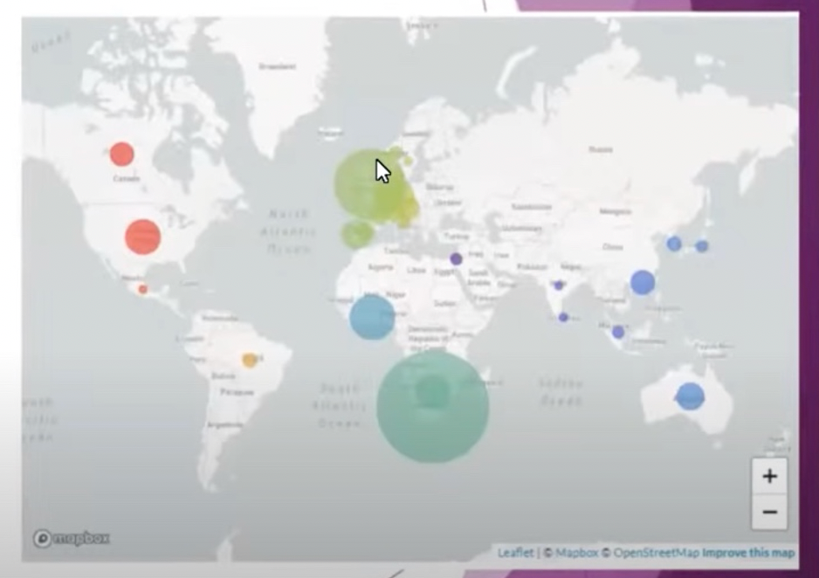
Omicron frequency in each country relates to the country’s sequencing capacity
Notes:
Here we have a new headline that tells the story in the figure. Make sure to mention that size of the circle related to sequencing capacity

Slide 31
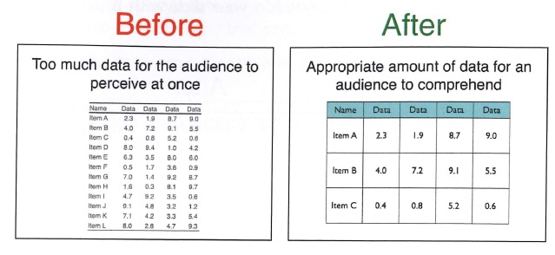
If the data in the table can’t be read, why waste the energy of the audience by showing the table?

Slide 32
How to make the spoken words images work together?
Consider using the Assertion-Evidence approach
From Michael Alley, Professor of Engineering, Penn State University
https://www.assertion-evidence.com/

Slide 33
What is the Assertion-Evidence (AE) presentation style?
Topic
Message

Slide 34
Starting with the presentation title, AE stresses the message rather than the topic
Topic
Message
Scientific Writing – Think Message, Audience, Objective
Writing a scientific paper

Slide 35
Introductory overview gives MESSAGE followed by images rather than just text outline
https://www.assertion-evidence.com/
Notes:
Note that the heading carries the message rather than just the topic of the presentation

Slide 36
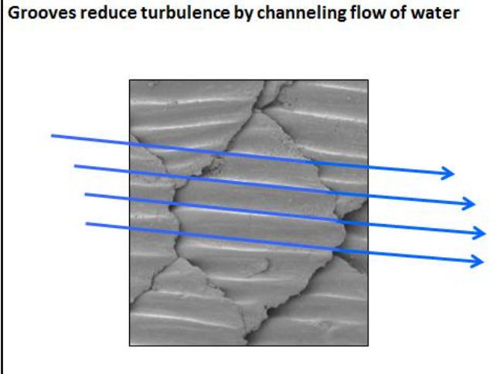
For each body slide, make a one-sentence assertion and then a figure(s) to support and reinforce the claim

Slide 37
Speaker spends several minutes describing the work relating to the image (including bringing in more detail to the simple figure)
Notes:
You can bring in more details about your research into the figures once you’ve given your audience a simple-to-comprehend frame of reference. Be clear about what each new component is showing.

Slide 38
Assertion-evidence gives the “punchline” first and supports each claim with evidence

Slide 39
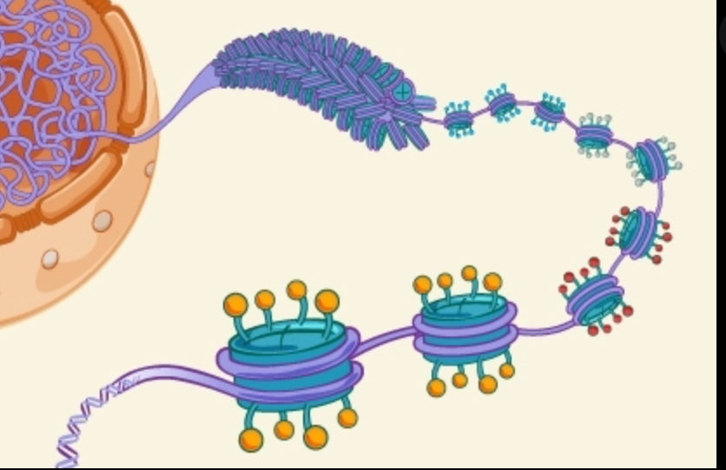
What about telling your story as a mystery?

Slide 40
What about telling your story as a mystery?
Yes!

Slide 41
Whether using AE or mystery solving, connect all the pieces together

Slide 42
Summary & Conclusion

Slide 43
Summary & Conclusion
Audience ?

Slide 44
But wait! Here’s a few tips
Slide preparation
Talk preparation

Slide 45
What to think about when preparing the slides
Review slides to remove all but the most essential text and graphic elements
Notes:
Make sure font is large enough, dark enough and simple enough to read in the venue.

Slide 46
What to think about when preparing the slides Tips for preparing slides
Review slides to remove all but the most essential text and graphic elements
Review slides to remove all non-essential text and graphics
Notes:
Make sure font is large enough, dark enough and simple enough to read in the venue.

Slide 47
Tips for preparing slides
Font style – san serif is easiest to read
Notes:
Make sure font is large enough, dark enough and simple enough to read in the venue.

Slide 48
Tips for preparing slides
Font style – san serif is easiest to read
Room or Zoom – Large room may need larger font, Zoom good for slide readability
Notes:
Make sure font is large enough, dark enough and simple enough to read in the venue.

Slide 49
Tips for preparing slides
Font style – san serif is easiest to read
Room or Zoom – Large room may need larger font, Zoom good for slide readability
Darkened room for image projection – use dark background, white/yellow text
Notes:
Make sure font is large enough, dark enough and simple enough to read in the venue.

Slide 50
Tips for preparing slides
For slides with images or movies, tell people what they should look for
Notes:
If the image needs annotation, make it clear and explain it to people in your own words, not just figure legend
If your images are not good, avoid showing them.50
Make sure font is large enough, dark enough and simple enough to read in the venue.

Slide 51
Tips for preparing slides
For slides with images or movies, tell people what they should look for
Avoid Low-quality images/videos; they waste viewer’s time
Notes:
If the image needs annotation, make it clear and explain it to people in your own words, not just figure legend
If your images are not good, avoid showing them.51
Make sure font is large enough, dark enough and simple enough to read in the venue.

Slide 52
Tips for preparing slides
For slides with images or movies, tell people what they should look for
Avoid Low-quality images/videos; they waste viewer’s time
If possible, test slides in venue/equipment before presentation
Notes:
If the image needs annotation, make it clear and explain it to people in your own words, not just figure legend
If your images are not good, avoid showing them.52
Make sure font is large enough, dark enough and simple enough to read in the venue.

Slide 53
Tips for preparing slides
For slides with images or movies, tell people what they should look for
Avoid Low-quality images/videos; they waste viewer’s time
If possible, test slides in venue/equipment before presentation
Pace yourself so that you don’t talk too fast or say too much
Notes:
If the image needs annotation, make it clear and explain it to people in your own words, not just figure legend
If your images are not good, avoid showing them.53
Make sure font is large enough, dark enough and simple enough to read in the venue.

Slide 54
Tips for giving presentations
Practice on your own

Slide 55
Tips for giving presentations
Practice on your own
Practice with a critical audience

Slide 56
Tips for giving presentations
Practice on your own
Practice with a critical audience
Think about questions you might get asked

Slide 57
Tips for giving presentations
Practice on your own
Practice with a critical audience
Think about questions you might get asked
Ignore the instructions ”1 slide per minute” but time your talk

Slide 58
Tips for giving presentations
Arrive early and engage individuals

Slide 59
Tips for giving presentations
Arrive early and engage individuals
Make eye contact with one or more audience members

Slide 60
Tips for giving presentations
Arrive early and engage individuals
Make eye contact with one or more audience members
If public speaking frightens you, try Toastmasters as a practice venue

Slide 61
Remember: Use these pillars to build effective presentations
Message
Audience
Duration and Venue
Objective
Notes:
Today, for the discussion on presentations, I want to throw a fourth pillar, that of duration, because a 10-minute talk at a conference needs to be different than an invited departmental seminar.
And a presentation on Zoom is different than an in-person one.

Slide 62
Recall a scientific talk that wowed you
What did you like about it?
Did it change how you give your own talks? Tell us about it
Tell us in chat box
Or ask other questions
drbethie@rcn.com

Slide 63
Useful references for scientific presentations
Assertion-Evidence from Michael Alley
Ten Simple Rules for Better Figures, Rougier, Droettboom, & Bourne
How to Give a Talk by David Stern
Designing Effective Scientific Presentations by Susan McConnell

