Slide 1
Accessible Communications A Training for the CCNY Community (Getting Started)
The Office of Institutional Advancement and Communications
The AccessAbility Center/Student Disability Services (AAC/SDS)

Slide 2
Welcome: Accessibility Training
Approximately 16 million (35 years and younger)*
General information applicable to many areas
Takeaways:
Document transformation
Adding metadata to documents and multimedia
Moving forward – Working group
Resources, Resources, Resources!
*2016 stats- US. Census

Slide 3
The AccessAbility Center/Student Disability Services (AAC/SDS)
Joseph LoGiudice, Director of AAC/SDS
Julia Silveira & Jeremy Britton-Miller, Access Interns of AAC/SDS

Slide 4
Outline for Training
An overview of disability laws that apply to communications of all types (e.g., on the Website, documents, presentations, online learning management programs) with a brief review of important terms
Narratives of university professors, higher education administrators, and students telling their stories on the importance of universal design and inclusion
Technicalities of making communications accessible
Resources
Contact Information

Slide 5
Introductions
Who are we and what we do here
What do we hope to impart from this training?

Slide 6
Who we are: AccessAbility Center (AAC/SDS)
Coordinate and implement academic adjustments, auxiliary aids, and support services for students with disabilities.
Actively works toward full inclusion in policies, procedures, and practices in the context of accessibility while maintaining essential academic and technical standards.
Engages in increasing disability awareness among members of the City College community through workshops, trainings and the dissemination of literature.

Slide 7
Accessibility in the Context of Technology
The term ACCESS is term derived from disability policies and laws. Likely, you have heard of EQUAL ACCESS and FULL PARTICIPATION to all services, activities, and programs for individuals with disabilities. Applies to CCNY due to being a public institution (i.e,. Section 504 of the Rehabiliation Act and Title II of the ADA).
Equal access as applied to technology means ensuring information is available to individuals with disabilities. This is typically conducted through the means of assistive technology and/or accessibility tools.
Best practice is not ad-hoc solutions, rather universal design principles, which are inclusive from the onset rather than retrofitting
Notes:
Deaf or Hard of Hearing – Captions of transcripts available for audio/video content
Low Vision or Blindness – Documents are OCRed, have proper tags, and contain alternate text for images
Learning Disabilities – Information is displayed clearly in proper order with no distracting colors or images

Slide 8
Disability Laws Applied to Public Institutions
Title II of the Americans with Disabilities Act
Prohibits discrimination by higher education institutions
Must provide access to all programs and services offered
The Rehabilitation Act
Section 504: Declares civil rights for individuals with disabilities
Section 508: Sets requirements for accessible technology

Slide 9
Specific Requirements for Equal Access with Respect to Communications
Communication of all types for students with and without disabilities must be equally effective and meet the following broad guidelines:
Timeliness of delivery
Accuracy of Translation
Provision in a manner and medium appropriate to the significance of the message and the abilities of the individual with the disability

Slide 10
Why do we need to make technology accessible?
Legal obligations for compliance, but the moral aspects as well
If you are provided with training and information on making your communications accessible and overtly make the choice not to, this can result in serious consequences (including legal and compensatory damages) both for the institution and the professional
According the U.S. Bureau of Labor Statistics, 16.4 percent of students with disabilities vs 34.6 percent of students have completed a bachelor’s degree. This gap is a product of the lack of support institutions give their students with disabilities, including the barriers they face due lack of to web accessibility.

Slide 11
Why do we need to make technology accessible? (cont.)
When digital material is inaccessible *:
→ Limits the students’ access to information
→ impacts and limits their educational experience, including their ability to perform as well as others
→ Due to increased use of technology across the board--Website, eLearning, databases, use of MS programs, further necessitates the need for digital accessibility.
*Please note: students with disabilities are utilized as an example, but this applies to all individuals with disabilities

Slide 12
Who Needs Accessible Communications
Three groups of disability categories have been a focus on attention in accessible communications:
Deaf/Hard of Hearing
Blind/Visually Impaired
Learning Disabilities
These three categories require the following access standards:
Deaf or Hard of Hearing – Captions of transcripts available for audio/video content
Low Vision or Blindness – Documents are OCRed, headers, and contain alternate text for images
Learning Disabilities – Information is displayed clearly in proper order with no distracting colors or images

Slide 13
Benefits of Universal Design (Best Practice Standards)
Every student, no matter their ability or disability has access to information.
While universal design promotes access for individuals with disabilities, it also benefits others
University of Arizona Disability Resources Office is an excellent example of the implementation of universal design principles

Slide 14
Benefits of Universal Design
Captions:
University of Washington Improving Access to Postsecondary Education
Notes:
This video highlights the benefits of captions and how it has benefited people without disabilities as well. Even though it only highlights a small aspect of the access communication and universal design, I thought it is only 7 minutes and it could be a nice way to show how important this issue of digital access is.

Slide 15
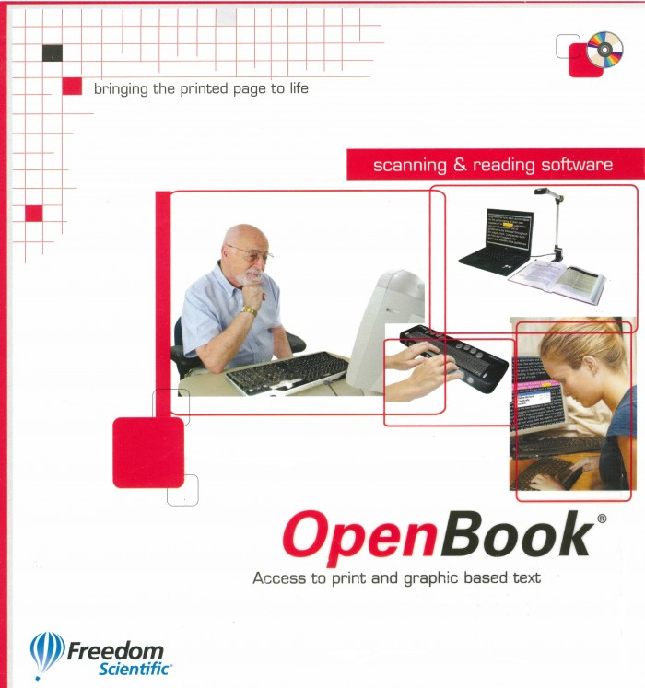
Types of Assistive Technology Available on Campus: AT Campus-wide Initiative
Enlarges, enhances, reads text aloud
Screen Reader with speech and Braille output
Text reading, voice dictation, research aids, teaching tools
Speech dictation and transcription
Dictionary, translation, grammar- and spell-check
Optical Character Recognition to convert scans to accessible formats

Slide 16
Accessibility in Communications Aligned with CCNY History and Mission
What Campus Leaders Have to Say (University of Washington, 2013)
“Access to Excellence”

Slide 17
Questioning Whether This is Necessary?
Lobbies/organizations that represent disability groups and individual students have filed legal cases against a number of universities for a lack of accessibility. These cases are reported in several areas: Chronicle for Higher Education, US DOE OCR. Some have resulted in agreements, settlements, and/or damages. Cases take several years for processing and many times the university is cited on additional ADA violations
More than 250 lawsuits filed in 2016 about inaccessible websites and/or mobile apps.
In 2016, UC Berkeley was sued for inaccessibility and violation of ADA.
DOJ directed the university to make its content more accessible and pay damages to the students affected.

Slide 18
Resources
CUNY Assistive Technology Services (CATS)
CUNY Assistive Technology Services
CCNY AAC/SDS Assistive Technology
Universal Design and Introduction to Accessible Materials
Accessible Technology UNIVERSITY OF COLORADO BOULDER
University of Washington DO-IT: Disabilities, Opportunities, Internetworking, and Technology

Slide 19
Contact Information
Joseph LoGiudice, Director of AccessAbility Center
212-650-7552 Jlogiudice@ccny.cuny.edu
NAC 1/218
Julia T. Silveira, Access Intern
jsilveira@ccny.cuny.edu
Shepard Hall 51A
Jeremy Leigh Britton
lbritton@ccny.cuny.edu
Shepard Hall 51A

Slide 20
Microsoft Office: Day-to-Day Use
Prem Nankoo
The Office of Institutional Advancement and Communication

Slide 21
Microsoft Office Accessibility Overview
Documents contain hidden obstacles that can disrupt users with a vision or reading disability.
Word has a built-in Accessibility Checker to help find and fix these obstacles.
Inspection Results
Errors - content that can’t be read by users with certain disabilities
Warnings - Content that is less serious, but still make it difficult for people with disabilities to read
Tips - any minor issues that might cause problems, but will help optimize document’s readability for everyone
Additional Information provides instructions on how to fix any of the issues above
Screen readers read out all the content on a document.
***Scanned documents are NOT accessible***

Slide 22
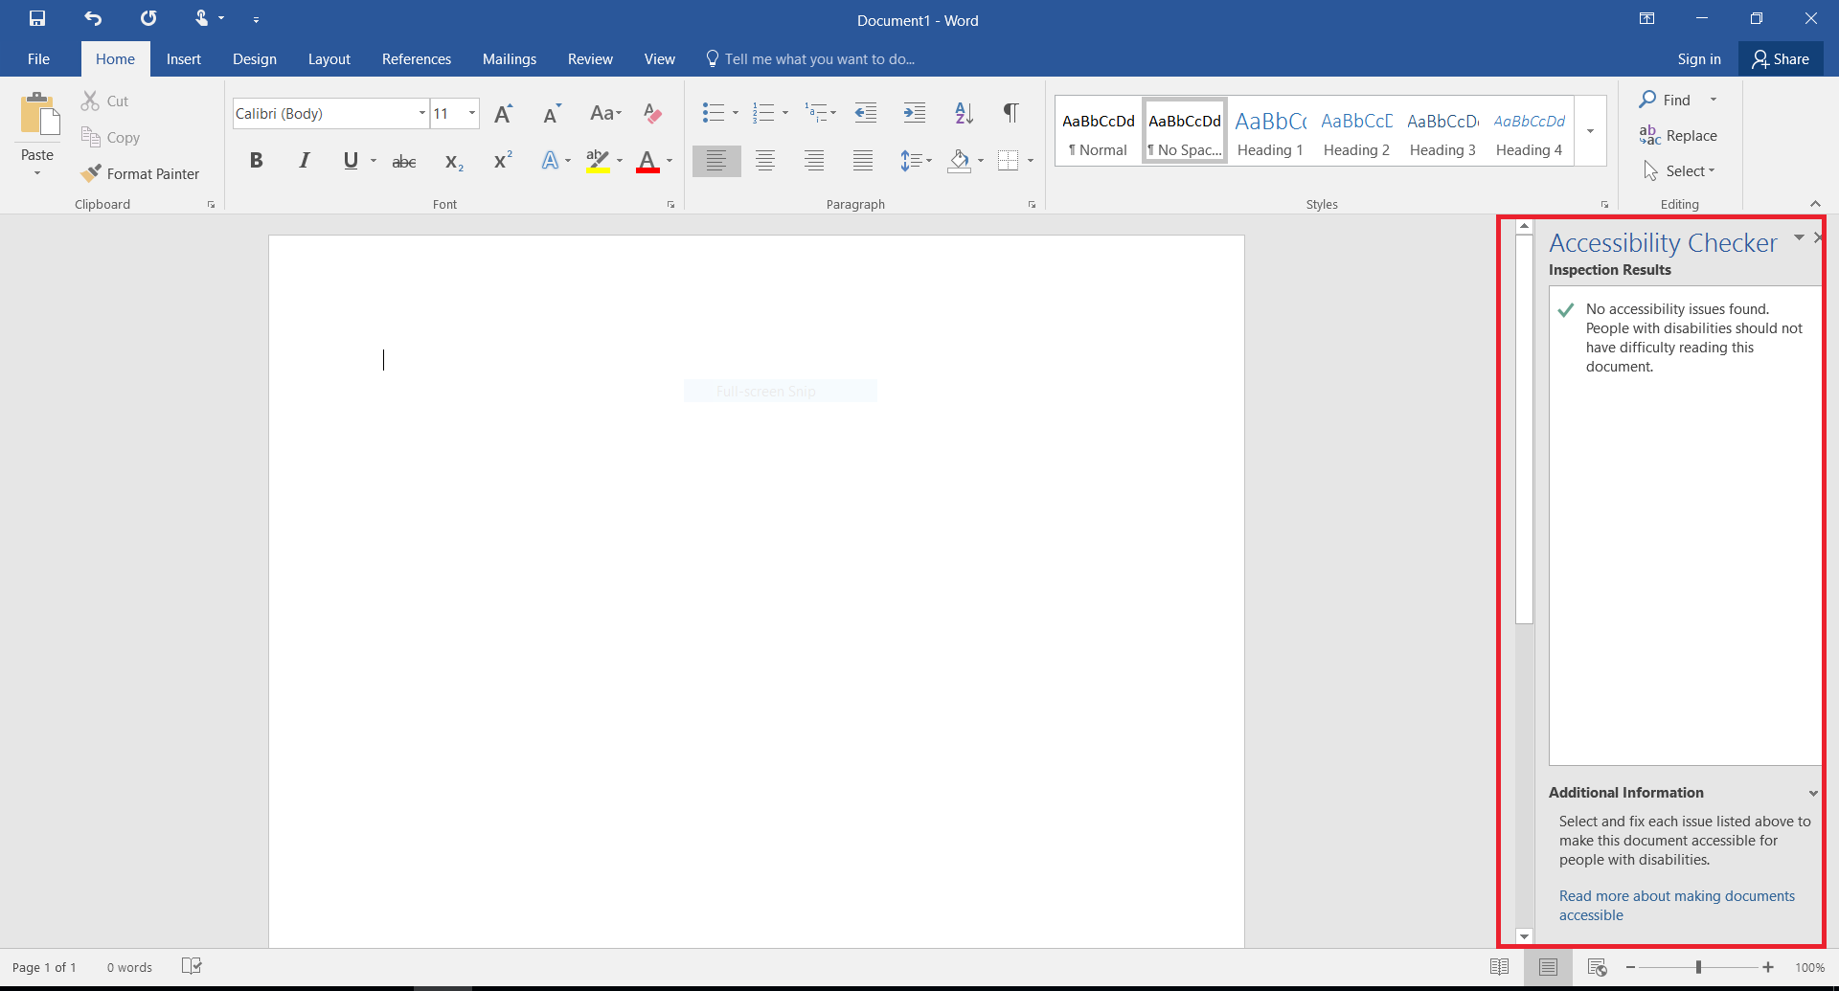
How To Find Accessibility Checker
Click on “File” and under the “Info” tab navigate to “Inspect Documents” and click on “Check Accessibility” under button saying “Check for Issues”
Example of Accessibility Checker window located on the right

Slide 23
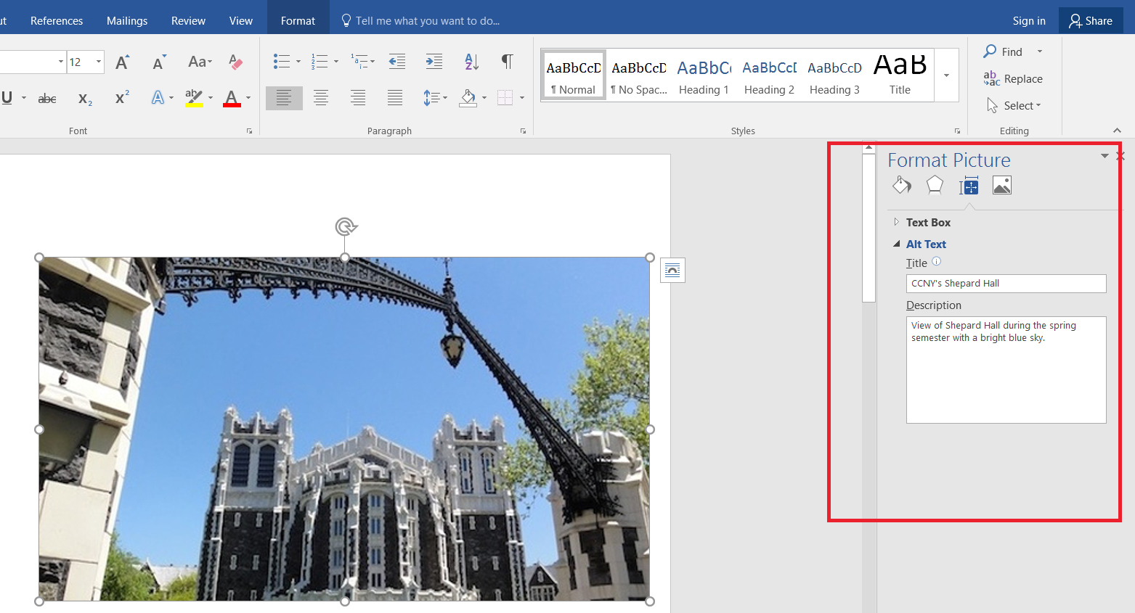
Basic Word Formatting For Accessibility
Headings – Screen readers arrange headings in order – H1 headings read before H2, H2 headings read before H3, and so on.
Users who have any reading issues depend on headings to:
Provide clues about the content
Organize content into groups of related ideas
Images - Add Alt Text to images, diagrams, SmartArt, and tables.
Screen readers read Alt Text out loud.

Slide 24
Basic Word Formatting For Accessibility (cont.)
Color Contrast - Ensure text and background have a sufficiently high level of contrast.
Links - Make hyperlinks more accessible by changing their display text to something more natural and meaningful.
Screen readers will read out each letter in the URL which is difficult.
Avoid generic terms such as “Click Here” or “Learn More”

Slide 25
Basic Word Formatting For Accessibility (cont.)
Tables - Make sure that the table has one Header Row, Add Alt Text, Fix any merged or split cells in the table.
Easier for screen readers to navigate through tables.
Creating one header row
Adding Alt text

Slide 26
Multimedia: Web & Digital
Seamus Campbell
The Office of Institutional Advancement and Communication

Slide 27
Video Overview
All videos must have closed captioning as required by Section 508 of the Rehabilitation Act
Subtitles and closed captions open up your content to a larger audience, including deaf or hard of hearing viewers or those who speak languages besides the one spoken in your video.
YouTube is recommended for video distribution
If you choose to not use YouTube to host your video, you must provide a transcript alongside the your video.
Notes:
1194.22 Web-based intranet and internet information and applications.
(b) Equivalent alternatives for any multimedia presentation shall be synchronized with the presentation.
Google will rank pages higher that have videos with captions and will translate the text for users using a different language via Google Translate.

Slide 28
How to Add Captions to YouTube Videos
Next, go to the Advanced settings and choose the video’s language from the “Video Language” drop-down.
Upload your video, then go to the Translations Tab, and then choose the video’s language from the “Original language” drop-down.

Slide 29
How to Add Captions to YouTube Videos (cont.)
After some time has elapsed, go to your Video Manager and select “Subtitles/CC” from the Edit drop-down menu next to uploaded video
On right side of the page that appears, click on the published subtitles track generated (it will usually will say “English (Automatic)”

Slide 30
How to Add Captions to YouTube Videos (cont.)
On the page that appears will be the generated transcript, click edit and edit the text as necessary.
When finished, click “Save Changes.”

Slide 31
Additional Resources
The CCNY AccessAbility Center/Student Disability Services (AAC/SDS) offers a range of software to help create and manipulate accessible documents.
CUNY
Digital Accessibility in Practice
Microsoft
Video tutorials on creating accessible content in Word, PowerPoint, Excel, and Outlook
Accessible Office templates
Adobe
Adobe Acrobat Accessibility
Create Accessible documents with InDesign
Create Accessible PDF documents with InDesign CS6
Social Media (Facebook, Twitter, Instagram, etc.)
Create Accessible Social Media posts

Slide 32
Contact Information
Office of Institutional Advancement and Communications
General Website Inquiries: Simone K. McMillion, D.Sc Director of Marketing x7581
Technical Inquiries: Seamus Campbell Website Coordinator x7582
Training Inquiries: Prem Nankoo Web Content Assistant x8170

