Slide 1
Becoming a City College Student: Managing the business of being a student at CCNY
Presented by: Dominic Stellini, Director of the New Student Experience Center

Slide 2
Our goal for this session:
There are at least three parts of being a City College student:
Academic Stuff
Administrative Stuff
Social Stuff
Our goal in this session is to give you a quick introduction to the administrative side of being a student here at City.

Slide 3
CCNY is a big Place, BUT you are not alone
City College understands that you are not an expert at being a college student, yet. To address that we have a number of people and offices whose job is to get you to the point of being an expert.
They are:
Your academic advisor(s)
Enrollment Offices
Admissions
Bursar
Enrollment and Testing
Financial Aid
Registrar
Student Affairs

Slide 4
Academic advising
You will encounter two kinds of advisors who have two different roles:
Professional Advisors:
Your first contact, point person and guide
Works with you on the whole of being a student
Will teach you to use the tools you need to succeed
These folks include NSEC, SEEK, SSSP, Honors and Divisional advisors
Major advisor
Your point person and guide within your chosen academic discipline
Please Note: In some divisions these roles are merged into one position.

Slide 5
Enrollment Offices
Admissions
CUNYFirst (issues with claiming your account)
New York State residency (tuition rate)
Transfer Credit (including AP, College Now, IB, and credit from other colleges)

Slide 6
Enrollment Offices
Bursar
Evaluation & Testing (2nd FL, Rm. 213)
Paying your bill
Tuition Payment Plan
CUNY Assessment Testing
English as a Second Language (ESL)
Math Placement Testing
Ability to Benefit Testing (if attended high school outside the U.S.)

Slide 7
Enrollment Offices
Financial Aid
Registrar
Grants including PELL, TAP
Student and Parent Loans
Financial Aid Verification
Official custodian of your student records
Declaration of major
Applying for graduation from City College
Ordering a transcript of your City College course work
Correction of WN grades

Slide 8
Student Affairs

Slide 9
Tools of the trade
In addition to a dedicated staff, City College Provides you with a number of tools that are essential to your success as a student. Many of these tools are managed by the Office of Information Technology (OIT).
IT SERVICES
https://www.ccny.cuny.edu/it
Valuable IT information for all new students:
https://www.ccny.cuny.edu/it/new_students
IT SERVICE DESK
https://www.ccny.cuny.edu/it/help

Slide 10
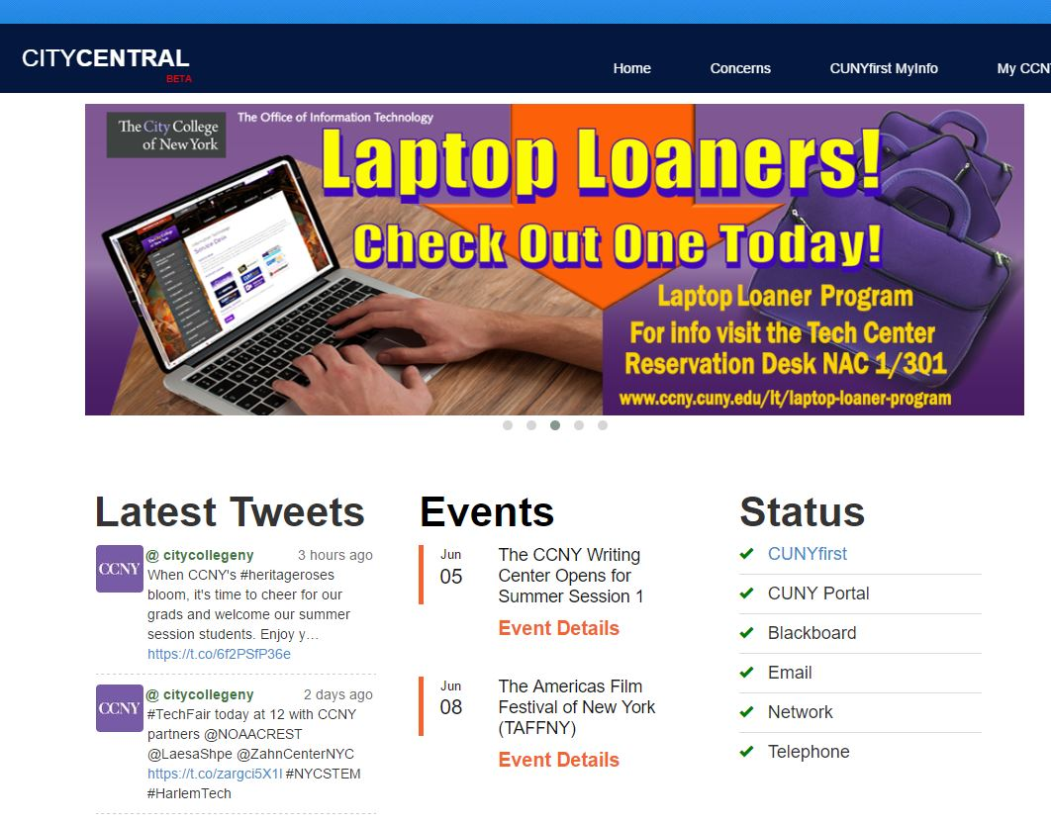
Tools of the Trade: City Central Portal
citycentral Student portal
The CITYCENTRAL Student Portal
provides CCNY students with easy access
to some of their most used resources:
CUNYFirst MyInfo
MyCCNY+
Latest Tweets
Events
Status for Campus Systems
Mobile App!
(https://central.ccny.cuny.edu/index.php)

Slide 11
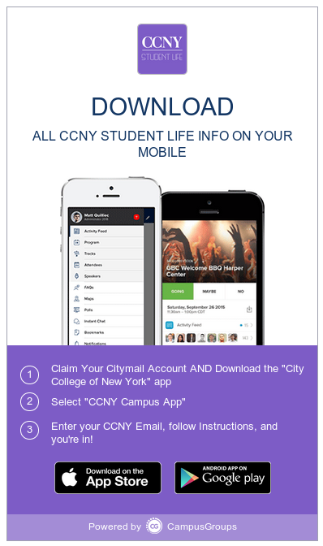
Tools of the Trade: CCNy Guide
Features:
Campus Map
Checklists
Resources on Campus
Academic
Student Affairs
Technology
Meet your student leaders
Free food alerts
Beaver Lingo
Academic Calendars
All in the palm of your hand!

Slide 12
Tools of the trade: CUNYFirst
CUNYFirst is the Student Information System we use at City College to keep track of all of your information. Contact information, grades, registration, finances, bills, etc. In a word, everything.
The primary thing you will use CUNYFirst for, is registering for your classes. However, there is a lot more you can do in CUNYFirst. Some of these are:
Enrollment
Search for classes (Class Search Guide)
Enroll in classes (Enrollment Guide)
Add/Drop/Swap classes
Withdraw from classes
View your enrollment dates
Finances
View holds, including financial aid holds
View your financial aid
Check your tuition balance
Personal information
Update your address
Update your email address
Update your phone number
Update your emergency contact information
Access unofficial transcripts
Other
View your grades
View your schedule
View your course history
Apply for an ePermit (ePermit Information)
Apply for graduation

Slide 13
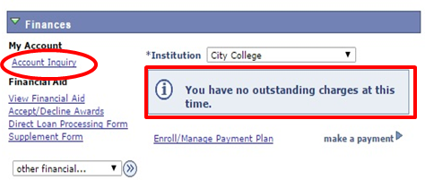
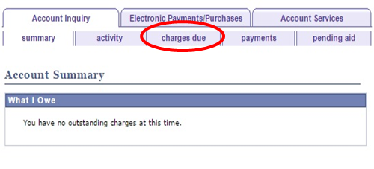
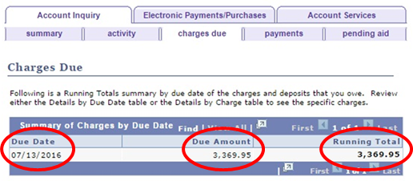
Know What You Owe
When you register for classes, your tuition balance will change, but did you know that if you add or drop a class, your balance may change again?
Follow the below steps to KNOW WHAT YOU OWE!
1. Check your CUNYFirst Account for any current charges.*
2. Select Charges Due for a detailed report.
3. Don’t miss your bill due date on the left!

Slide 14
Know when you owe

Slide 15
Tools of the Trade: CUNY portal
BLACKBOARD
DEGREE WORKS
Online home for your classes
Single dedicated location for professors to post assignments and readings
The syllabus is often posted in advance of the class starting
Professors may utilize discussion board forums
Professors can send announcements/contact the entire class at once
A digital checklist of your degree requirements
It maps courses you have completed at City College into categories
For transfer students, it includes courses from previous colleges (if the transfer credits were evaluated)
An easy way to see what you have completed / what is still left to obtain your degree
Closely tied with financial aid eligibility (if applicable to you).
Online BlackBoard Support
https://www.ccny.cuny.edu/it/blackboard
Online DegreeWorks Support
https://www.ccny.cuny.edu/registrar/degreeworks
For further assistance, you may contact the CUNY Portal/Blackboard Support at 212-650-6990 or via email bbsupport@ccny.cuny.edu/

Slide 16
Tools of the Trade: Citymail
CityMail is your official City College email account and so much more.
This is your business address as a City College Student.
This is the only email account that the college (including professors) will use to communicate with you, so check it daily.
Your login credentials for this account also serve as your login to the campus Wi-Fi and computers in all computer labs.
CityMail is part of the FREE Microsoft 365 package that you are entitled to as a CCNY Student

Slide 17
To claim your Citymail account
Go to http://accountlookup.ccny.cuny.edu
Check “Change Password”
Submit required information to obtain access to your email

Slide 18
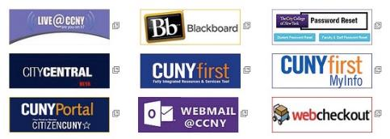
IT Help
CONTACT
Location: North Academic Center (NAC) Room 1/301
Phone: 212.650.7878
E-Mail: servicedesk@ccny.cuny.edu

Slide 19
Doing Your part is essential!
Tips for stress free enrollment:
1. Know your degree requirements (check the Undergraduate Course Bulletin)
2. Check your CUNY First Account frequently
3. Check your CityMail at least once daily!
4. You must attend classes during the first week of classes in order to verify your enrollment.
5. See your academic advisor often, at least twice a semester. Advising is about more than your class schedule.

Slide 20
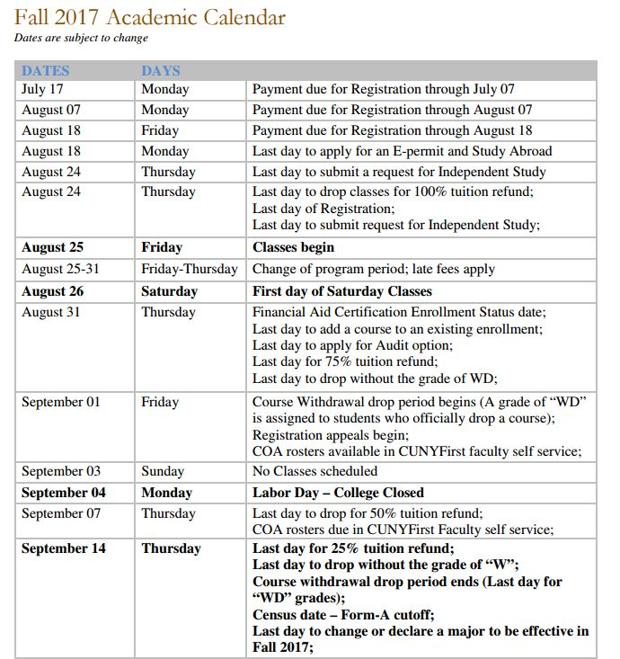
Your part is essential!
Tips for stress free enrollment:
6. Consult the academic calendar frequently
7. Whether paying your bill or changing your major, allow at least two business days for processing before a deadline

Slide 21
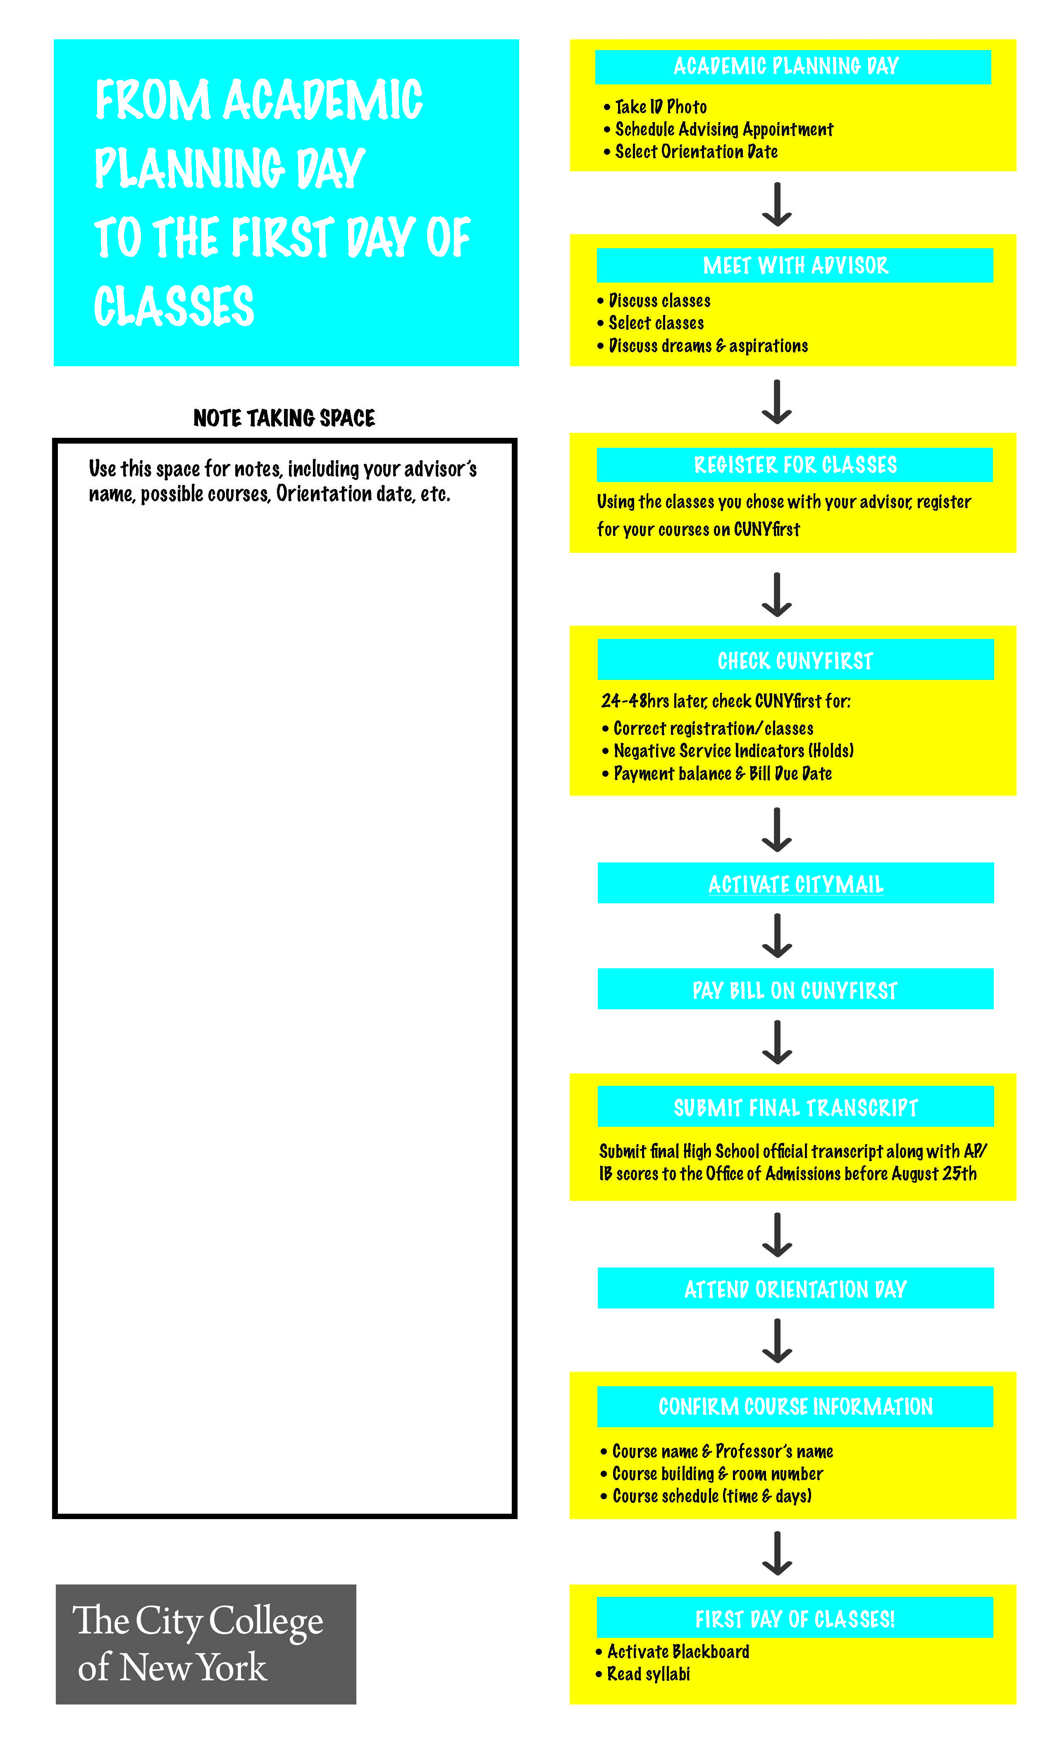
From your academic planning day to your first day of classes

Slide 22
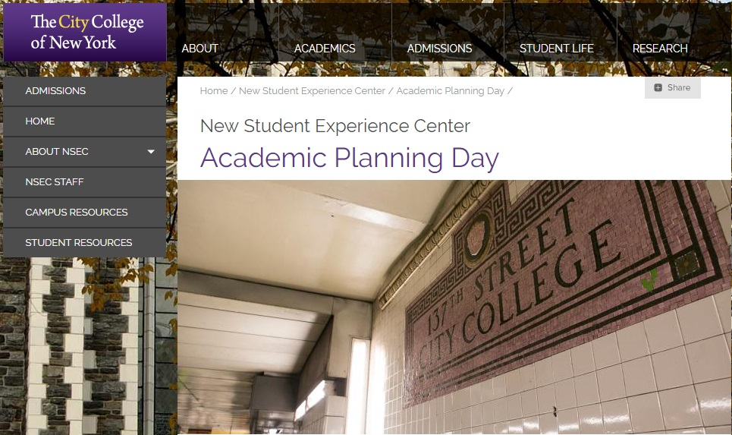
Academic planning day website
https://www.ccny.cuny.edu/nsec/academic-planning-day-0

