Slide 1
Being Successful at CCNY: Tools, Strategies and Tips
Presented by: Dominic Stellini, Director of the New Student Experience Center
Carlito Berlus, Senior academic advisor

Slide 2
Thriving At The City College of New York: what you need to know tO SUCCEED
Expectations
Difference between H.S. and college
Being responsible/Taking responsibility
Resources
People and Places to help you Succeed
Advisement
What to expect from your Advisors
Understanding the structure of your degree
Notes:
Expectations: We will discuss the differences between high school and college and what it means to be responsible in college.
Resources: We will discuss the people and places that will help you succeed in college and where to find them.
Advisement: We will discuss what to expect when talking to an advisor. This includes the structure of your degree.

Slide 3
Expectations
College is not High School
Difference between H.S. and college
Class sizes & Format
Taking responsibility for your education
Classroom etiquette
Technology
Communication
Time management
Spring 2018 Academic Calendar
Notes:
Classes come in several sizes: Large lectures with discussion sections (called recitation) or labs; medium size classes, small seminars – even individual instruction.
You need to understand what it means to be prepared for your classes no matter what size they are. You also need to learn how you learn best! Know how much to study for each class (3 hours outside for every hour inside of class), know to read your books before class, take notes on your reading and in class. PARTICIPATE!
Understand the messages that you send by how you behave in the classroom. If you want respect, you need to act respectfully. If you dress and behave like a clown, that’s how people will think of you.
Know when it is ok to use technology in the classroom and when it is not.
Know how to approach your advisors, instructors and administrators. Be polite and formal in your emails. Spell correctly and use proper grammar and salutations.
Managing your time is crucial! You have an academic calendar. Don’t plan vacations during the semester!
You are given a syllabus in each class. Use it! You need to understand how to best plan your day; your week; your semester and your 4 or 5 year plan. Know how many credits you need to take to finish in 4 years, or make a plan that works for you and your life.

Slide 4
Know the Resources
What are the resources available to you when you need help?
Professors
Advisors
Academic resources
https://www.ccny.cuny.edu/academics/support
Wellness
https://www.ccny.cuny.edu/services
Be in the know
Know how to find information
(Directory)
The Undergraduate Bulletin
(Bulletin)
Speak to your advising division
Notes:
Write down the name contact information for your professors and TAs. They should be your first line of help!
Your advisor should be someone you know. They will be with you for much of your college career.
We have tutoring in most areas. Use the Directory or to figure out where the help is. We have science tutoring, a writing center, math tutoring…
We have several offices in Wellness that can help you succeed. Accessabilites can help when you have a diagnosed condition – anything from emotional issues to a broken leg. Counseling can help when you are stressed and that stress is interfering with your academic progress. We have health services and even emergency loans here. Don’t wait till things have reached a boiling point. Go for help early!
How do you find help? You can use the directory! You can use the bulletin. This is your contract.

Slide 5
CCNY ACADEMIC STRUCTURE: Schools and Divisions
Grove School of Engineering
Spitzer School of Architecture
School of Education
College of Liberal Arts and Science (CLAS)
Colin Powell
Humanities
Sciences

Slide 6
College of liberal arts and sciences
Humanities & Arts | Powell School (Social Sciences) | Science
Art | ANTHROPOLOGY | BIOLOGY
Asian Studies | ECONOMICS | CHEMISTRY
Black Studies | INTERNATIONAL RELATIONS | EARTH AND ATMOSPHERIC SCIENCE
Comparative Literature | INTERNATIONAL STUDIES | MATHEMATICS
English | LATIN AMERICAN & LATINO STUDIES | PHYSICS
Foreign Languages & Literatures | POLITICAL SCIENCE | PRE-MEDICAL STUDIES PROGRAM (Any major)
History | PRE-LAW PROGRAM (Any major)
Jewish Studies | PSYCHOLOGY
Media & Communication Arts | PUBLIC POLICY & PUBLIC AFFAIRS (minor)
Music | WOMEN'S STUDIES (minor)
Philosophy
Theatre

Slide 7
The components of your degree
Bachelor of Arts
Bachelor of Education
Bachelor of Science
Bachelor of Engineering
Bachelor of Architecture
Notes:
You need 120 (or more) credits for your degree. There are about 45 credits in General Education (Pathways); about the same in your major (give or take). There are pre-requisites to courses and co-requisites. You need to know these when planning ahead. And then you can take other courses that make you happy… declare a minor or 2… or just take classes.

Slide 8
Advising: Knowing what to Take and When to Take it
Pathways Checklist:
(Checklist)
The classes you take depend on the degree you are pursuing, NOT what you friends say.
Notes:
You can see an example of a pathways checklist here. Later on, you can find the checklist for all degrees except Engineering that is appropriate for you and download it to keep track of your progress.
Additionally, most majors have a curriculum grid on their websites or available in their offices. Make sure that you have that too so that you can plan which courses you need to take and when.
Note that students who are not in Engineering will take a course called FIQWS (freshman….) this is unique to CCNY and combines a writing course with a topic course which will fulfill one of you general education classes. Your advisor will explain this to you in greater detail.

Slide 9
Conclusion & Reminder
Key Points:
Bring updated transcripts/APs (CN)
Follow all recommendations on MyCity
Expectations
You are NO longer in H.S. – Take responsibility for your education
Resources
Know where & how to find information
Advisement
You are to be advised in your division & in your major

Slide 10
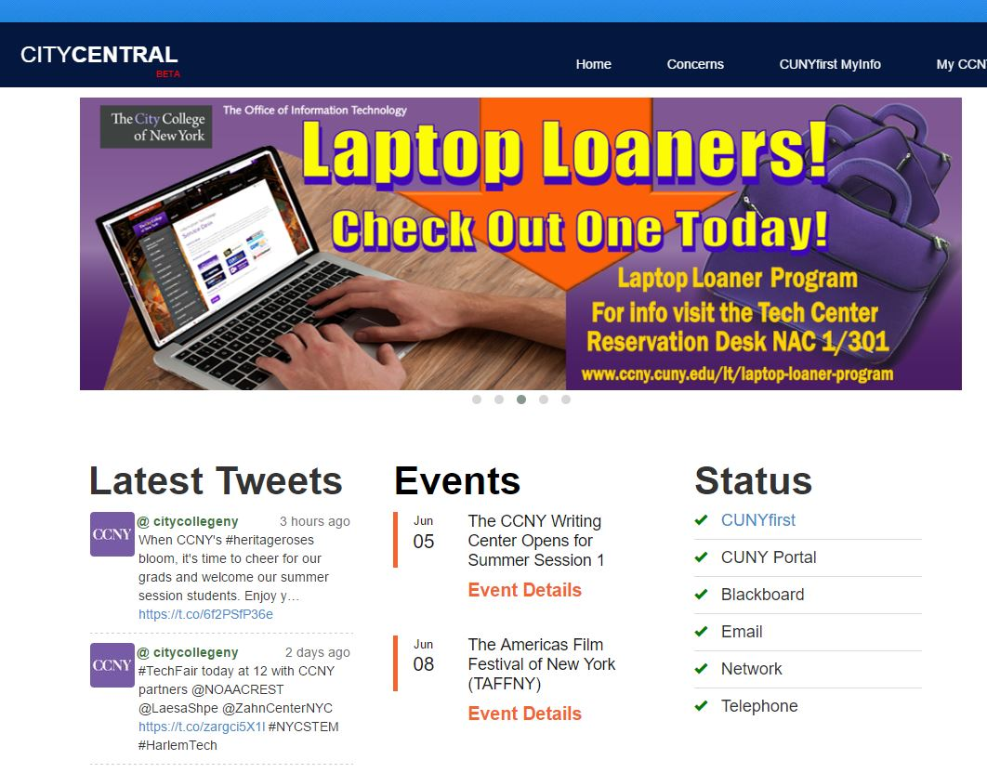
Tools of the Trade: City Central Portal
citycentral Student portal
The CITYCENTRAL Student Portal
provides CCNY students with easy access
to some of their most used resources:
CUNYFirst MyInfo
MyCCNY+
Latest Tweets
Events
Status for Campus Systems
Mobile App!
(https://central.ccny.cuny.edu/index.php)

Slide 11
Tools of the trade: CUNYFirst
CUNYFirst is the Student Information System we use at City College to keep track of all of your information. Contact information, grades, registration, finances, bills, etc. In a word, everything.
The primary thing you will use CUNYFirst for, is registering for your classes. However, there is a lot more you can do in CUNYFirst. Some of these are:
Enrollment
Search for classes (Class Search Guide)
Enroll in classes (Enrollment Guide)
Add/Drop/Swap classes
Withdraw from classes
View your enrollment dates
Finances
View holds, including financial aid holds
View your financial aid
Check your tuition balance
Personal information
Update your address
Update your email address
Update your phone number
Update your emergency contact information
Access unofficial transcripts
Other
View your grades
View your schedule
View your course history
Apply for an ePermit (ePermit Information)
Apply for graduation

Slide 12
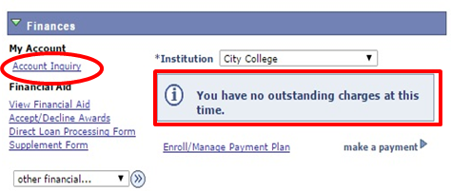
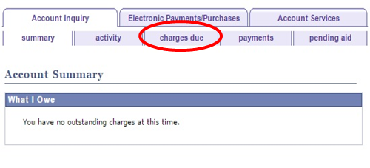
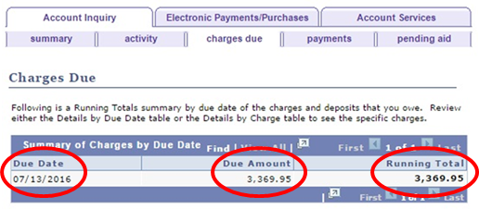
Know What You Owe
When you register for classes, your tuition balance will change, but did you know that if you add or drop a class, your balance may change again?
Follow the below steps to KNOW WHAT YOU OWE!
1. Check your CUNYFirst Account for any current charges.*
2. Select Charges Due for a detailed report.
3. Don’t miss your bill due date on the left!

Slide 13
Tools of the Trade: CUNY portal
BLACKBOARD
DEGREE WORKS
Online home for your classes
Single dedicated location for professors to post assignments and readings
The syllabus is often posted in advance of the class starting
Professors may utilize discussion board forums
Professors can send announcements/contact the entire class at once
A digital checklist of your degree requirements
It maps courses you have completed at City College into categories
For transfer students, it includes courses from previous colleges (if the transfer credits were evaluated)
An easy way to see what you have completed / what is still left to obtain your degree
Closely tied with financial aid eligibility (if applicable to you).
Online BlackBoard Support
https://www.ccny.cuny.edu/it/blackboard
Online DegreeWorks Support
https://www.ccny.cuny.edu/registrar/degreeworks
For further assistance, you may contact the CUNY Portal/Blackboard Support at 212-650-6990 or via email bbsupport@ccny.cuny.edu/

Slide 14
Tools of the Trade: Citymail
CityMail is your official City College email account and so much more.
This is your business address as a City College Student.
This is the only email account that the college (including professors) will use to communicate with you, so check it daily.
Your login credentials for this account also serve as your login to the campus Wi-Fi and computers in all computer labs.
CityMail is part of the FREE Microsoft 365 package that you are entitled to as a CCNY Student

Slide 15
To claim your Citymail account
Go to http://accountlookup.ccny.cuny.edu
Check “Change Password”
Submit required information to obtain access to your email

Slide 16
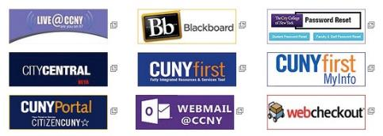
IT Help
CONTACT
Location: North Academic Center (NAC) Room 1/301
Phone: 212.650.7878
E-Mail: servicedesk@ccny.cuny.edu

Slide 17
Doing Your part is essential!
Tips for stress free enrollment:
1. Know your degree requirements (check the Undergraduate Course Bulletin)
2. Check your CUNY First Account frequently
3. Check your CityMail at least once daily!
4. You must attend classes during the first week of classes in order to verify your enrollment.
5. See your academic advisor often, at least twice a semester. Advising is about more than your class schedule.

Slide 18
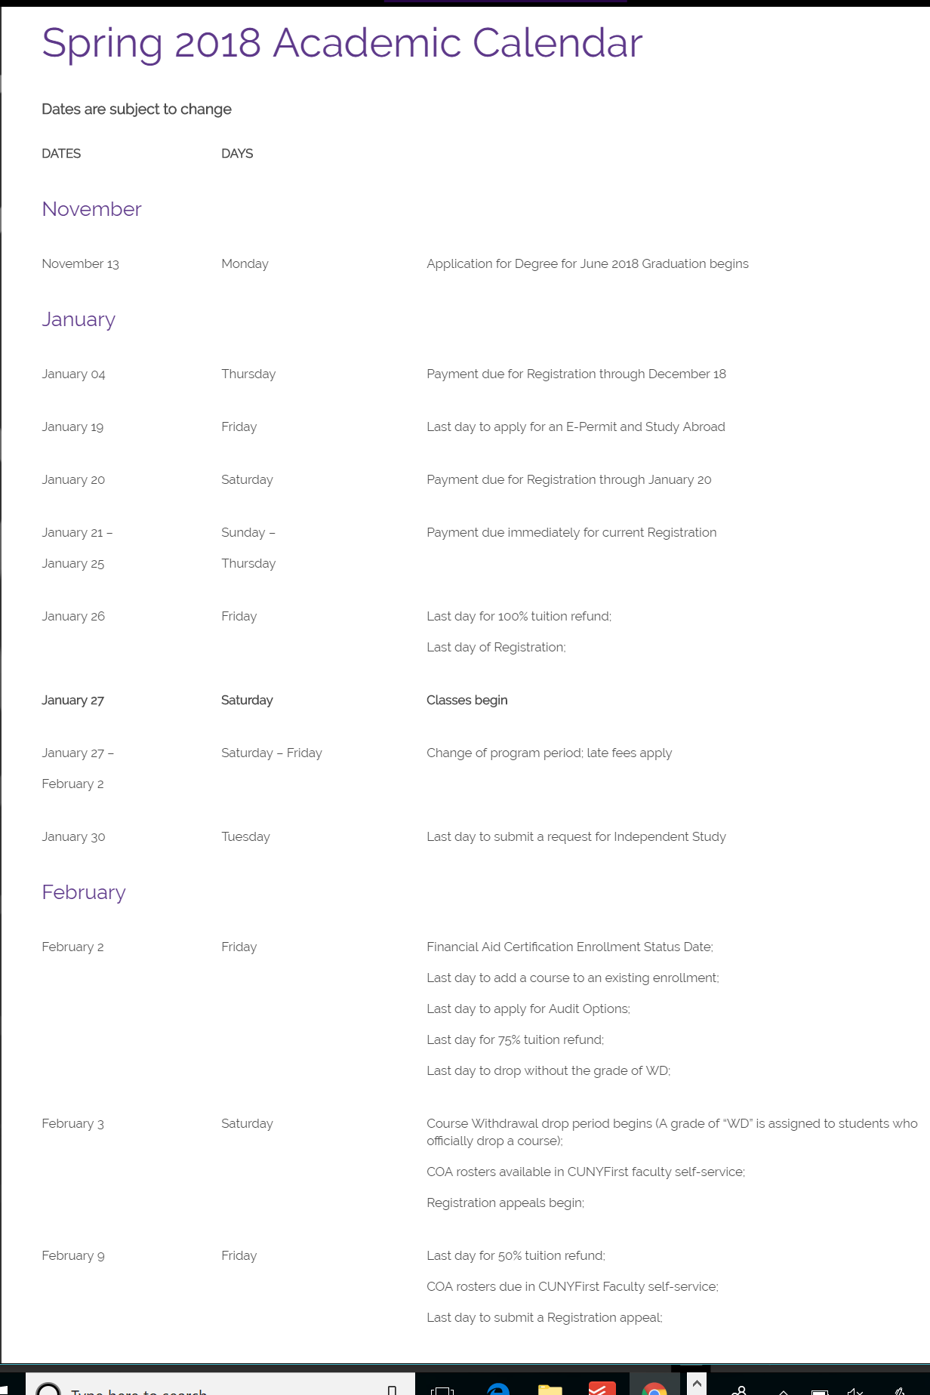
Your part is essential!
Tips for stress free enrollment:
6. Consult the academic calendar frequently
7. Whether paying your bill or changing your major, allow at least two business days for processing before a deadline

Slide 19
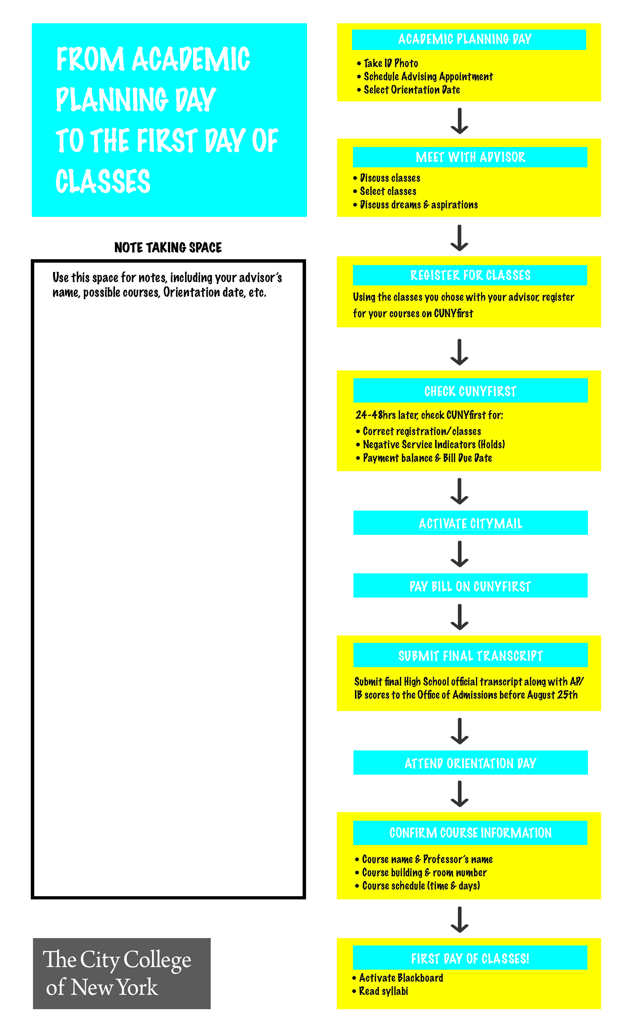
From your academic planning day to your first day of classes

Slide 20
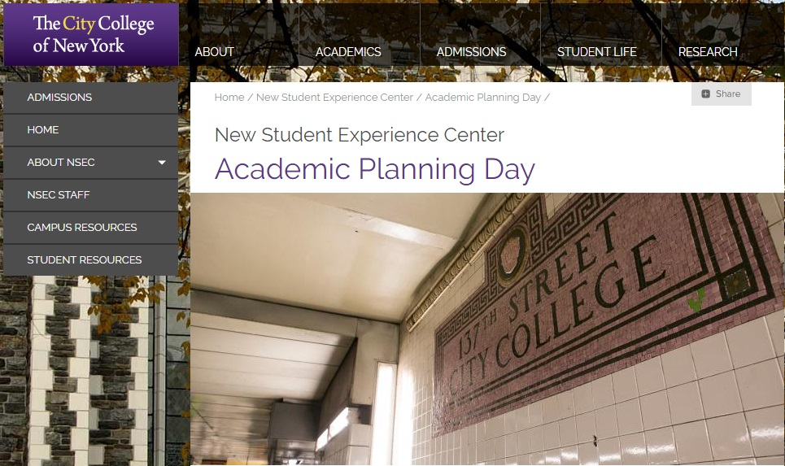
Academic planning day website
https://www.ccny.cuny.edu/nsec/academic-planning-day-0

