Slide 1
CUNY City College Kickoff Meeting November 2nd, 2017

Slide 2
PrintSmart Program Participation
Contract Phase I
Assessment and Strategy Development
Contract Phase II
Limited Implementation
Contract Phase III
Completion of Implementation and Steady State
Analysis of current print infrastructure.
Development of Current State Assessment (“CSA”) and Baseline TCO (Total Cost of Ownership).
Present client with Future State Document (“FSD”) – showing recommended optimal print environment.
Present client with Gap Analysis – showing projected savings from FSD.
Client Acceptance and Signoff: considering Phase 1 completed
Implement PrintSmart program print services in select agreed upon locations.
Market program internally encouraging users to modify behavior to reduce printing.
Results of limited implementation are presented.
If the client is satisfied with the limited implementation and results: state in writing that Xerox has satisfactorily completed Phase II of implementation and may move on to Phase III.
Develop a schedule to implement PrintSmart program print services throughout the enterprise.
Combining Phases II and III
After consultation with Xerox, client in his/her reasonable discretion may decide to combine Phases II & III into an enterprise wide implementation following Phase I.
© 2017 Xerox Corporation. All Rights Reserved. Xerox Confidential.
2

Slide 3
Benefits of PrintSmart
Lower the City’s printing costs by using fewer administrative resources and reducing the IT workload.
Recommend an optimal print environment that consolidates the number and type of devices.
Monitoring the networks to ensure devices are supplied with toner on as needed basis.
Support NYC sustainability initiatives by reducing waste and power consumption.
Reduce Overall
Print Spend
Right Size the
Agency Print Fleet
Consumables Management
Reduce Our
Carbon Footprint
Support DoITT print security policies helping us maintain security and confidentiality.
Simplify device support to help employees stay focused on their business goals.
Reduced printing leads to business process solutions that integrate IT, document and business operations.
Simple and secure print solutions that support mobile workers.
Meet Security
Requirements
Improve Productivity
Improve Workflows
Provide Innovative Solutions
Xerox Confidential

Slide 4
Next Steps
Helpdesk Processes.
Pilot Area Discussion.
Walkthrough
Pilot FSD
Devices Orders.
Installation Schedule.

Slide 5
Help Desk Support Set up
Process:
Xerox will schedule a series of two calls, which will review
The Xerox process for incident management
Review supplies process
Review Move, Add, Change & Dispose process
Process for engaging with client support team on network issues
Items to think about:
Will Xerox be Tier 1 or Tier 2?
Tier 1: Customer calls Xerox directly
Tier 2: Customer calls campus helpdesk and then route to Xerox if necessary
Contacts for engagement on items requiring client technical support
Approval contact for MACDs (Move, Add, Change, Dispose)

Slide 6
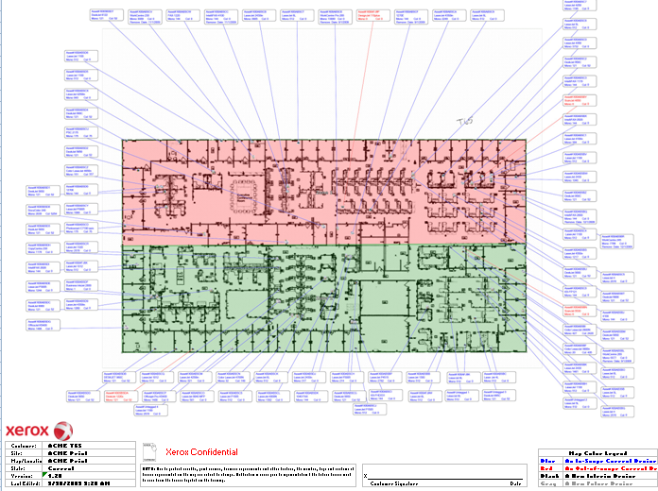
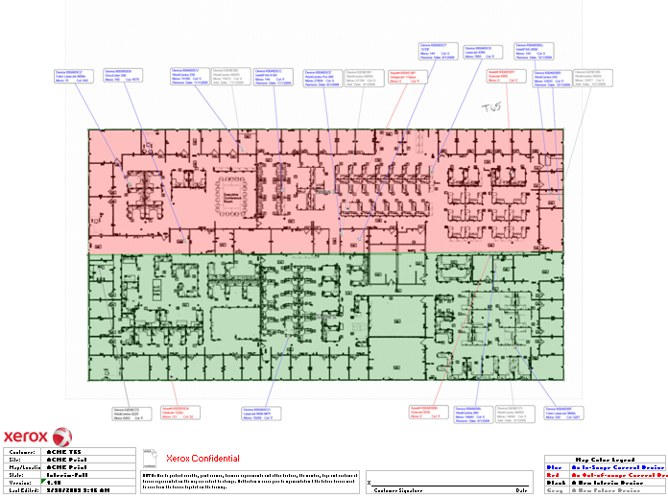
Future State Design Process
Xerox to Provide FSD
Based on design Principles discussed
City College will review and provide feedback
Xerox will update FSD’s with requested changes
City College will have to approve changes

Slide 7
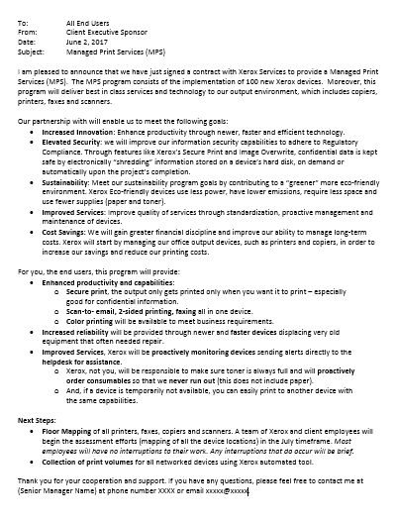
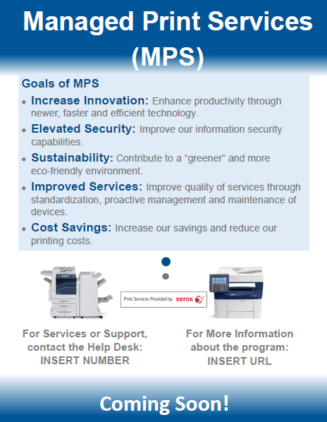
Change Management Methodology
Phase 1 – Program Level Communication:
Set Vision and Direction
Build Excitement for the Transformation
Phase 2 - Just-in-Time Communications:
Implementation of Devices
Lead Users through Transformation

Slide 8
Implementation Key Steps
Implementation workshop – early engagement
Device certification process
Process for IP addresses (DHCP or Static)
Print queue creation / Print driver set up
Process for end user printer mapping
Site acceptance criteria
Site escalation process
Facilities workshop
Onsite escorts/security/safety process
Dock/delivery procedures
Client Site Walk through to ensure site readiness (space, electric, network)
Identification of local Site Contacts
Staging area/removal process
Communication end user governance

