Slide 1
OCTOBER: ESE ADVISING for Summer/Fall 2019
In ST-424
Our web-page is https://www.ccny.cuny.edu/enveng/

Slide 2
Academic Calendars
https://www.ccny.cuny.edu/registrar/summer-2019-academic-calendar-extended-session#overlay-context=registrar/academic-calendar
https://www.ccny.cuny.edu/registrar/fall-2019-academic-calendar
March 15 | Friday | FAFSA priority deadline for 2019 - 2020 Financial Aid
April 01 | Monday | Course withdrawal period ends. Last day to withdraw from a course with a grade of W;
April 02 | Tuesday | Registration appointments for Summer 2019 and Fall 2019 begin for continuing students. Check your CUNYFirst accout for your appointment date and time
April 12 | Friday | INC grades for Fall 2018 for Undergraduate students convert to FIN;

Slide 3
Think about:
Your plans for the next semester
Your plans for the graduation
Your plans for after graduation

Slide 4
Graduation requirements
48 Engineering credits
9 credits engineering electives (minimum)
Liberal Arts, including Pathways
127 (if you joined ESE before fall’16)
128 (if you joined ESE after fall’16)
If you are transfer student with other degree, please contact Dr. K.

Slide 5
Please schedule appointment
Bring with you:
Advising form (see Appendix 1)
ESE curriculum sheet (see Appendix 2)
FACTS current eligibility sheet (see Appendix 3)
https://doodle.com/poll/s9tnb3zx4ceqk6wd

Slide 6
When
Where
Up to 20 students/session, please

Slide 7
Sign for appointment
Come to the advising meeting
Fill the forms:
if you are freshman, please fill blank form
Otherwise, update the form from last semester
E-mail forms to lkreminska@ccny.cuny.edu
I will send you revised advising form and remove the hold.
You can start registering for classes at enrollment appointment.
Please store the form for updates for next semester.

Slide 8
Scholarships, fellowships, internships, study abroad, research…..
Use multiple resources
https://www.ccny.cuny.edu/enveng/apply-internship-research-opportunities-scholarships-fellowships
https://www.ccny.cuny.edu/engineering/internship-research-opportunities
And others
Will increase your chances to get great job in the future
And will give you extra green for now

Slide 9
Student clubs!
NYWEA
EWB
Many more!!!!

Slide 10
Need help?
Tutoring at GSOE
Tutoring at college https://www.ccny.cuny.edu/academics/tutoring

Slide 11
If you want to graduate asap
Required /must take courses for Spring:
If you plan to graduate in Spring 2021:
CSc 102, Math 391, Phys 208
If you plan to graduate in Spring 2020:
EAS 217, and three of Engr 301, Engr 59910, CE 365, CE 372
DEPENDING ON YOUR TRANSCRIPT !

Slide 12
If you need more information, please see
Faculty advisors
Water resources
Prof. Krakauer
Prof. Devineni
Remote sensing
Prof. Gilerson
Prof. Gross
Energy
Prof. Gonzalez
Prof. Castaldi
Prof. Ramamurthy
Prof. Moshary

Slide 13
Are you close to graduation ?
YES
NO
Not sure
Provide with the graduation check
Plan for it
It is never too late to start thinking about it

Slide 14
Think about
After graduation
FE exam: please take it asap
Grad schools: MS in ESEE and other
Jobs at: Agencies, industry, etc

Slide 15
Join our community at LinkedIn: communicate with current students and alumni

Slide 16
Appendix 1, please fill these cells with your information on the tab “Transcript”
tr
Sp’15 A

Slide 17
Please remember about Liberal arts requirements
See the links https://www.ccny.cuny.edu/engineering/flexible-core to follow Pathways requirement and https://www.ccny.cuny.edu/engineering/gsoe-liberal-arts GSOE Liberal Arts is required for ESE students.
If you have BA, BS, AS degrees, please meet with your advisor
2-level
and Engr 27600 is required for EVERY ESE student!

Slide 18
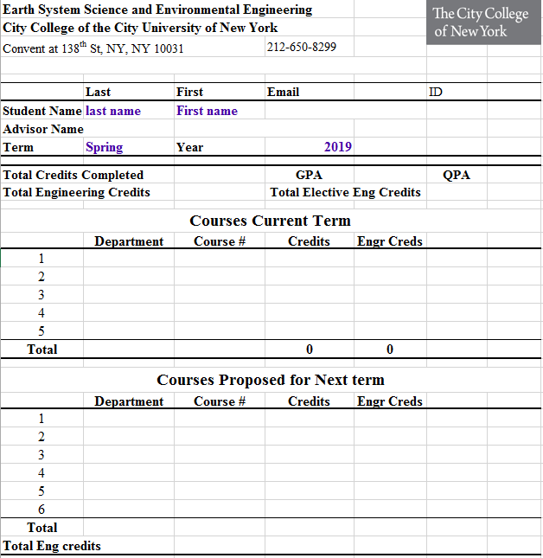
Appendix 1, please fill these cells with your information

Slide 19
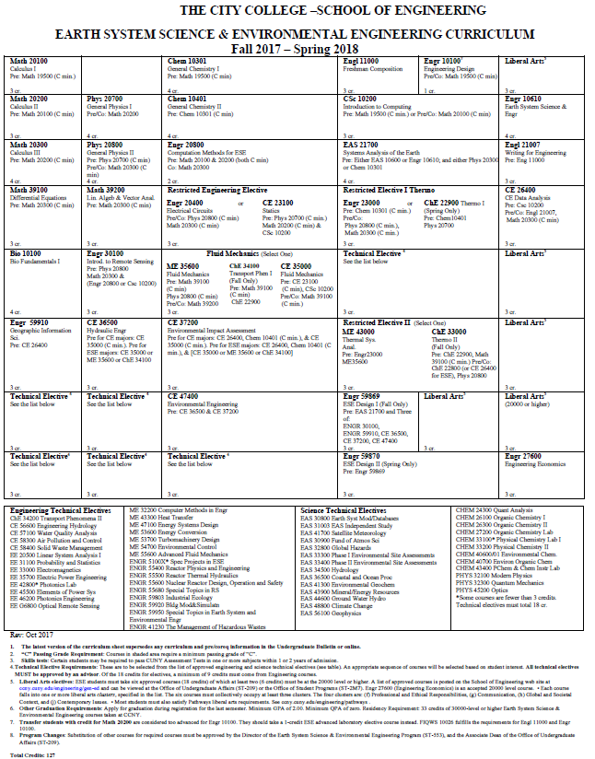
Appendix 2, Curriculum Sheet, mark semester and grade
tr
Fall’17, A

Slide 20
Appendix 3, FACTS eligibility report
You must provide your eligibility report to get the advising hold removed

