Slide 1
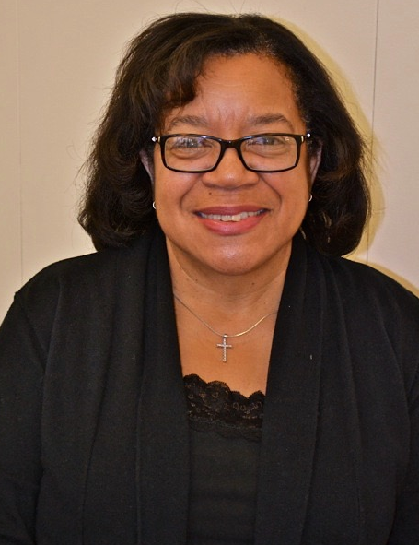
Dr. Karen Hubbard, Chair of the Department of Biology
Biology Recognizes…
Dr. Karen Hubbard, the new Chairperson of CCNY’s Department of Biology is a woman with a dizzying number of responsibilities. On any one day she might be dashing off to the Memorial Sloan Kettering Cancer Center, where she is a P. I. in the CCNY-MSKCC Partnership promoting more participation by the cancer research institution in minority communities. At the same time, she could be attending one of numerous conferences concerned with health disparities in underserved populations; or, she might be found in her molecular biology lab, investigating the relationship between cell death, cancer and aging. She might be in our lecture halls teaching undergraduate as well as graduate courses; and finally, she could be at her desk to administer the myriad responsibilities of a department Chairperson. If those tasks seem daunting, Dr. Hubbard has still another, perhaps even more consuming: she is facilitating the relocation to South Campus of a number of research faculty to the Center for Discovery and Innovation, and she has dedicated herself to ensure the cohesiveness of the department in the face and aftermath of the change. “It’s been a learning experience,” says Dr. Hubbard, of the first months of her 3-year tenure, in her characteristically understated yet confident tone.

