Slide 1
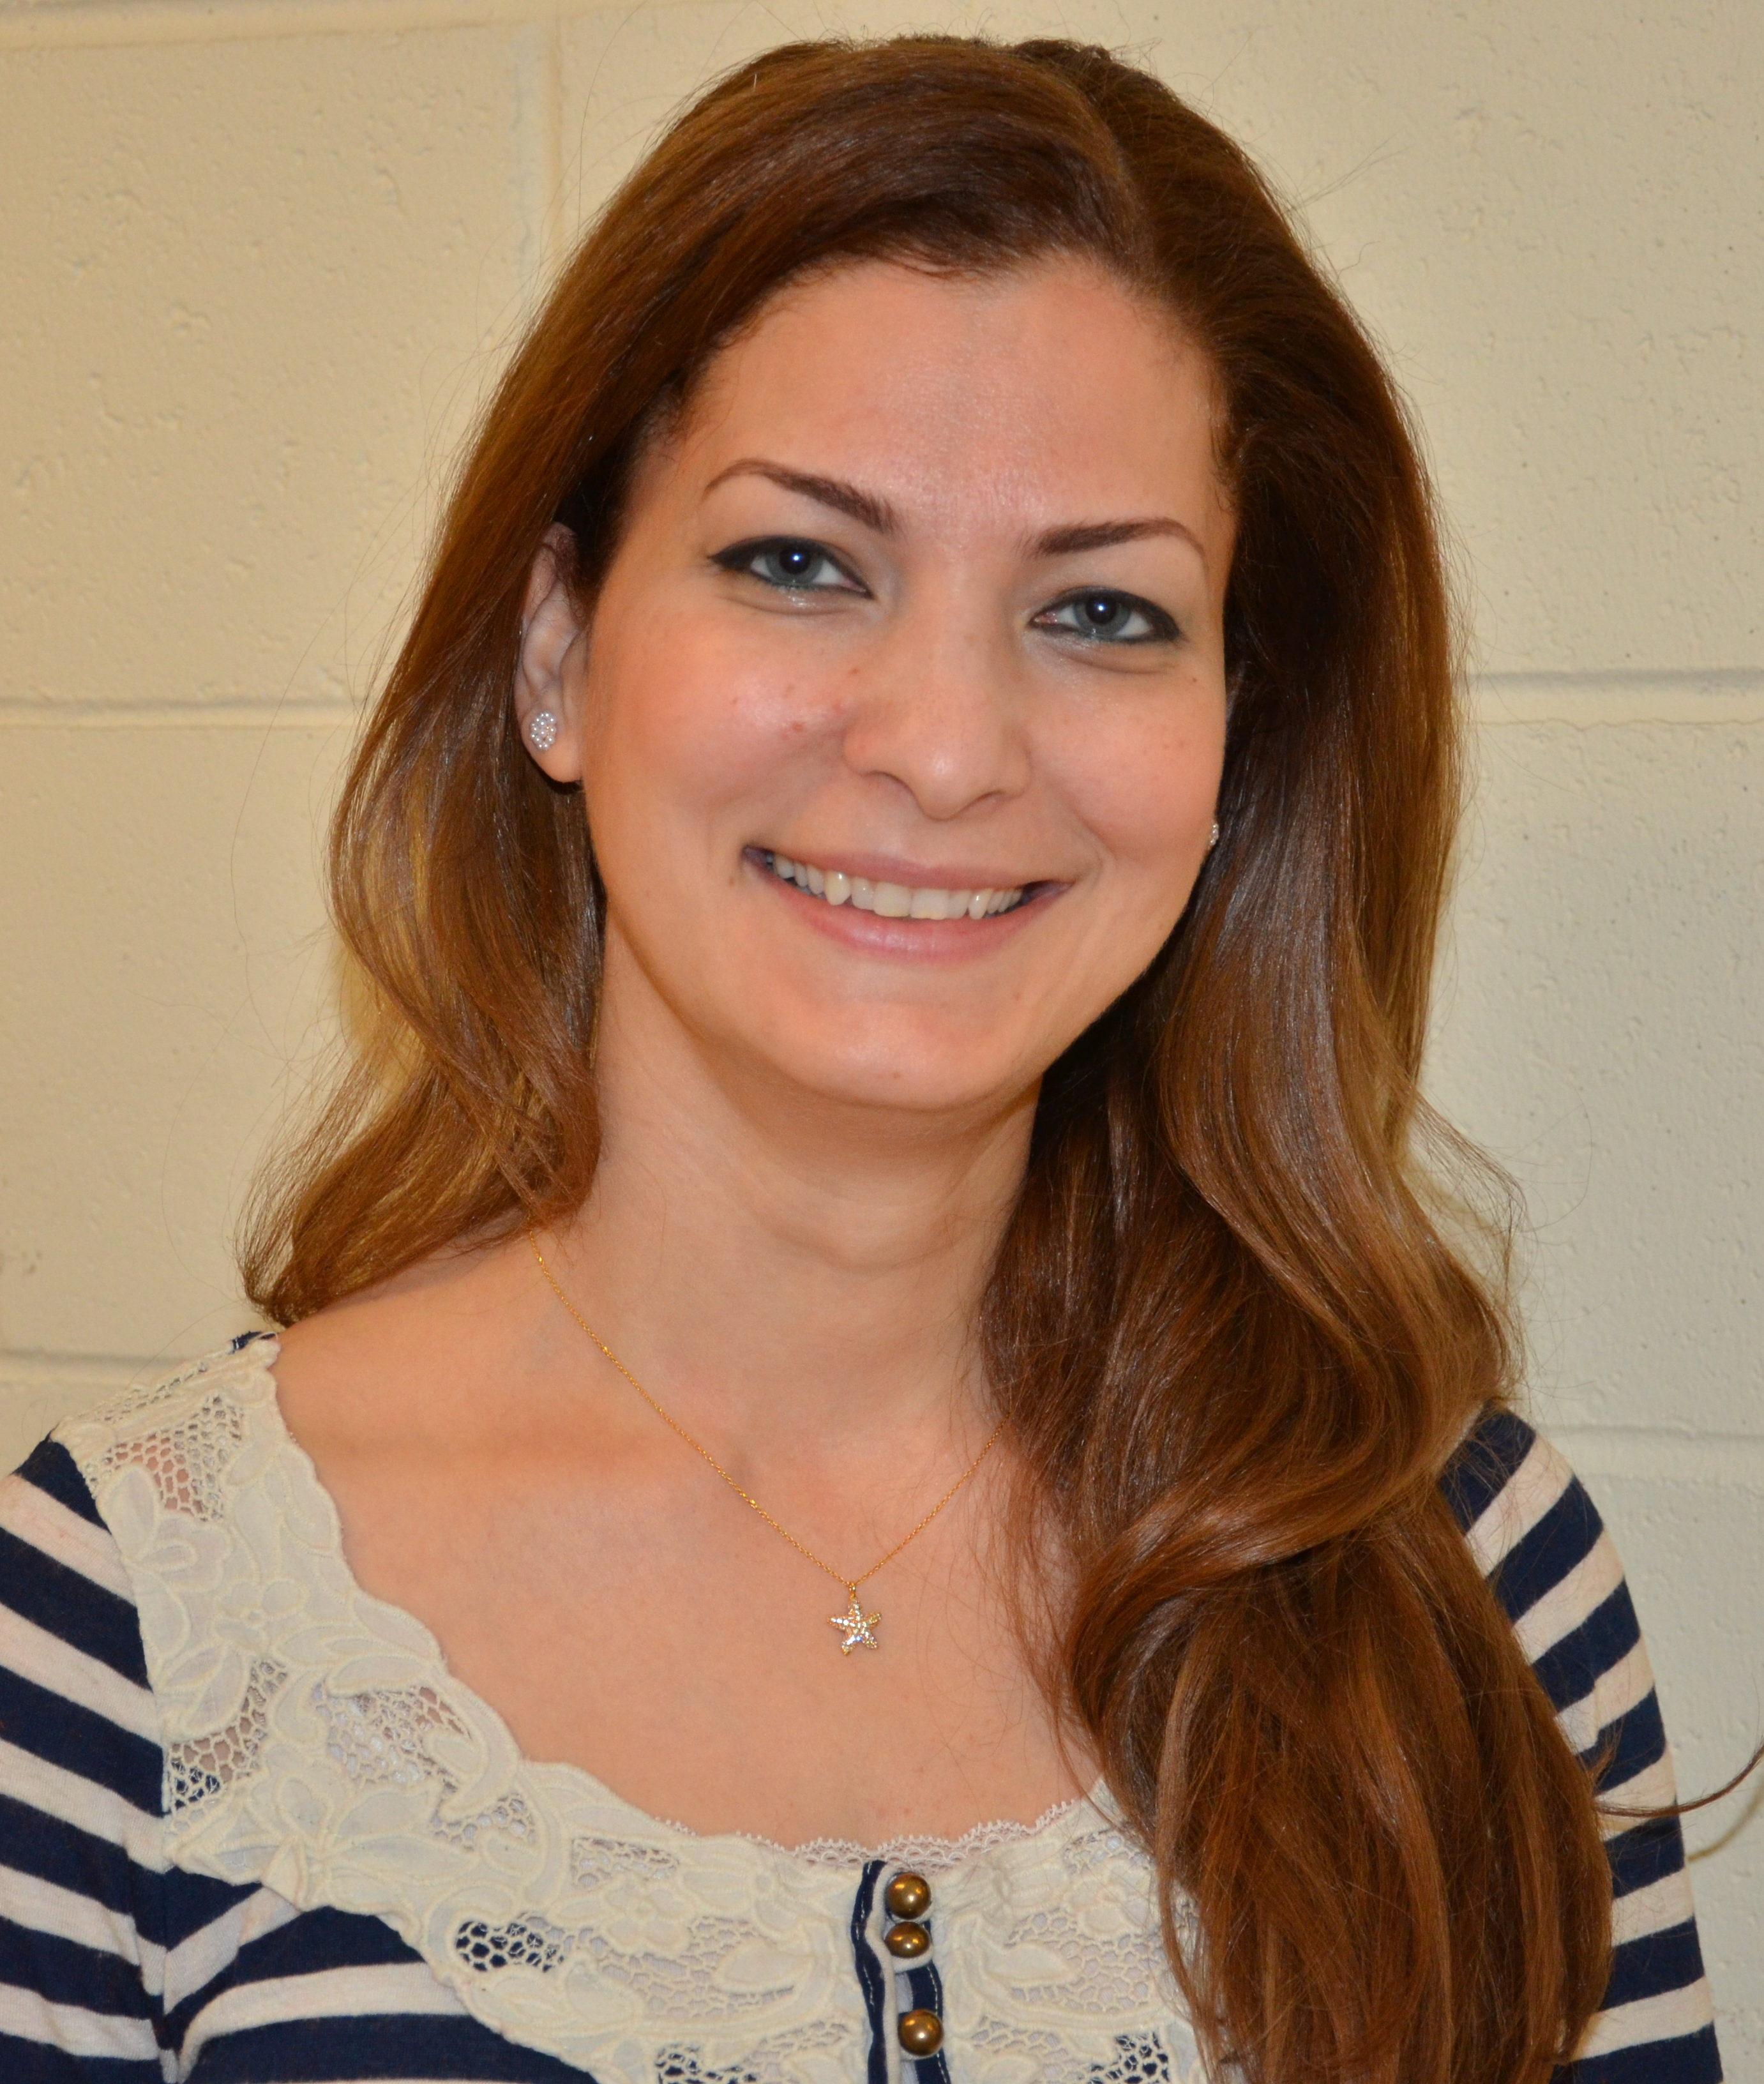
Reem Khalil considers herself lucky. Fresh from earning her doctorate in September 2013, she landed a teaching position at the American University of Sharjah, an Emirate state that sits on Dubai’s doorstep. “I always thought I ultimately wanted to teach neuroscience and to have the opportunity to do that so early in the game, that’s what I’m really excited about,” she says.
Born in Syria, but raised in New York, Reem observes Dubai as evolving into a modern Islamic state, one that maintains rituals and traditions while welcoming a diverse population of foreign visitors and residents. After two brief visits she concludes, “What I like most about it is the diversity of its people; it reminds me so much of New York.”
If she should become homesick, summers will find her back in New York and CCNY. She will be picking up from where she leaves off in the laboratory of her mentor of seven years, Dr. Jonathan Levitt, studying the different brain areas that mediate visual perception in ferrets.
Biology Recognizes…

