Slide 1

Educating All Students
Test Taking Strategies
@CUNYTeacherEd

Slide 2
Test Description
The EAS test measures professional and pedagogical knowledge and skills necessary to teach all students effectively in New York State public schools.
From the EAS Framework:
  “This test consists of selected-response items and constructed-response items. Each constructed-response item will share scenario-based stimulus material with several selected-response items.”
Notes:
This test measures professional and pedagogical skills. It is focused on the practice of teaching- not on your specific content area. Specifically, it focuses on teaching strategies for meeting the needs of diverse learners to ensure that all students are successful.
In terms of format, the test includes multiple choice and written response questions. In looking at the sample questions, you will see that you are given a series of documents to read (similar to a case study) before you answer questions based on those documents.

Slide 3
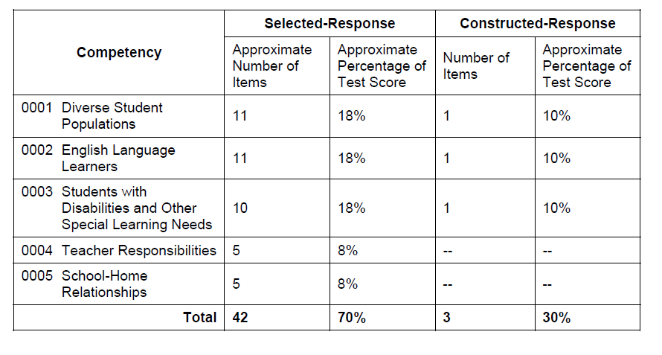
Test Format
Copyright © 2014 by the New York State Education Department
Notes:
The exam questions fall into 5 exam categories (read list of competencies)
Overall, there are 42 selected response (multiple choice) questions which make up 70% of your score. The number of questions varies by section. Three of the areas (diverse student populations, English language learners and students with disabilities) also have a constructed (written) response question. Each written response counts for 10% of your total score.

Slide 4
Registration
  Exam Fee: $102
  Registration:
    http://www.nystce.nesinc.com/
  Computer based testing sites
    www.pearsonvue.com/es/locate/
Notes:
There is a fee of $102 to register for the EAS. Registration is through the NYSTCE website.
EAS is only offered as a computer based test and requires going to a computer based testing location. Some test sites and dates fill up quickly, so if you need to test at a specific location or during a specific period of time, you will want to make sure to register early. You can look up testing sites and check for seat availability on the Pearson VUE website.

Slide 5
Testing Strategies

Slide 6
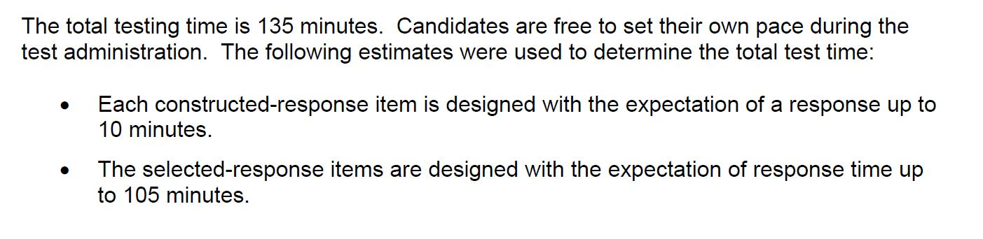
Plan Your Time
From the exam framework:
Each constructed response is 10% of your total score. The selected response items are 70% of your total score.
Copyright © 2014 by the New York State Education Department
Notes:
You are given 2 hours and 15 minutes to complete the exam. Some candidates have reported that they felt rushed during the exam, so you will want to plan out your time.
For example, when you come to a constructed response item, you may want to limit yourself to 10 minutes, and then come back to review or revise them if you have time at the end.
There is no penalty for getting a multiple choice question wrong, so it is always better to guess than to leave it blank. If you find yourself running out of time at the very end of your test, you may want to go through and make sure that you have not left any of the questions blank.
Think about your strengths and areas where you may need extra time and plan out your testing time accordingly. Do you know that it takes you a long time to type out responses? If so, you may want to give yourself more than 10 minutes per written question. Or do you know that you typically do better on written questions than multiple choice? If so, you may want to start with those questions first.

Slide 7
Make a Study Guide
From the EAS Framework:
  Research- or evidence-based strategies, including utilizing universal design principles, for teaching and working effectively and inclusively with all students
  Strategies for effectively integrating recommendations from IEPs into instructional activities and daily routines
  Research-based instructional strategies for promoting literacy for English Language Learners
Notes:
The EAS framework contains very specific terms and skills that you may be tested on. Read the framework and make a list of terms you need to study or ideas you think may appear on the test. A copy of the framework is included in today’s materials.
In reviewing the sample questions online, as well as the practice test questions, you should pay attention to key terms that come up often. These are things you will want to include in your study guide.
It is important to note that this is a pedagogy assessment- focused on teaching skills and strategies- and is not content specific. That means you may have case studies and questions that feature content areas or grade levels that are unfamiliar to you. Be sure to focus on best teaching practices, but in your study guide you may also want to talk with faculty or other students in your school about strategies for other grade levels or content areas that you may be unfamiliar with.

Slide 8
Sample Study Guide Resources
NY State’s Bilingual Education Resources: http://www.p12.nysed.gov/biling/bilinged/resources.html
NY State’s IEP Guidance: http://www.p12.nysed.gov/specialed/publications/iepguidance/intro.htm
NY State Teaching Standards: http://www.engageny.org/resource/new-york-state-teaching-standards
Notes:
A sample study guide template has been included in today’s materials. In creating your study guide, you may want to consult the following sources (if you have any campus specific resources please feel free to include them).
Candidates who have taken the assessment recommend reviewing RtI strategies, IDEA legislation, or IEP requirements in creating your study guide. They also said that you should be prepared to write about strategies for scaffolding a task/assignment or differentiating instruction.

Slide 9
Review the Rubric
CONTENT
  The extent to which the response meets the requirements of the assignment
ANALYSIS, SYNTHESIS, AND APPLICATION OF PEDAGOGICAL PRINCIPLES
  The extent to which the response demonstrates understanding of and engagement with the provided exhibits
COMMAND OF EVIDENCE
  The extent to which the response presents relevant support
Copyright © 2013 by the New York State Education Department
Notes:
Review the rubric for the written response before you take the exam. Make note of what you will be assessed on: including meeting the requirements of the assignments and providing support or evidence for your response. Make sure that you answer all parts of the question, give evidence to support your answer, and use the information provided in creating your response.
The preparation guide online has the full rubric, which includes score point description. This lets you know what your response will need to have in order to receive full credit. A copy of the rubric is included in today’s materials.

Slide 10
Computer-Based Testing
The EAS is only offered through computer-based testing, which may be a new format for many candidates.
  Computer-based testing tutorial
    http://www.nystce.nesinc.com/NY_CBTTutorial.asp
  Sample Practice Test
    https://www.starttest.com/ITDVersions/5.0.0.0/ITDStart.aspx?SVC=9f571e8a-adc2-47bf-a5e9-4b37f1deeaac
Notes:
The EAS is a computer based test, which may be an unfamiliar format for some of you.
Before you go to take the test, you can practice with the computer based system so that it is more familiar and comfortable to you. The NYSTCE website offers a free tutorial on computer based testing that shows the features of computer based tests, including how to move between the questions and how to select your answers. In addition, a free sample practice test is available. While it does not contain questions specific to the new exams, it does provide additional practice in selecting answers and navigating the testing platform.

Slide 11
Computer-Based Testing Strategies
Note taking
  “Whiteboard” to take notes
Navigating the System
  Move to different parts of the test using the “navigator” feature
Flagging Questions for Review
  Allows you to identify questions you skipped or want to come back to
Notes:
Even though you are taking the test on a computer, there are still some strategies you can use.
First, although you cannot take notes on the test, you are given a “notebook” which is similar to a whiteboard to take notes. If you find that taking notes is a helpful strategy for you, you may want to practice reading documents on a computer and taking notes on a white board so this feels more familiar to you.
The computer based platform also allows you to navigate through the test, so if you want to do all of the written questions first, or save a certain section until the end, you have the ability to do that.
You also have the ability to flag questions for review. If you need to skip a question or are unsure of your answer, be sure to flag them. This saves you time because you don’t need to go back through every question to find them later on.

Slide 12
Test Taking Strategies
Review the test to see when and where the constructed response questions are located
Read the questions first before reading the documents and charts
Take note of key words and phrases from the questions
Look for important evidence/details in the documents to include in your constructed response
Notes:
The written response items are not all at the end of the test, which can make pacing a challenge. You may want to go through the test to see where they are so you can plan out your time.
Because you can navigate back and forth between the questions, one strategy is to read the questions first and note key words so you know what to pay attention to when you start reading the case study materials. You may also want to note which students the questions are asking about, so you know which information to pay attention to while you are reading the exhibits.
You will also way to pay attention to evidence or phrases from the documents to include when you are writing your constructed responses.
Based on how comfortable you are with the computer based testing format, and your own test taking strategies, you could take notes using the whiteboard provided or click back to the documents when answering your questions.

Slide 13
Study Materials
EAS Preparation Guide here
EAS Test Design and Framework here
EAS Practice Test (Fee $29.95) here
CUNY EAS webinar here
NYSTCE Exam Support on Blackboard
Notes:
There is a preparation guide for the EAS with sample questions and rubrics. In addition, there is the exam framework and a practice test available for a fee.
Be sure to read over the exam framework as well as the sample questions in the preparation guide, as the framework provides a list of specific topics that may be covered on the exam. The preparation guide also includes a rubric to let you know how your written responses will be evaluated.
If you would like to re-review this information, CUNY has recorded a webinar of today’s presentation, which can be found at the link above.
Finally, you can join the CUNY NYSTCE Exam support group on Blackboard to receive access to additional preparation materials. Instructions for joining this group are included in your presentation materials.
(You may also want to link to any campus specific resources)

Slide 14
Thank you
Additional questions? Email: teacher.education@cuny.edu
Notes:
If you have additional questions, you can reach out to the CUNY teacher education email address at teacher.education@cuny.edu

