Slide 1

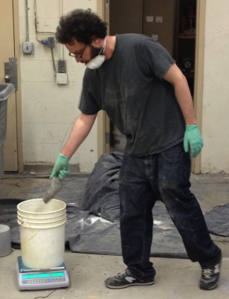
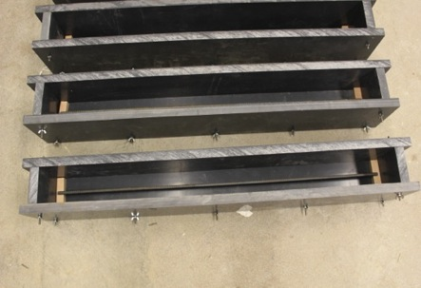
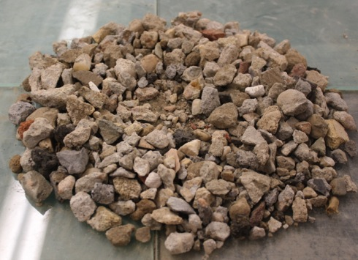
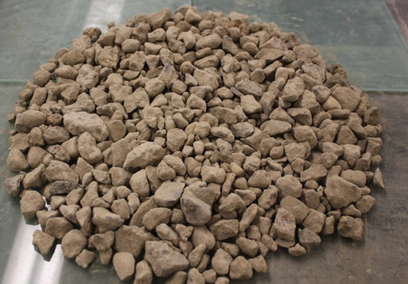
The Mechanical Properties of Concrete Made with Recycled Concrete Aggregate and Supplemental Cementious Materials
Jonathan Rosen Advisor: Professor Ardavan Yazdanbakhsh
Department of Civil Engineering, City College of New York
Abstract
Design and Sample Preparation
Natural Aggregate Concrete vs RCA Concrete
Silica Fume
This research investigates the mechanical properties of concrete made with recycled concrete aggregate (RCA). The incorporation of RCA reduces the compressive and flexural strength of concrete, this research seeks to enhance the strength of concrete made with recycled aggregate without increasing cement content. One of the primary motivations behind making RCA concrete is to increase environmental sustainability. Using increased amounts of cement, the production of which gives off a large amount of CO2, is not a suitable option for increasing the strength of RCA concrete. This research tests the effects of nanosilica and silica fume, byproducts of industrial processes with cementitious properties, on the strength and material properties of RCA concrete.
For each mix design, 5 beams and 8 cylinders were made to test in bending and compression, respectively. The small-scale beams were designed according to ACI Code.
Compression
After the failure of nanosilica, we tested the effect of silica fume on concrete performance. While silica fume is an environmentally preferable alternative to cement, it is 3-4 times more expensive than cement. Six batches of concrete were made where the amount of cement replaced by silica fume varied from 0-20%. The concrete was cast into cylinders that underwent compression tests.
Mean: 7600 psi
SD: 375
28% decrease
Mean: 5500 psi
SD: 350
Natural Aggregate Concrete
Not a significant change
RCA Concrete
Environmental Impact
Construction and demolition waste in the USA adds up to over 300 million tons per year, 90% of which is concrete and masonry. Other than recycling, the only option for C&D waste is landfilling. While it is estimated that there is the potential for up to 50% recycling, currently, only 20-30% of C&D waste is reused.
In addition to reducing the amount of waste that is landfilled, the use of recycled aggregate reduces the environmental impacts associated with the mining and transportation of natural aggregate. Recycled aggregate can create a source for construction material in locations where the limestone and granite commonly used for natural aggregate is not found. This could greatly reduce the environmental impact associated with transporting natural aggregate to these locations.
Another environmental factor common in the construction industry is the CO2 produced from cement production. The production of 1000kg of cement results in the release of 900 kg of CO2. By incorporating supplemental cementitious material into our mix, we are reducing the amount of cement required for concrete production.
Bending
1.8% decrease
Actual Ultimate Load: 6.25 kips
Design Ultimate Load: 4.52 kips
Actual Ultimate Load: 6.14 kips
Design Ultimate Load: 4.48 kips
0.9% decrease
Natural Aggregate Concrete
RCA Concrete
Silica Content and Strength Increase
% Replaced | 0 | 4 | 8 | 12 | 16 | 20
f'c | 5.37 | 6.33 | 6.46 | 7.04 | 7.0553 | 7.085
Increase, % | 0 | 17.9 | 20.3 | 31.1 | 31.4 | 31.9
As cement is replaced with silica fume, the strength of the concrete increases until 12% of cement is replaced. After this point there is not a significant change in the concrete’s strength, even when more cement is replaced.
We see a 31% increase in RCA concrete strength with the addition of silica fume, this is comparable to the 28% decrease we see in concrete strength when natural aggregate is replaced with RCA. We have created concrete using RCA that is as strong as natural aggregate concrete, while using less cement in the mix.
Despite the higher compressive strength of concrete made with natural aggregate, the beams display similar behavior during bending.
Conclusions
Collection and Analysis of Local Recycled Aggregate Supply
Testing and Failure of Beams
RCA Concrete Vs. RCA + Nanosilica Concrete
RCA concrete shows low variability in material and structural testing when it is made from a single aggregate source.
Although there is a significant decrease in compression strength between RCA and natural aggregate concrete, the overall behavior during the bending test is similar between the two different types of concrete. While the material strength of RCA concrete is less than that of natural aggregate concrete, this can be offset by proper design and application. An increase in compression strength relates to increased ductility, not an increase in ultimate load capacity.
A higher concentration of nanosilica may be effective in increasing the strength of RCA concrete. It is effective in reducing the variability of the material but this property is already low in RCA concrete.
When 12% of concrete is replaced with silica fume, there is a 30% increase in strength. This balances the 28% decrease in strength of RCA concrete when compared to natural aggregate concrete. It is possible to create concrete with RCA that is as strong as natural aggregate concrete, while decreasing the amount of cement in the mix.
One of the difficulties in developing mixes with recycled aggregate is the wide variety in the quality of recycled aggregate that is produced. The range in quality results in different absorption rates for the aggregates. This requires different mix proportions depending on the characteristics of the aggregates to be used. The samples collected from local suppliers displayed a range in quality. Sieve analysis revealed that some of the suppliers’ aggregate did not fit within the gradation range set by ASTM. Aggregate that fit the gradation range was considered high quality, while the aggregate that did not fit this range was considered low quality.
Compression
Mean: 5500 psi
SD: 350
Small decrease
Significant decrease
Mean: 5400 psi
SD: 93
RCA Concrete
RCA + Nanosilica Concrete
Low Quality
High Quality
All specimens were tested at the age of 28 days.
The displacement rate was 0.001 inch/second.
The failure for all beams was flexural and gradual, as expected.
Bending
Future Work
Actual Ultimate Load: 6.14 kips
Small decrease
Actual Ultimate Load: 5.8 kips
Experimenting with additional types of cementitious material, such as fly ash and economical alternatives, to try to improve the mechanical and structural properties of RCA concrete.
Wrapping RCA concrete beams and cylinders in Fiber-reinforced Polymer (FRP) to compare compression and bending tests with natural aggregate concrete wrapped in FRP.
Analyze and design different structures to see which are less sensitive to concrete strength. Produce select results to verify calculations.
Casting columns out of RCA concrete to test in compression.
RCA Concrete
RCA + Nanosilica Concrete
Acknowledgements
I would like to acknowledge: Professor Ardavan Yazdanbakhsh for his guidance and support during this research. Lab Technician Jifang Zhu for his assistance while testing the beams and cylinders. I would also like to thank Dr. Yuying Gosser and Luis Alicea for their help in attaining the STEP grant that supported this research.
Despite being advertised as a material that would increase the strength of concrete, our results shows that RCA concrete made with nanosilica had a lower compressive strength than concrete made without nanosilica.

