Slide 1

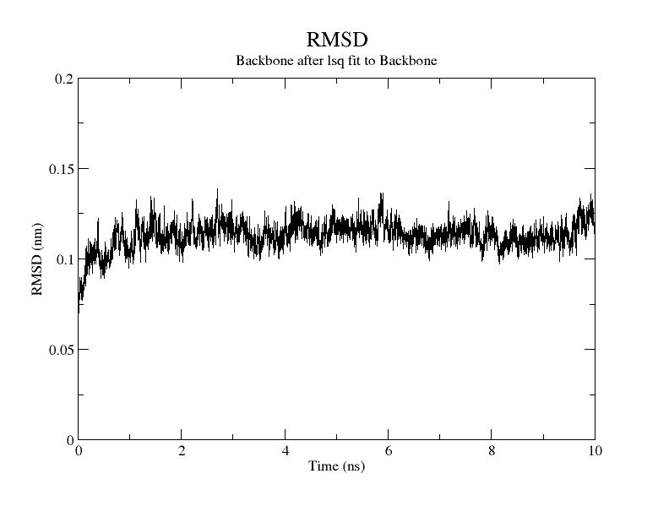
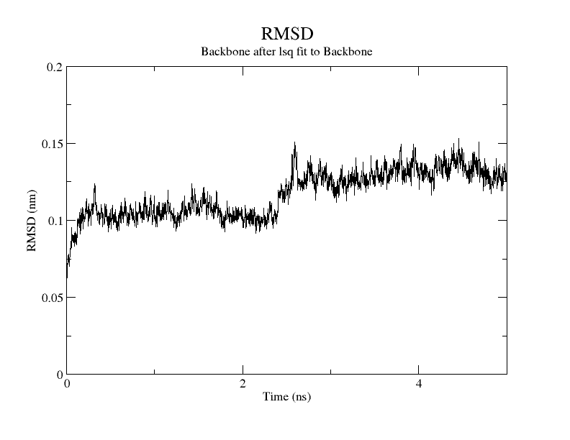
Native State Dynamics of a Bacteriophage RNA-dependent RNA Polymerase
Moustafa Elshaabiny¹, Ranajeet Ghose^{2,} and Andrea Piserchio³
1-Sophomore Computer Engineering Student ; 2-Faculty Mentor, Department of Chemistry, The City College of New York, and The Graduate Center of CUNY ; 3-Senior Research Scientist, The City College of New York
Email: moustafa.elshaabiny@gmail.com
Author Profile
Results
Moustafa Elshaabiny is a native Egyptian and a graduate of Lycée La Liberté d'Alexandrie high school, in Alexandria, Egypt. He came to the United States in January 2012 to pursue his higher education at the City College of New York. He is a sophomore international student at the City College Honors Program. He majors in Computer Engineering. Moustafa believes in the important role of research in the process of invention and creativity. Throughout his college years he concentrates on applying theories and concepts learned in his studies in laboratory work and pursue his goal of building a strong intellectual foundation in physical sciences, mathematics, and computer science with future contributions to engineering in mind. Furthermore, Moustafa is interested and passionate about chemistry. Putting his passion into action, as a freshman, Moustafa joined prof. Ghose’s research team in the chemistry department. Using his computer engineering knowledge and love for chemistry Moustafa hopes that he could further develop chemistry research and ultimately impact public health. Moustafa is also involved in community-based activities. He has won a Dobrich Scholarship in the Colin Powell Program for Leadership and Public Service.
We then performed energy minimization on our system in order to remove any kinetic energy, which could cause thermal noise and instability in the structure. The energy minimization was conducted for 1000 steps using the steepest descent algorithm.
To calculate the non-bounded forces between atoms we used a distance (rlist) of 1.5 nm. Only if the atom j falls within rlist relative to atom i it is considered in our total non-bounded forces. We used the particle mesh Ewald method (PME), which, by summing the electrostatic interactions in the Fourier-space, is computationally more efficient than summations techniques working in the real space. Pre-equilibration of the protein-solvent interactions was achieved by running a 100 ps MD at constant mass, Volume, and Temperature (NVT). In particular protein and non-protein atoms were independently coupled with a bath at 300 K using a modified Berendsen thermostat. The equations of motion were integrated every 2 ps, and the holonomic constraints were maintained using the LINCS algorithm. Snapshots of the simulation were collected every 2 ps for data analysis. MacPyMOL version 1.1 was used to visualize the resulting trajectories.
Root-Mean Square Fluctuation. In an attempt to determine the flexibility of each residue, we calculated Root-mean-square fluctuations (RMSFs).
t_{j}: time of the jth snapshot.
dt: frequency at which coordinates are written.
T: total simulation time.
Covariance Analysis. Gromacs utility “covar” was used to calculate covariance matrices (eq 2). Covariance matrices provide us with a better sense of how motions of atoms i and j are correlated. Motions that are completely (positive) correlated have a Cij value of 1, while completely (negative) correlated motions have a value of -1, and finally if the motions of the two atoms are not correlated (orthogonal) then Cij value is zero.²
Where:
r_{i} and r_{j} are instantaneous positional coordinates
<r_{i}> and <r_{j}> are average position vectors.
Table 1 shows a small scale comparison between the setup used for Run1 and Run2.
Figure 1 and 2 shows the Root Mean Square Deviation (RMSD) least square fitted to the protein’s backbone of Run1 and Run2 respectively.
Figure 5 shows the total Root Mean Square Fluctuation (RMSF) of Run1 and Run2
Run1
Figure 5
Figure 1
CONCLUSIONS
Abstract
Run2
The first MD simulations (Run1) took about 1 ns to stabilize. On the other hand, Run2 seemed to stabilize after about 0.5 ns, but at 2.5 ns we saw a significant shift in RMSD. This seems to indicate a structural transition to a different local minima
In general in Run2 we observed a larger around amount of C-alpha fluctuations and therefore showed more dynamics. Also we observed greater correlated motions.
Visual analysis of the regions undergoing larger motions suggests that the MDs detects a re-shaping of the template loading channel. This also proves that functionally relevant motions are observable in the ns time scale accessible to our MD simulations
Aforementioned observations suggest expanding Run2 simulation time by a factor of 10 should allow us to better sample the conformational space accessible to the protein.
In the last few decades, Hepatitis C-related deaths have increased sharply. More than 350,000 people die from Hepatitis C and related diseases every year due to the lack of effective vaccination¹. RNA polymerase is a target of our studies since it is responsible for the replication of the viral genome. In our research we seek a detailed understanding of the role of protein dynamics in the function of the RNA-dependent RNA-polymerase (RdRps) from the cystovirus ϕ12. Given the similarities between the RdRps across the viral kingdom, our results should provide insights into other viruses including Hepatitis C virus (HCV). In order to determine the native state dynamics of the ϕ12 RdRp, we performed solvated MD simulations using different schemes, with and without Graphics Processing Units (GPUs) . We performed three type of analysis: 1-Root Mean Square Fluctuations, 2- Covariance Analysis 3- Principle Component Analysis. We noticed that our protein showed a larger amount of fluctuations, and thus more dynamics, as well as larger amount of correlated motion when running simulations without GPUs and using a Shift method for computing Van der Waals forces. Analysis of the regions undergoing larger motions suggests that the MDs detects reshaping of the template loading channel. This also proves that motions that are likely to be functionally relevant are observable in the ns timescales accessible to our MD simulations.
Figure 2
Figure 3 and 4 shows the C-alpha correlation maps of both simulations Run1 and Run2 respectively. Positive correlations are denoted by red, while anticorrelations (negative correlations) are denoted by blue as show by the color scale to the right of the figures, computed values have been normalized to lie between 1 and -1
Residue Index
Run1
REFERENCES
Figure 3
[1] World Health Organization. Hepatitis C Fact Sheet No. 164. http://www.who.int/mediacentre/factsheets/fs164/en/ (June 2011)
[2] Zhen R, Franklin M and Ghose R. (2013) structure of the RNA-directed RNA polymerase from the cystovirus ϕ12. Proteins, 81,1479-1484.
[3] Davis, B. C. and Thorpe, I. F. (2013), Thumb inhibitor binding eliminates functionally important dynamics in the hepatitis C virus RNA polymerase. Proteins, 81: 40–52. doi: 10.1002/prot.24154
Residue Index
Materials and Methods
Table 1: Run setup comparison
Structure preparation and MD simulation. We used a crystal structure of P2 previously solved in our laboratory (Protein Data Bank, 4IEG). The simulation was conducted using GROMACS version 4.6.0 and AMBER99SB force field.
Solvation plays an essential role in determining the biophysical properties of biomolecules, including their dynamical features. As a result, we decided to explicitly treat our model by adding solvent water molecules to the system. To do so, we used the GROMACS utility genbox to fill a dodecahedron box with additional 34282 molecules of non-polarizable (Simple Point Charge) water molecules. We also neutralized the side chain charges by introducing 85 Na⁺ and 83 Cl⁻ ions.
Point of Comparison: | Run1 | Run2
Simulation time | 10ns | 5ns
Run time | 5 days (2ns/day) | 31 days (0.2ns/day)
GPU | ✓ | ✕
Cutoff scheme (Verlet) | ✓ | ✕
Van der Waals method (Shift) | ✕ | ✓
Residue Index
ACKNOWLEDGMENTS
This Project is supported by the National Science Foundation (NSF STEP)
I would like to thank the CUNY High Performance Computing Center.
Run2
Figure 4
Residue Index

