Slide 1
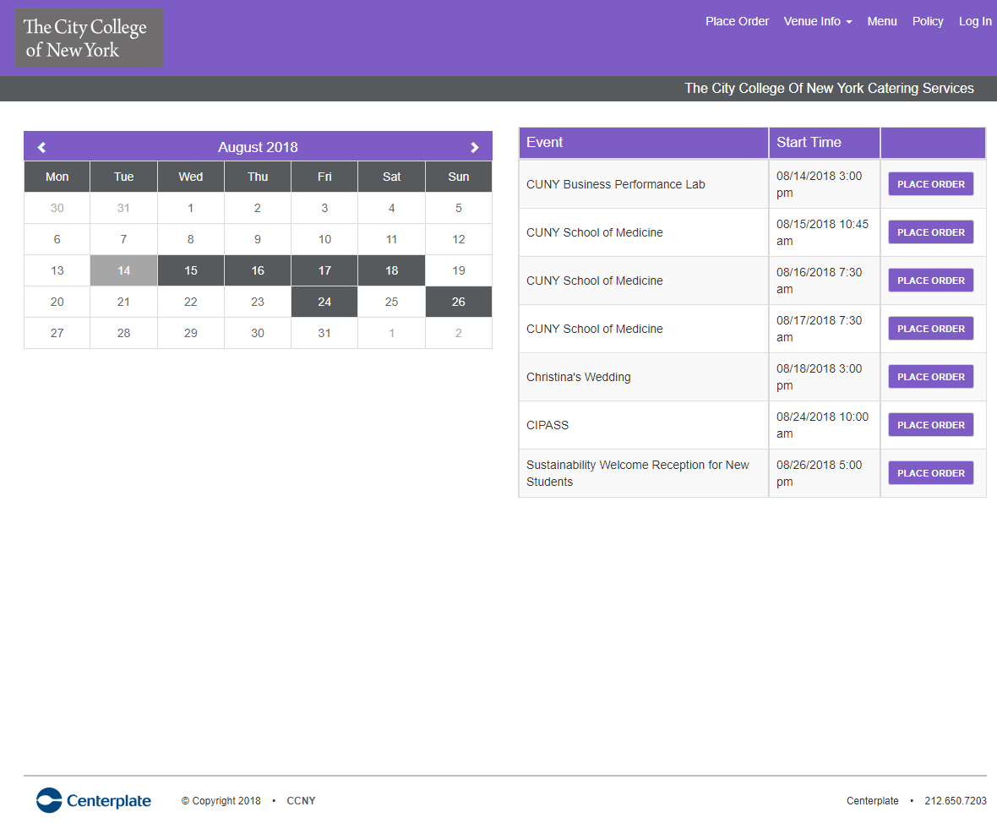
Welcome to Online Ordering at
https:// ccny.ezplanit.com

Slide 2
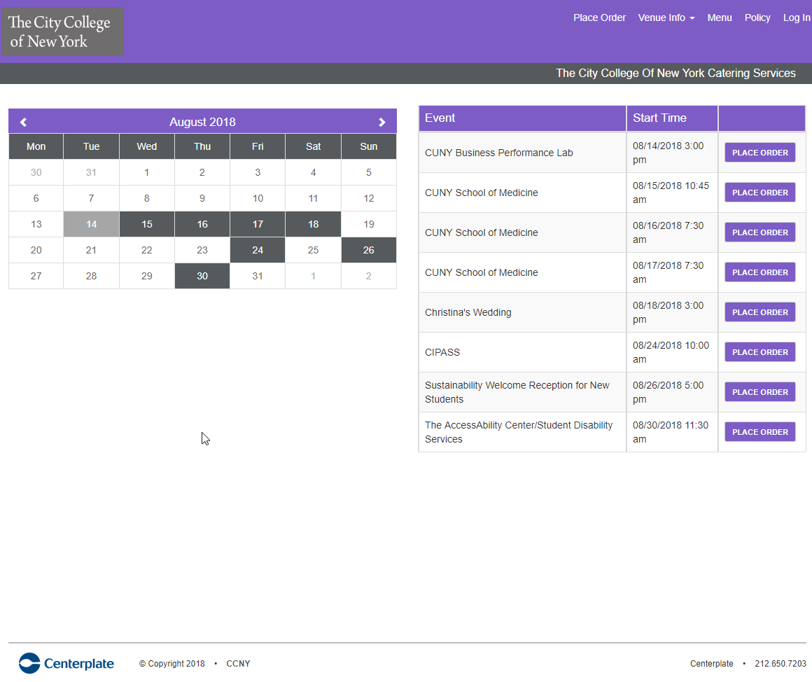
Click on desired date and corresponding event will appear

Slide 3
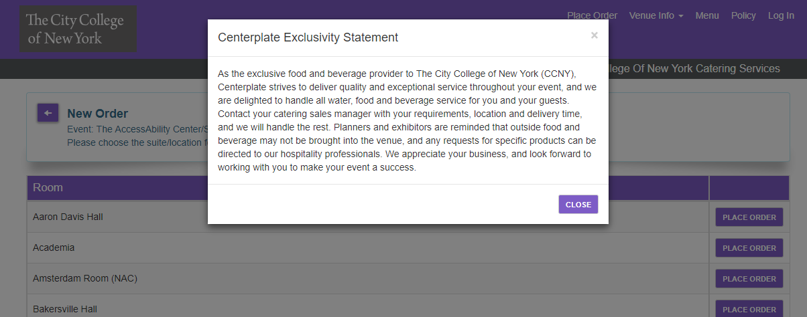
After the first click, the exclusivity statement appears which explains restrictions on outside food and beverage.

Slide 4
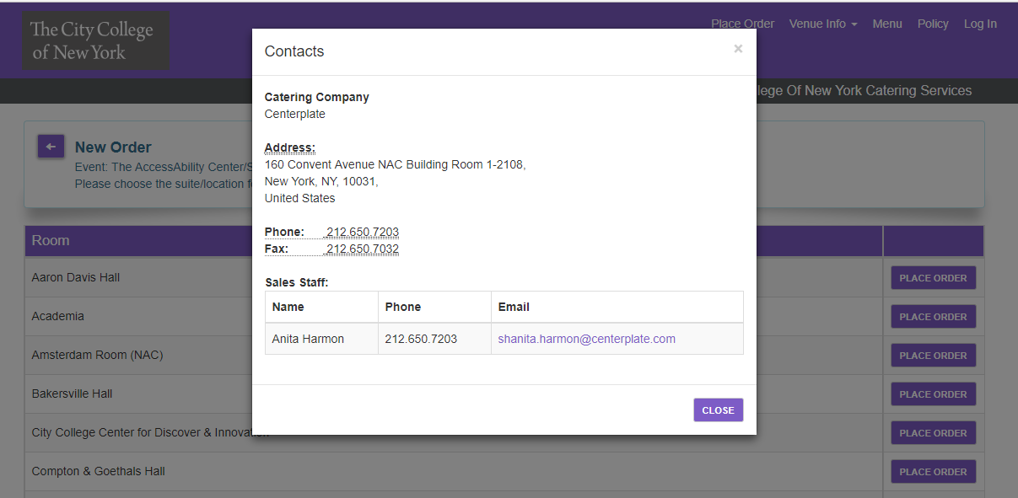
Venue Info provides contact
Information for sales team

Slide 5
Menu tab opens to Exhibitor Menu which
Can be downloaded or printed

Slide 6
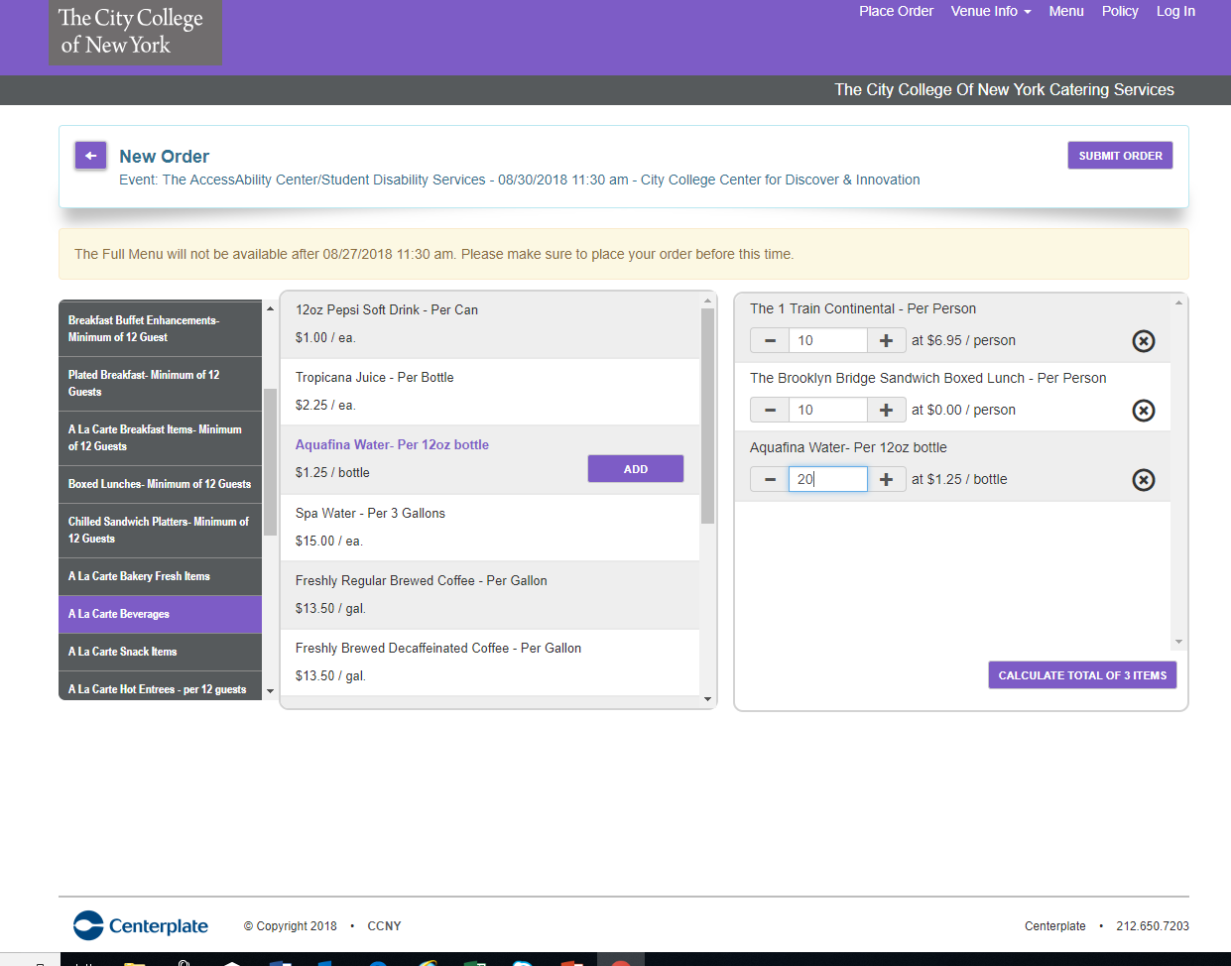
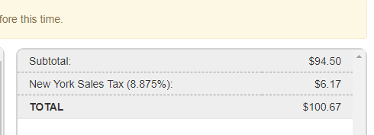
Click Submit when order is complete
Select ‘Place Order’ and menu appears
Category
Menu Items
Shopping cart
Click ‘calculate total’ to see final charges

Slide 7
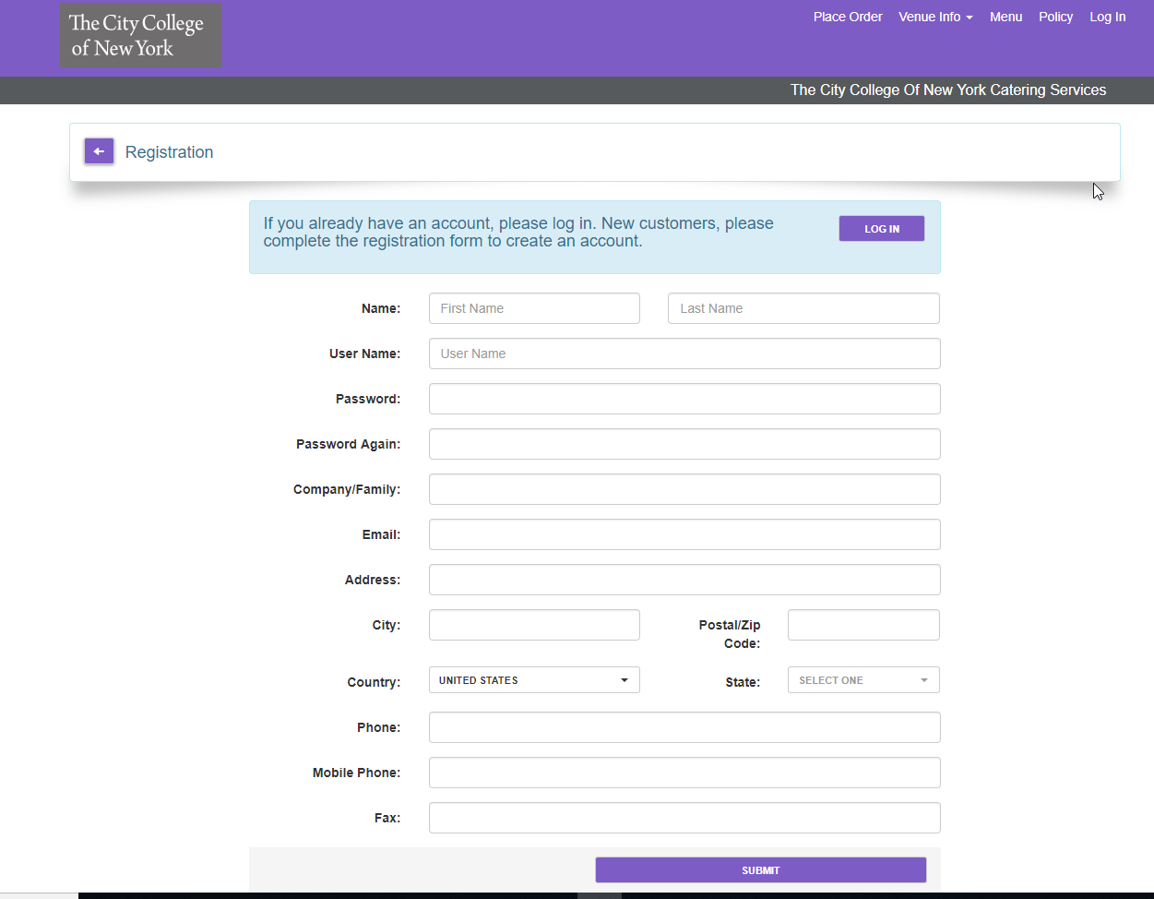
Register by completing the form and using the billing address of your credit card.

Slide 8
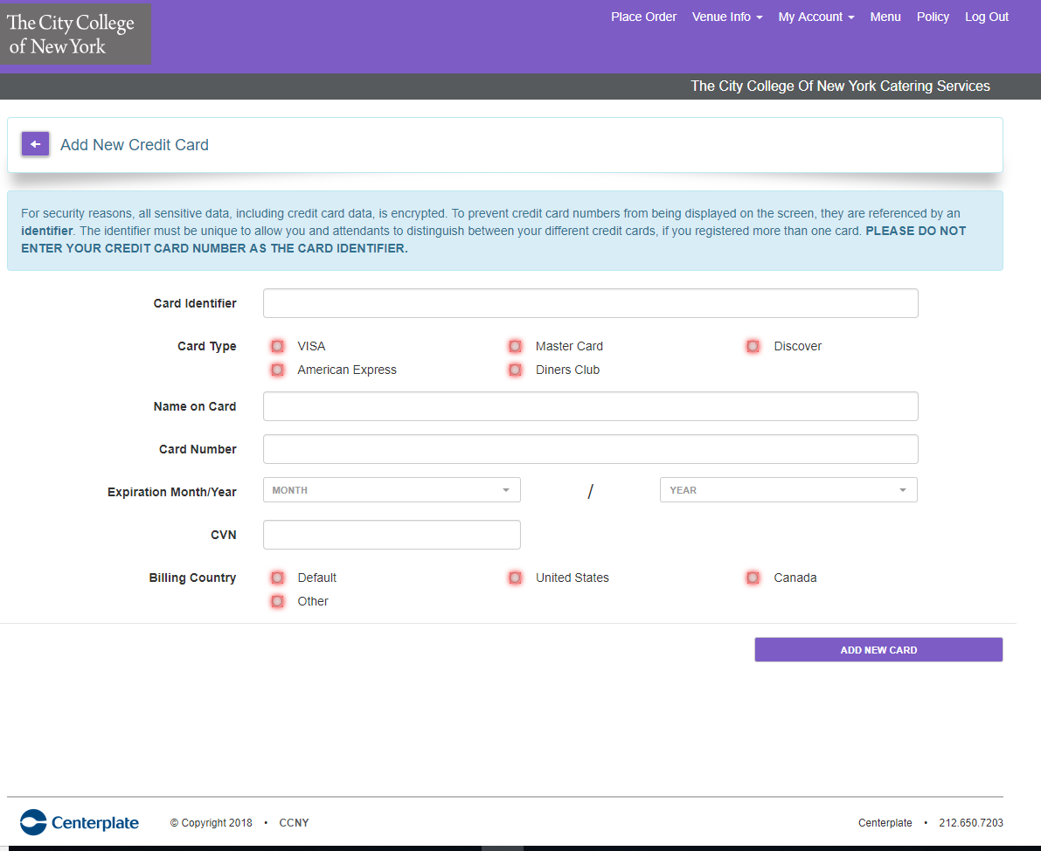
2017 Amex (use identifier that will allow you to remember the card
Add credit card information which is encrypted and NOT saved within our program

Slide 9
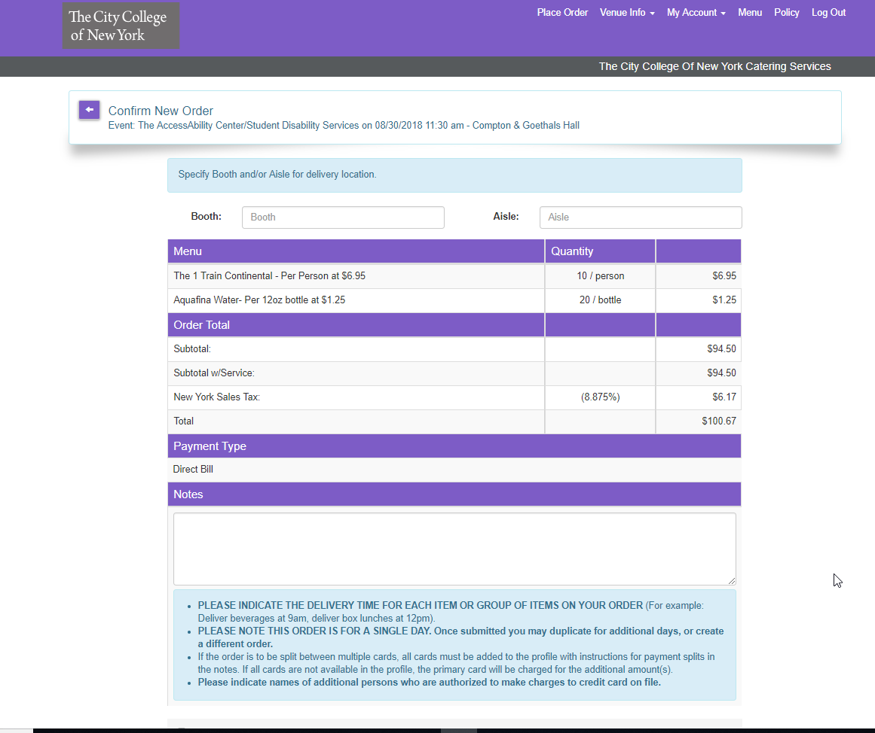
Add Booth Number (alpha-numeric)
Add Aisle number (alpha-numeric)
Review final order for completeness
Add notes for delivery times

Slide 10
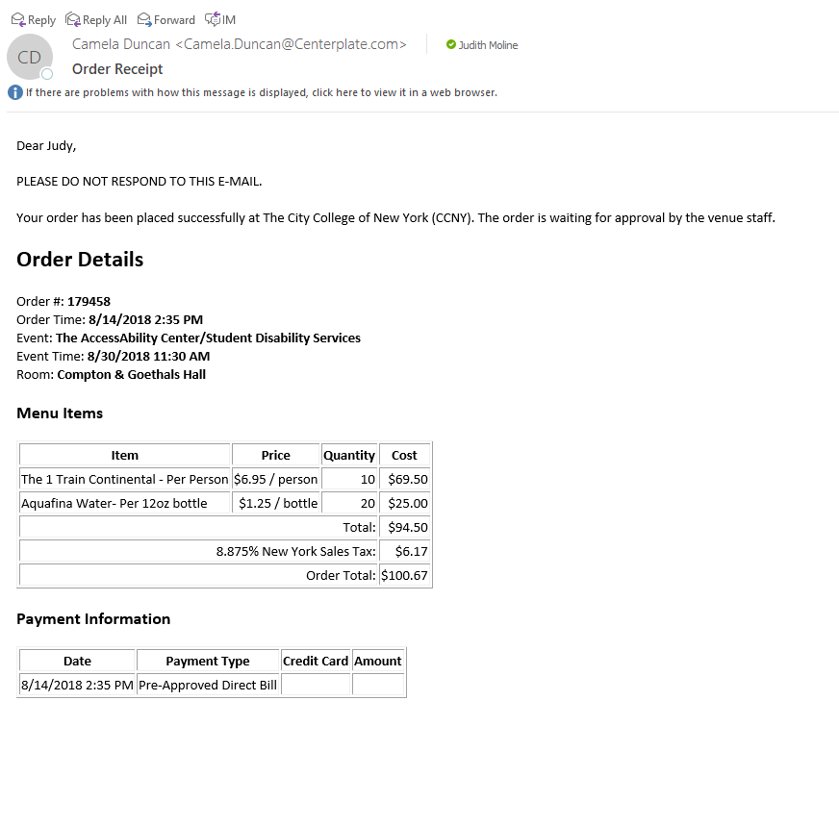
Immediate notification that order has been placed
There are two confirmations for each order
Emailed confirmation of order

Slide 11
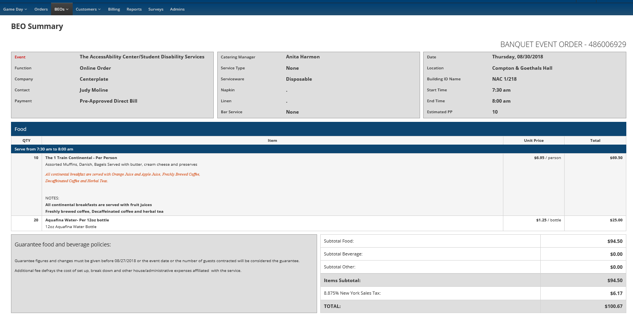
All Banquet Event Orders will be sent to you along with a Contract

Slide 12
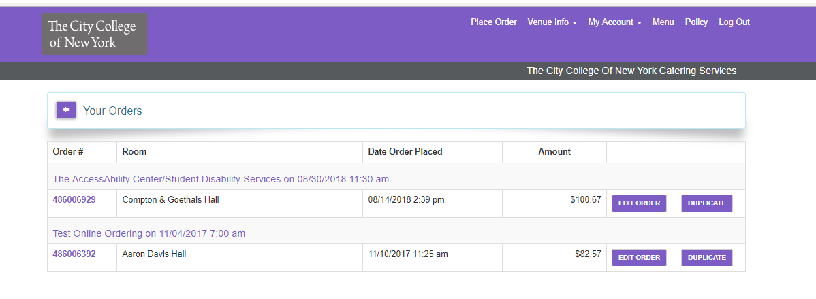
If you wish to duplicate your orders, go to My Account/My Orders
Locate the order and click DUPLICATE

