Slide 1
Immigrant Health Towards Equity in Health Thinking OUTSIDE tHE BOX TO Improve the health of immigrants
Francesca Gany, M.D., M.S.

Slide 2
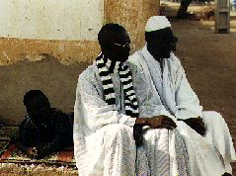
Notes:
Mamdou Diop was my patient. One of a series of 40 Senegalese men that I saw in my clinic as a resident at Bellevue, 18 years ago. They started me on this journey.

Slide 3
Senegalese Cohort: Results
TOOY
Senegalese Somatization Syndrome
Notes:
Tooy is a Senegalese culture-specific somatization syndrome, similar in many ways to syndromes known in other cultural groups, such as neurasthenia.
Tooy is characterized by waist pain, radiating around to the back. It is described as occurring when people are working too hard, and separated from family and community.

Slide 4
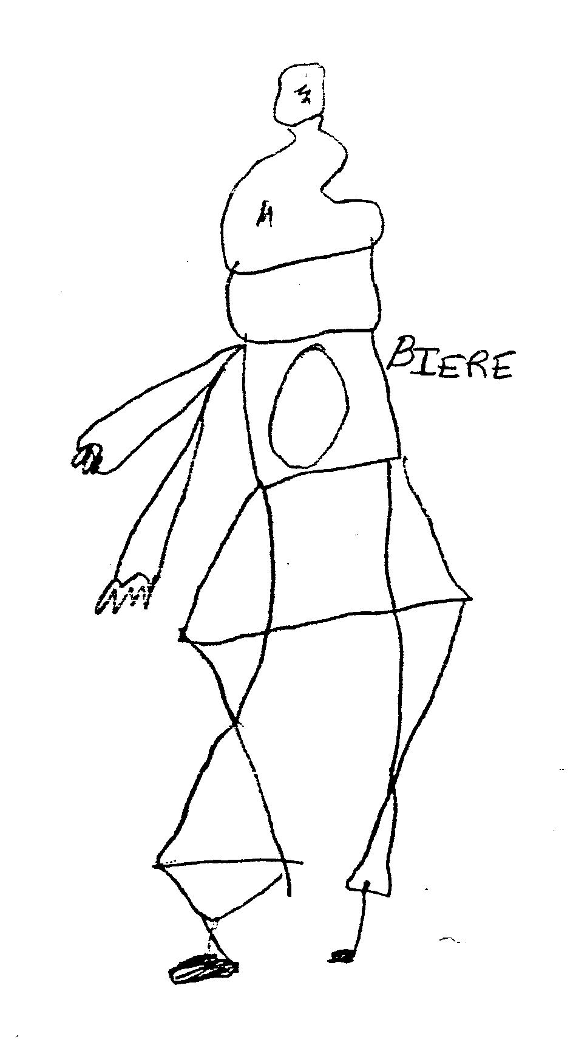
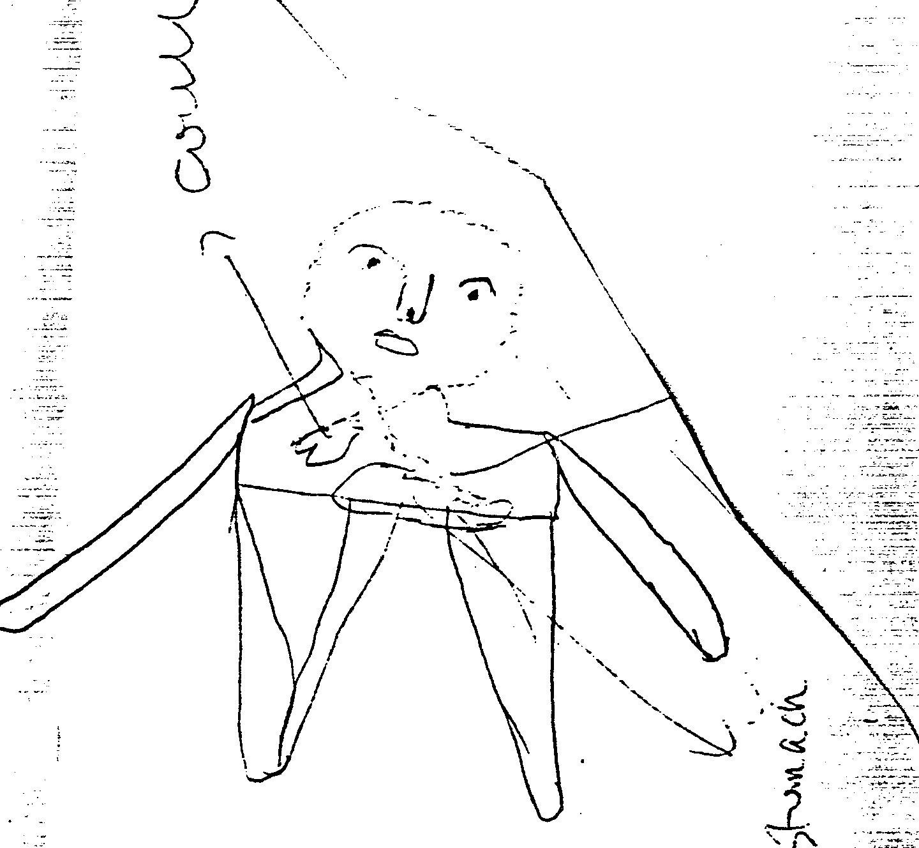
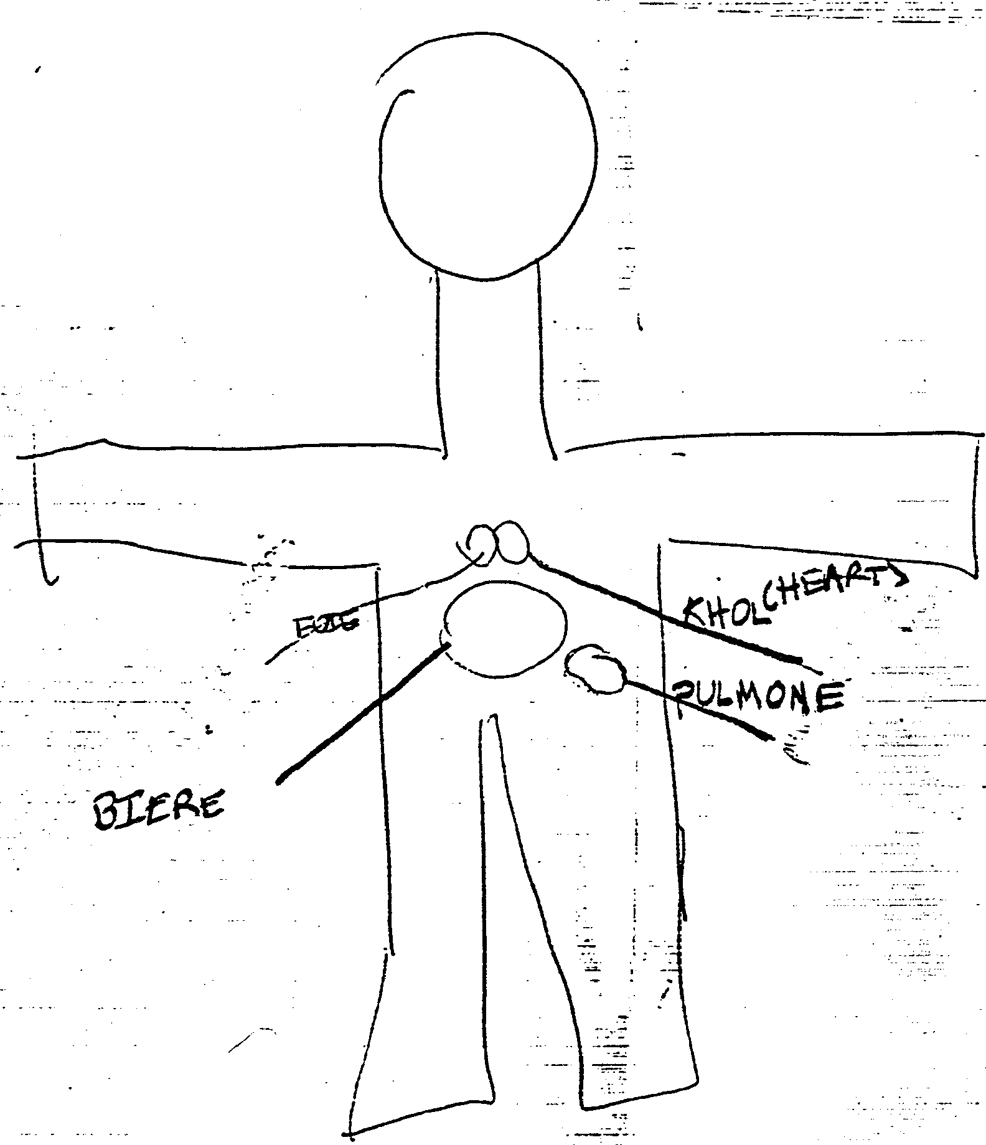
Body Drawings
Notes:
As was told to me by the men who did these drawings, the stomach is the center of the soul, hence, the physical manifestation of psychic distress is in the abdomen.

Slide 5
Senegalese Cohort: Treatment
Kell
Healing Talk Therapy
Community Support
Notes:
I learned that in Senegal, Tooy is successfully treated using three things together….
The ingestion of Kell, a gelatinous substance which comes form a tree;
Talk Therapy with a Healer; and
Gathering the community together to ease the workload of the person who is ill.
Therefore, I designed a treatment program for my patients which included the U.S. version of each of these things….
Knox gelatin was a culturally familiar substitute for the Kell, I provided the healing talk therapy in my office-based practice and, with my anthropology partner, spent time in the community addressing relevant issues.
At a one-year follow-up, all but 4 reported dramatic relief of their symptoms and were back at work full-time.
I realized from this experience that in to be an effective physician, I needed to fully integrate the patient’s cultural perspective and immigrant experience into my care.

Slide 6
The Immigrant Health and Cancer Disparities Service
NYSDOH Immigrant Health Policy Analysis
First ever National Symposium
Led to founding in 1989 as NYTFIH at NYU School of Medicine → Center for Immigrant Health → Center for Immigrant Health and Cancer Disparities at MSKCC 2011
Network of community members/CBOs/FBOs, providers, researchers, facilities and administrators, program and policymakers
Mission: To facilitate the delivery of linguistically, culturally, and epidemiologically sensitive healthcare services to newcomer populations
Research, Outreach, Education/Training, Information Dissemination, Program/Policy Development

Slide 7
PARTNERS

Slide 8
Immigrant Health: Intersecting Spheres
Access Barriers/Socioeconomic Determinants of Health: Linguistic, Cultural, Legal-Immigration Related(Perceived and Real), Economic, Technology
Health Conditions(Tuberculosis, Cancer, Cardiovascular, Mental Health)
Immigrant Community(SAHI, HHI, Latino Health Initiative/Mexican Consulates)
Subgroups(Occupational…Taxi, Restaurant, Construction; Home Health Workers; Religious)
Across the Life Cycle

Slide 9
Immigrant Health and Cancer Disparities Aims
To use a transdisciplinary community-engaged approach to more fully understand and effectively address immigrant health disparities at the local, national, and global levels.
Research
Further understand disparities: underlying causes and complex interplay of contributing factors
Foundational: biology, socicultural, economic, structural, environmental
Interventions: develop and test interventions to address causes, measure a range of outcomes
Translate findings into practice and policy
Facilitate inclusion of the underserved in research
Develop an inclusive research infrastructure and describe paradigm methodologies
Outreach, Education, Service Delivery
Provide evidence-based, culturally responsive education and care
In the context of socioeconomic and linguistic factors, co-morbidities
Across prevention, diagnosis, treatment, survivorship, and end-of-life
Translate findings into practice and policy
Training
Develop a cadre of well trained practitioners and scientists, representative of the populations served, able to deftly consider approaches to eliminate disparities in their clinical and research practices

Slide 10
Immigrant Health and Cancer Disparities Methodology
Research
Service
Research
Service
Research
Service
Integrated Approach
Community Based Participatory
Mixed Methods
Health Services Research, Behavioral Sciences, Outcomes Based
Multilevel
Laboratory, Patient and Community
“Community/Clinical Service” and Research Tightly Linked and Inform Each Other into Patient Care and into Population- Based Policy and Practices
Translate Findings into Patient Care and into Population-Based Policy and Practices

Slide 11
Barriers to Care/Socioeconomic Determinants of Health
Language and Literacy
Socioeconomic Determinants of Health

Slide 12
Communication Across the Language/Literacy Barrier
Communication is the cornerstone of effective, quality cancer care, from primary prevention to survivorship.
It is a final common pathway of all of our translational efforts.

Slide 13
Our Data Show…..
Linguistically targeted interventions are imperative
Interpreter Training and Patient Safety and Med Errors:
27% of errors made by untrained interpreters in the cancer setting were of moderate or greater clinical significance vs. 8.5% of errors made by trained interpreters
Vocabulary precision rate .69 for trained vs. 0.34 for the untrained
Standardized training program developed and disseminated
Results have guided policy developments/NYS regulations
Gany, F, Gonzalez CJ, Basu G, Hasan A, Mukherjee D, Datta M, Changrani J. Reducing clinical errors in cancer education: interpreter training. Journal of Cancer Education 2010 Dec;25(4);560-4.

Slide 14
Error Examples
Dr: The results were positive which means that you carry the gene that puts you at risk for developing breast cancer
Int: The results were correct
Dr: One important thing that you have going for you is the fact that the cancer has probably been caught early
Int: One important thing is the fact that the cancer is working quickly in your body
Dr: The doxy could hurt your heart
Int: The doxy can give you pain

Slide 15
Training Innovations
VITAL
Virtual Interpreting Training and Learning
PROMISE
Program for Medical Interpreting Services and Education

Slide 16
Our Data Show: Limited English Proficient Patients and Cancer Diagnosis Knowledge……
Design
A nested cohort of 472 predominately immigrant cancer patients participating in the Integrated Cancer Care Access Network
Surveys and and Chart Review
Results
14% had incorrect knowledge of their cancer diagnosis(cervix/ovarian)
91% preferred a non-English language in the health care setting.
This misunderstanding of cancer diagnosis may have a significant impact on subsequent cancer treatment and care. Limited English proficient patients may be at particular risk for suboptimal knowledge and hence care.
Leng CF; Yogendran L; Massie D; Ramirez J; Lee T; Lobach I; Gany F Doctor, what do I have? Limited-English proficient patients and cancer diagnosis knowledge [Abstract]. Journal of Clinical Oncology 2011;29(Suppl).

Slide 17
Intervention: Remote Simultaneous Medical Interpreting(RSMI)
“ U.N. Style” Medical Interpreting
Pooled Resource, Multiple Languages
Remotely Located, Linked through Technology
Our Data Show
RSMI almost two times faster….efficiency of service
RSMI 30% likelihood of medical error compared with Usual and Customary Interpreting (**P<0.05)
Gany F, Kapelusznik L, Prakash K, Gonzalez J, Orta LY, Tseng CH, Changrani J. The impact of medical interpretation method on time and errors. J Gen Intern Med. 2007 Nov;22 Suppl 2:319-23.

Slide 18
RSMI vs. U & C Randomized Controlled Trial
Patient Satisfaction
Significantly increased: protected privacy
Higher colonoscopy referral rates (OR of 1.7)
More BDI-FS+ patients newly diagnosed with depression (27% vs 20%)
Higher rates of Rx/referral
Mean # instructions per encounter
Significantly higher than U &C, same as concordant
Gany F, Leng J, Shapiro E, Abramson D, Motola I, Shield DC, Changrani J. Patient satisfaction with different interpreting methods: a randomized controlled trial. J Gen Intern Med. 2007 Nov;22 Suppl 2:312-
Leng JCF, Changrani J, Tseng CH, Gany F. Detection of depression with different interpreting methods among Chinese and Latino primary care patients: A randomized controlled trial. JIMH: in press.

Slide 19
Language Access Research Next Steps
“Doctor, What do I Have?”: Lesions in Knowledge of Diagnosis
RCT of RSMI versus U&C on knowledge of diagnosis, chemotherapy and RT adherence, disease outcomes, QOL, with cost analysis
Physician fluency, physician threshold for calling an interpreter, and associated medical outcomes
Impact: Policy change in New York State and nationally
Working with New York Lawyers in the Public Interest and New york Immigration Coalition, Medicaid Redesign Task Force, MSKCC Center for Health Policy

Slide 20
Socioeconomic Determinants of Cancer Treatment Outcomes Integrated Cancer Care Access Network
Baseline cancer treatment completion ~ 75% among immigrant cancer patients in NY safety net facilities
Started ICCAN in Response
Over 1700 participants
Nested cohort of 328 Latino patients.
59% reported needing assistance with financial resources, 37% with food resources, and 21% with transportation resources.
In high-need patients in urgent need of financial support, 86% reported that portal services helped them attend cancer care and treatment appointments, 72% reported that portal services decreased worry about their care.
Nested cohort study of 82 immigrant Chinese cancer patients
87% of Chinese patients reported needing assistance with financial resources, 18% with food resources, and 18% with transportation resources.
Just 23% of patients reported working with a social worker
Missed appointments due to misunderstanding of when the appointment was scheduled and conflicts with other appointments, language barriers
Gany F, Ramirez J, Nierodzick ML, McNish T, Lobach I, Leng J. Cancer Portal Project: a multidisciplinary approach to cancer care among Hispanic patients. J Oncol Pract. 2011 Jan;7(1):31-8.
Gany F, Ramirez J, Chen S, Leng JC. Targeting social and economic correlates of cancer treatment appointment keeping among immigrant Chinese patients. J Urban Health. 2011 Feb;88(1):98-103.

Slide 21
ICCAN Research Next Steps: RCT of Impact
ICCAN Intervention Design:
Multilingual ‘access facilitators’ meet with patients at 10 different safety net cancer centers
Determine the causes of missed appointments and issues with care
Connect patients with culturally and linguistically relevant insurance, transportation, food/nutrition, legal, financial, and psychosocial support resources
Outcomes
Primary
Treatment Completion
Secondary
Quality of Life
Co-Morbidities
Cost Analysis
Results could guide policy vis-à-vis reimbursements
NCI-U54 CCNY-MSKCC Partnership for Cancer Research, Training and Community Outreach. Grant#U54-137788-04-S2.Integrated Cancer Care Access Network (ICCAN),2011-2013, $460,000

Slide 22
Is Hunger Affecting Cancer Treatment Completion?
Context
Food insecurity(FI):disruption in a household’s eating habits due to insufficient food resources
Growing problem in the U.S
17.4 million households are food insecure.
Especially detrimental to oncology patients.
No studies have yet assessed levels of food insecurity among oncology patients in major population centers.
Study Design
Multilingual nested cohort of 411 ICCAN patients
Surveyed using USDA Food Security Survey and the IHCD Food Security Supplemental Module.
Results
FI prevalence 61%
Treatment-appropriate food more expensive
Missed appointments because of FI
77% of all patients reported less money to spend on food since treatment began
Transportations costs(84%), decreased work hours(82%), Co-pays/med fees(39%)
Consider food insecurity screening as standard of care.
Gany F, Lee T, Ramirez J, Massie D, Moran A, Crist M, McNish T, Leng J. Are our severely ill patients hungry? Manuscript submitted for publication. 2011 May.

Slide 23
Broader Systems Impact: Food to Overcome Outcomes Disparities(FOOD) RCT
Baseline Intervention/Usual and Customary
Hospital-based Food Pantries developed with Food Bank for NYC, HHC
5 developed(Queens Cancer Center, Woodhull, Brooklyn Hospital, Lutheran, Bellevue)
2 in development(Lincoln, Ralph Lauren)
RCT
3 Arms: Food Pantry vs Food Stamp-like Vouchers vs Home Grocery Delivery
Study Outcomes
Treatment Completion
QOL
Nutritional Parameters
Policy Implications
Emergency food vouchers for cancer patients who qualify for “Emergency Medicaid”
(New York State Health Foundation, Food for Health: To Study the Impact of Food Insecurity Interventions on Cancer Treatment Adherence and Quality of Life, 2011-2013, $240,000)

Slide 24
Community Specific Research Programs
South Asian Health Initiative(SAHI)

Slide 25
SAHI(South Asian Health Initiative)
South Asian Populations(India, Pakistan, Sri Lanka, Bangladesh, Nepal) Growing Rapidly
Population increasingly varied socioeconomically
Robust CBPR Program
Longevity: working together for seven years
30 member multilingual Community Advisory Board
Co-directed by SACSS
Focus Areas
Screening(CVD, DM, Oral Cancer, CRC)
Testing of Interventions for Health Systems Linkage(Queens Health Bridge)
Risk Factor Reduction
RCT of Pedometers in Taxi Drivers
Saturation Models
Smokeless Tobacco Interventions
Risk Modeling in Mice
Development of Dependence Scale
Risk Perception Study
Quit Interventions at Community, Patient, Provider Levels

Slide 26
STOP PAAN (Smokeless Tobacco Oral Pathology Prevention and Awareness Network)

Slide 27
Areca Nut Usage in South Asians
Indigenous to South Asia and migrants from South Asia
Strong cultural associations, a part of rituals and everyday social customs
Consumed in various ways, and also used by itself
Most popular ways are in a ‘paan’ or as ‘gutka’

Slide 28
What is a Paan?
Literally, ‘paan’ simply means leaf
More commonly, it denotes a mixture of various ingredients wrapped in a betel leaf
In scientific literature, it is referred to as a betel quid
Most popular ingredients are areca nut, tobacco, lime, and catechu

Slide 29
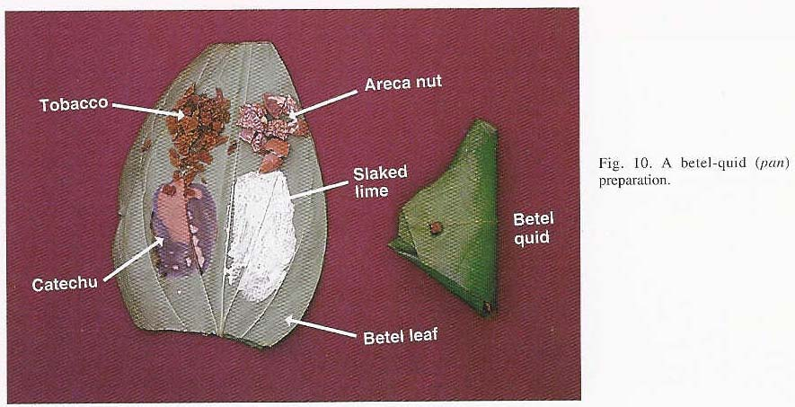

Slide 30
What is paan masala and gutka?
Paan masala is generic term used for areca nut products that are manufactured industrially and marketed commercially
Gutka=paan masala+tobacco
Introduced two decades ago
Particularly ominous:
Convenient to use and store
Low cost
Youth appeal

Slide 31
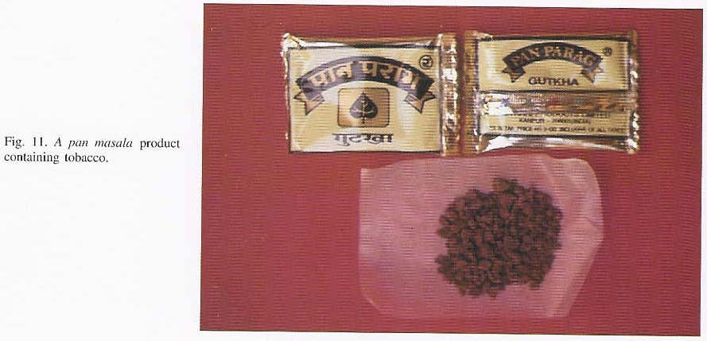

Slide 32
Effects desired from paan and/or gutka
Scientifically substantiated
Euphoria/antidepressant
Salivation/thirst quenching
Strengthen gums, fortify teeth
Aid cognitive performance
Antihelminthic
Analgesic/sedative

Slide 33
Effects desired from paan and/or gutka
Scientifically unsubstantiated
Stimulate appetite for food (Not significant)
Suppress hunger (Not significant)
Reduced salivation (No data)
Aid digestion (No data)
Dispel nausea (No data)
Anti-diarrheal (No data)

Slide 34
Oral Manifestations of Areca Nut and Smokeless Tobacco
Oral Squamous Cell Carcinoma
Oral Leukoplakia
Oral Submucous Fibrosis
Others:
Betel Chewer’s Mucosa
Lichenoid Lesions
Periodontal Disease
Effects on hard tissues

Slide 35
Additional Manifestations
CVD Risk
Other Cancers
Bladder
Pancreas

Slide 36
Prevalence of Use in South Asian Migrants
Migrant studies conducted in
Indians in the Malay peninsula
Indians in Natal province in South Africa
Asians in the United Kingdom (persons from India, Pakistan, Bangladesh, and people from East Africa whose families originated in the Indian subcontinent)
Patterns of use similar to the local chewing customs prevalent in countries of origin

Slide 37
Paan and Gutka in the United States
Easily available in South Asian enclaves in the New York Metropolitan Area
Paan $0.50 to $1.00 per quid
Gutka $0.50 to $1.00 per sachet
In June 2003, the New York State Senate and Assembly passed legislation to ban the sale of gutka to minors

Slide 38
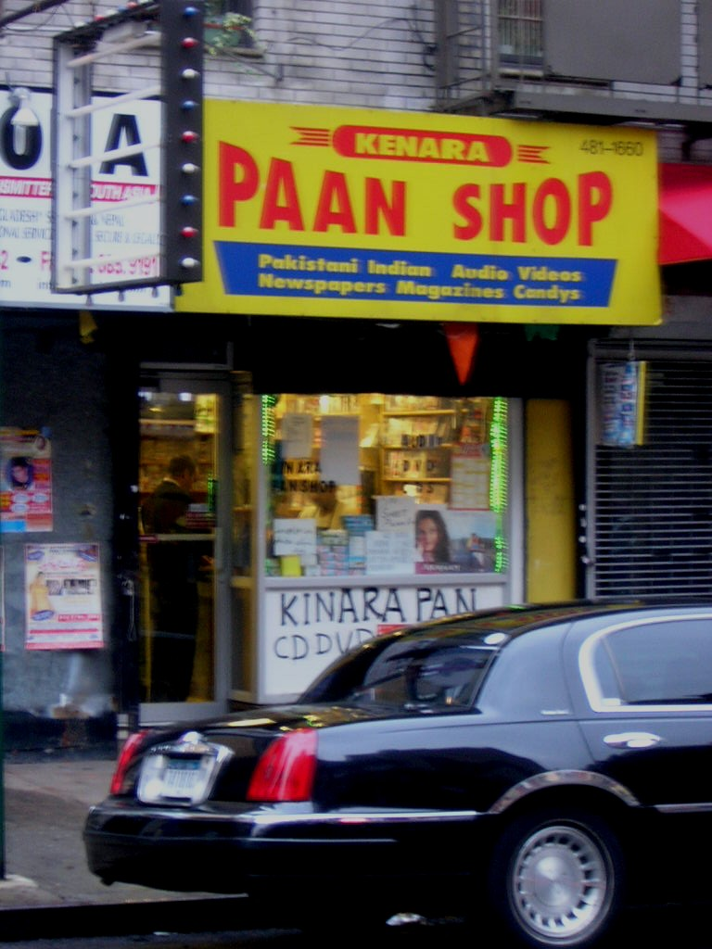

Slide 39
STOP PAAN (Smokeless Tobacco Oral Pathology Prevention and Awareness Network)
CBPR(SAHI)
Multilevel Research Program
Mouse models to elucidate mechanisms
User and community knowledge, attitudes, beliefs
Dependence scale development
Risk Perception
Quit interventions
Environmental and social marketing interventions
Providers serving the community

Slide 40
Collaboration with PengFei Zhang, Ph.D.
Characterization of toxins by mass spectrometry
Use results to determine impact in human populations

Slide 41
Partnership with NYU Toxicology and Environmental Science Researchers
Zelikoff(PI): Mouse modeling of impact of ST on user and offspring
Cancer Risk
Cardiovascular Risk
Birth Outcomes

Slide 42
Population Sciences
Utilization in adult and adolescent populations
Pregnant women: beliefs and practices, quit interventions
Availability in businesses serving the immigrant communities
Policy around regulation of culturally-linked ST products

Slide 43
SAHI Model for Taxi Drivers
Taxi CAB
CVD Risk, Exposure and CVD Risk and Lung Cancer
PM Monitoring in taxis
Analyze PM Constituents
Examine Biomarkers

Slide 44
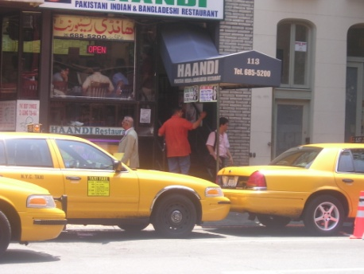
STEP On It! Taxi Drivers
43,000 Immigrant Taxi Drivers in NYC
Convenience sample of 650 taxi drivers at JFK airport: Window of Opportunity
Over half are uninsured, have no health screening, no primary care
11% with undetected/untreated diabetes, 50% with elevated BPs, 18% use tobacco products
STEP: RCT of Pedometer Intervention
Half with statistically significant increases in step counts
STEP led to STEP On It!
Lifestyle change targeting diet, exercise
Health systems navigation
Policy Next Steps: Mayor’s Office of Immigrant Affairs and TLC
One NYC One Nation
Taxi Holding Lot Health Assessment and Screening Services for Drivers and their Families
Gany and Leng, New York State Empire Clinical Research Investigator Program (ECRIP). No grant#. STEP: South Asian Taxi Drivers: Exercise Through Pedometers. 2010-2011, $210, 000)

Slide 45
Key Considerations Into the Future Low Tech/High Tech
Collect Appropriate Demographic Data
HHS New Categories
ACS new standard
Categories need to be more granular
Latino Example of Need to Granulate
Language: Indigenous Languages
Account for Transnational Migration
Collected Sensitively
Canadian Evidence-based International Migrant Project

Slide 46
Key Considerations Into the Future Low Tech/High Tech
Socioeconomic Determinants of Health
Social Network Analysis
ACA
Undocumented immigrants
Debunking Myths/Public Opinion
Sales Tax, Payroll Tax, Medicare
Community Health Workers
FOOD (Food to Overcome Outcomes Disparities)
Saturation Model
Job Training
DREAM Act
Remittances and Impact of Migration on Home Countries

Slide 47
Into the Future…..
NCI Provocative Question 2
What environmental factors change the risk of various cancers when people move from one geographic region to another? Background: Numerous studies have identified associations between the incidence of various cancers and local living conditions. There are many well-documented examples of cancer incidence changing as populations migrate from one site to another. These migrating populations will often adopt the cancer incidence profiles of their new host locale. In these instances, it is likely that environmental or cultural influences are contributing to the increased incidence of various cancers. Early studies identified this phenomenon and confirmed these relationships, but continued work on the identification of risk factors in migrating populations has languished in recent years. This question seeks to stimulate more sophisticated studies on epidemiological risk identified through studies of migration.
Complex Etiologies
Epigenetics
Microbiome(Disease, Obesity)

Slide 48
Into the Future
Tap Technology
Be Mindful of the Digital Divide But Do Not Assume
VCIC, Chinese Support Groups
Smart Phones
Personal Electronic Health Record/ Health IT
Especially with Transnational Migration
Community Provider Dissemination Networks
Widespread Language Solutions
Interpreter Networks, SIRI-like voice recognition
Bidirectional Solutions Key
National Interpreter Certification
Financing Models
Informed Consent

Slide 49
Into the Future…
Exposures, Stress, and Biomarkers
Follow the Suburban and Rural Migration
Mental Health/Unique Culturally Responsive Models
Home Country Pre-migration Interventions
Impact on Children Left Behind or Sent Back

Slide 50
Immigrant Health and Cancer Disparities Service
Introductions
Director of Research
Kate Duhamel, Ph.D.
Directors of Research Program Areas
Jennifer Leng, M.D., M.P.H.
Abraham Aragones, M.D., M.S.C.I.
Lisa Diamond, M.D., M.P.H.
Research Manager
Nicole Roberts, M.P.H.
Data Manager
Dana Massie
Immigrant Cancer Care Action Network (ICCAN)
Cancer Portal Project
Julia Ramirez, M.A.
Michell Chang-Qui
Thelma McNish
Charles Stern
Joshua Wessler
Lalanthica Yogendran, M.D.
Victoria Blinder, M.D., M.S.
Food to Overcome Outcome Disparities (FOOD)
Julia Ramirez
Joshua Wessler
Latino Health Initiative
Abraham Aragones, M.D., M.S.C.I.
Rosario Costas, Ph.D.
Lisa Diamond, M.D., M.S.
Julia Ramirez
Linguistic and Cultural Responsiveness
Lisa Diamond, M.D., M.S.
Javier Gonzalez, M.F.A
Elena Yanjun Li
Zoe Schutzman, M.S.
Barry Xiaoliang Ma
Anthony Severino
South Asian Health Initiative (SAHI)
Pavan Gill
Smita Bannerjee, Ph.D.
Sehrish Bari
Aparna Sarin, M.D., M.P.H.
Chinese American Cancer Care Access Program
Jennifer Leng, M.D., M.P.H.
Elena Yanjun Li
Barry Xiaoliang Ma
Charles Stern
Arab American Breast Cancer Education
and Referral Program (AMBER)
Claudia Ayash, M.P.H.
Sahar Farah
Hala Borno
Rawan Yasmin

