Slide 1
Frontiers in The Social Determinants of Health
Peter Muennig, MD, MPH
3/22/2012
Sophie Davis
Notes:
Ounce of prevention
Talk does not work
1% of patients told to quit smoking by doctor do so.
This is the topic of my talk for the day. Where do we need to go to improve the health of Americans, and what information do we need to get there? 2 points: social + enviornment

Slide 2
Problem

Slide 3
Prob
lem

Slide 4
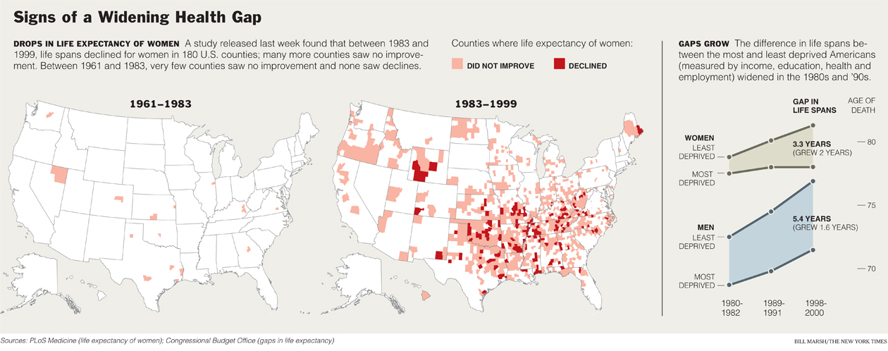
Background
Notes:
Life expectancy increases over time. Only in rare circumstances—AIDS in many SSA nations, the Russian shock economics transition to capitalism, influenza in 1918, war, famine, and Chinese cancer villages—do we see declines in life expectancy. In this map, we see that between 1961 and 1983, there were only a handful of counties for which life expectancy of women did not improve, and these tended to be stroke-belt small counties.

Slide 5
Background
Notes:
Things changed over the following two decades, in which many counties did not see an improvement, and more still saw a gross decline.

Slide 6
Notes:
In fact, the overall health of Americans is projected to decline, and the American standard of living is in decline as well. Much of this is because health costs are increasing.

Slide 7
1975
Per Capita Spending and Survival, 45 Year Old Women
Notes:
Explain axis
In 1975, the US had the same health system it has today.
other nations on this graph offer universal coverage.
United States has rapidly adopted new medical technologies, these other nations generally have rationed care as medical costs increased.

Slide 8
2005
Per Capita Spending and Survival, 45 Year Old Women
Notes:
Not surprise that health costs increased
But surprise is that health worsened. Significantly.

Slide 9
2005
Per Capita Spending and Survival, 45 Year Old Women
Notes:
You are thinking obesity and smoking. Of course, these things are bad for us. But they are not what is causing us to move further behind.
Social and physical environment shapes our health

Slide 10
2 Minutes:
Ask your neighbor why?

Slide 12
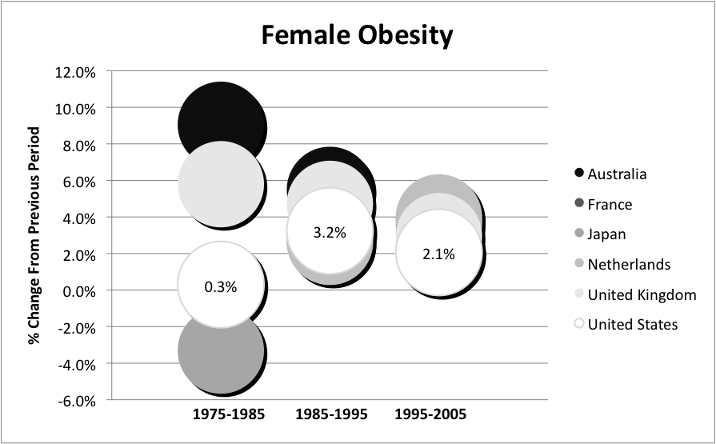
Notes:
Clearly, this is’t the problem.
But even if it were, we would have to ask ourselves why. Why are we doing things that are making us less healthy?
And what are they?

Slide 13
Years of Perfect Health Lost, United States 2008
Notes:
As it turns out, many such things might have more to do with the way we structure our society than our own gluttony. Again, these things are bad for us, but they do not explain why we are moving away.
There are two things I’m going to hammer on about from this point on. One is that it is our social environment that shapes the things we think, feel, do, and behave.
The second is that the physical environment in which we live shapes our social environment.
If you are coming from an environment where it is important to excell in school, you will more likely do well in school.

Slide 14
How Do We Fix This Big Problem?

Slide 15
Causality

Slide 16
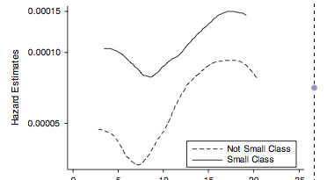
Causality

Slide 17
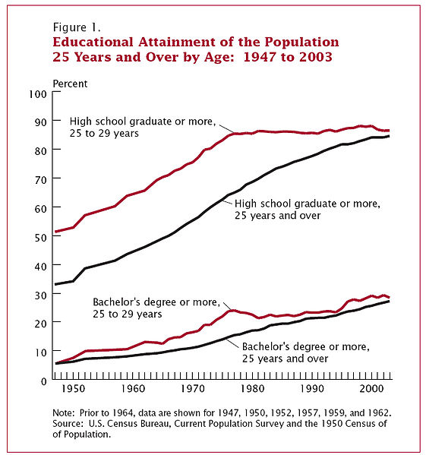

Slide 18
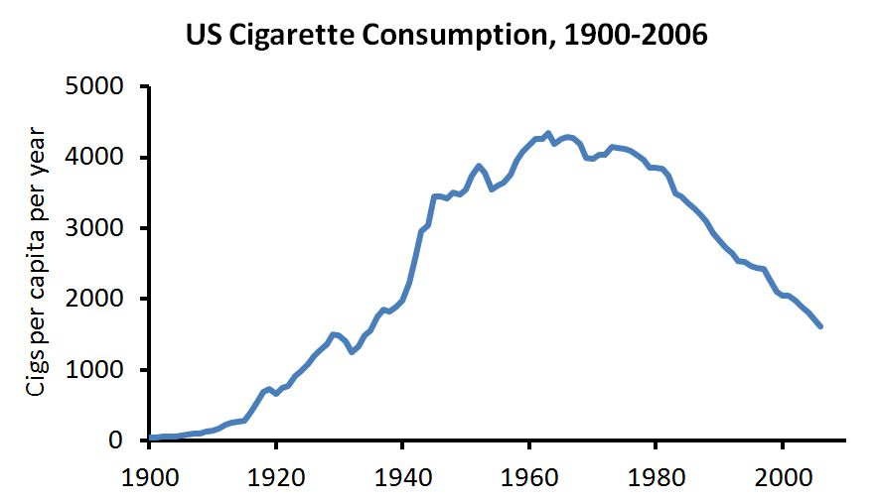

Slide 19
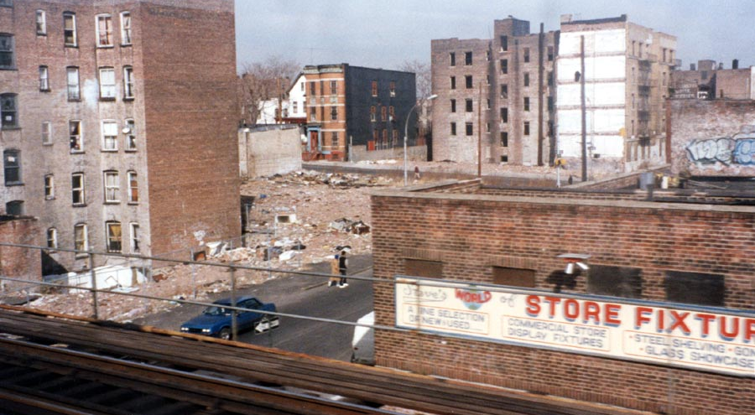
Notes:
One alternative explanation is that it is the way that we build our communities
Our policy landscape
Poverty is most important and smoking second most important.
One common element to both is stress.

Slide 20
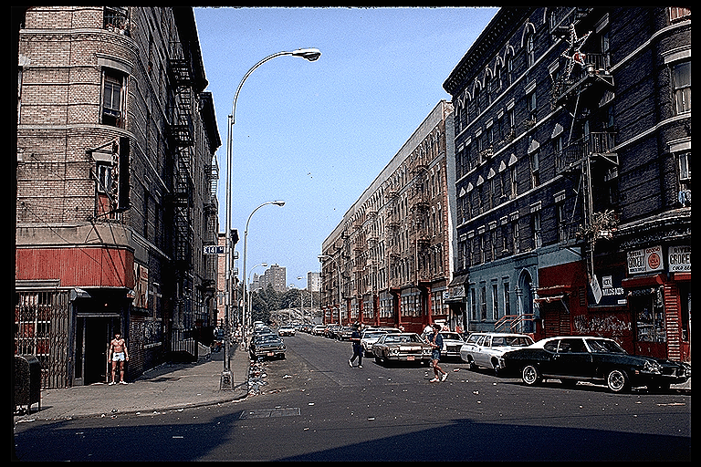
Notes:
I mentioned that those who are motivated to do well in school will do better in school, on aerage.
But some of our schools have no working bathrooms.
There are others with 2 students to one desk.
And still others for whom lunch starts at 9:45AM. Material disadvantage matters to. And it influences the social. Here are 2 other pictures taken over 10 year intervals of this same block.

Slide 21
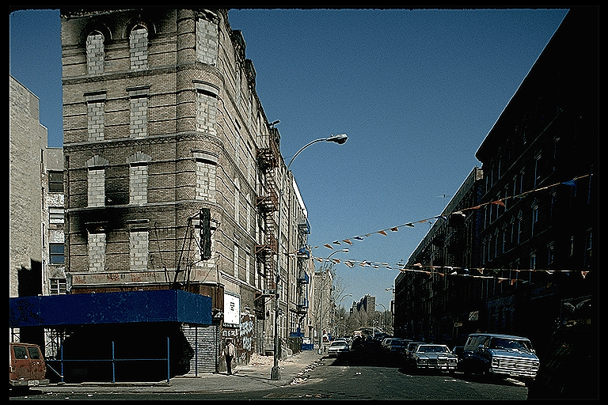

Slide 22
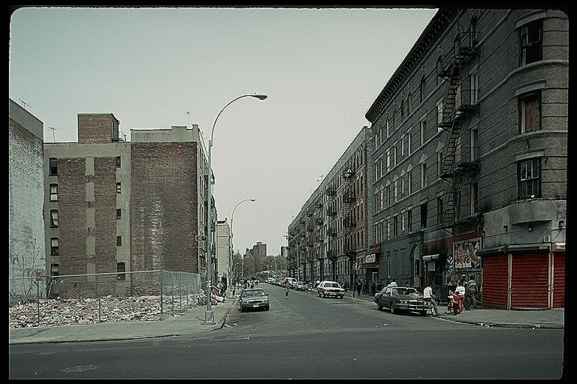

Slide 23
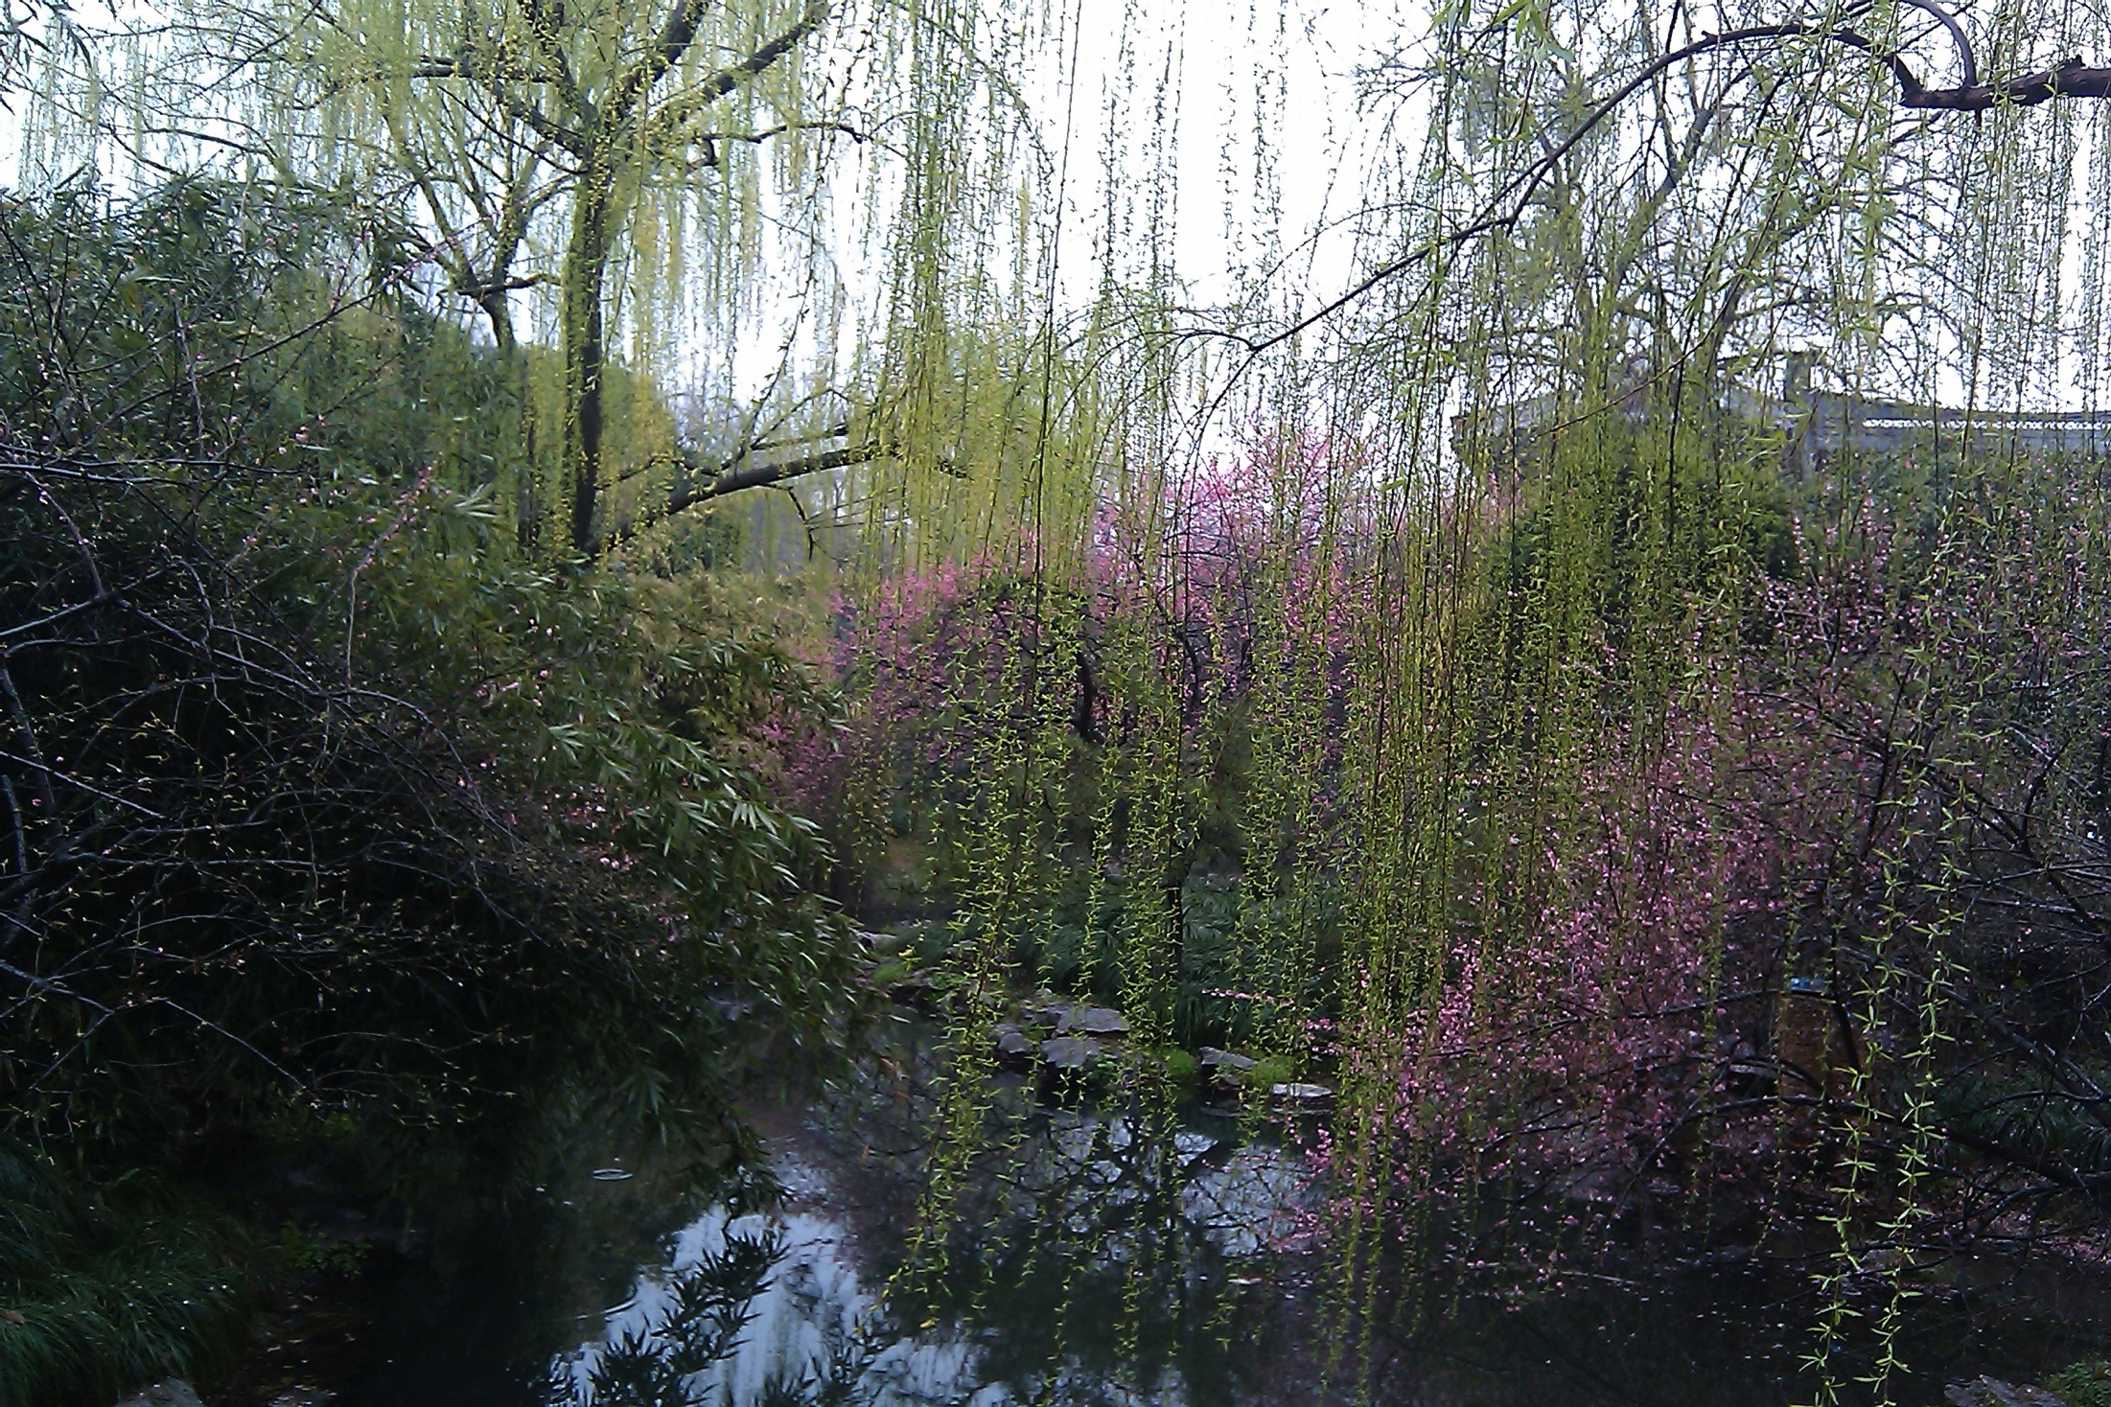

Slide 24
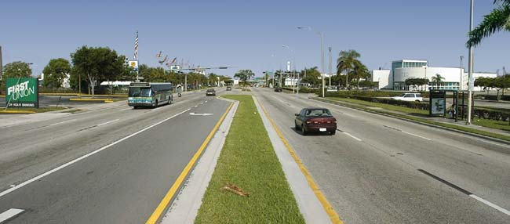
Notes:
Obviously, relative

Slide 25
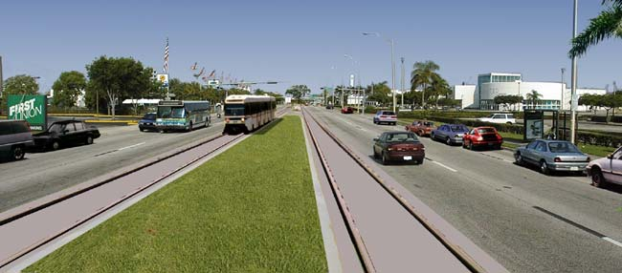

Slide 26
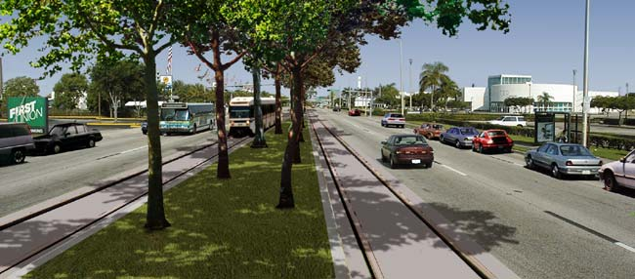

Slide 27
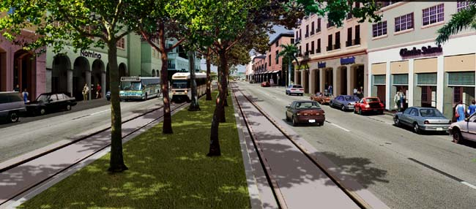

Slide 28
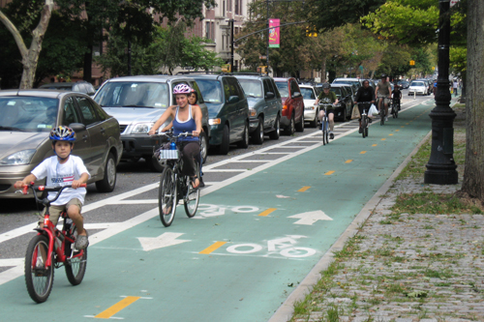
Notes:
This bike lane reduced speeding by 75% while not impacting congestion. It greatly reduced bicycle traffic on the sidewalk (from half of all cyclists to 3% of all cyclists) while tripling the number of bicycles from 349 to 1010.

Slide 29
