Slide 1
New insights into breast cancer etiology
Elisa V. Bandera, MD, PhD
Associate Professor of Medicine
The Cancer Institute of New Jersey
Robert Wood Johnson Medical School

Slide 2
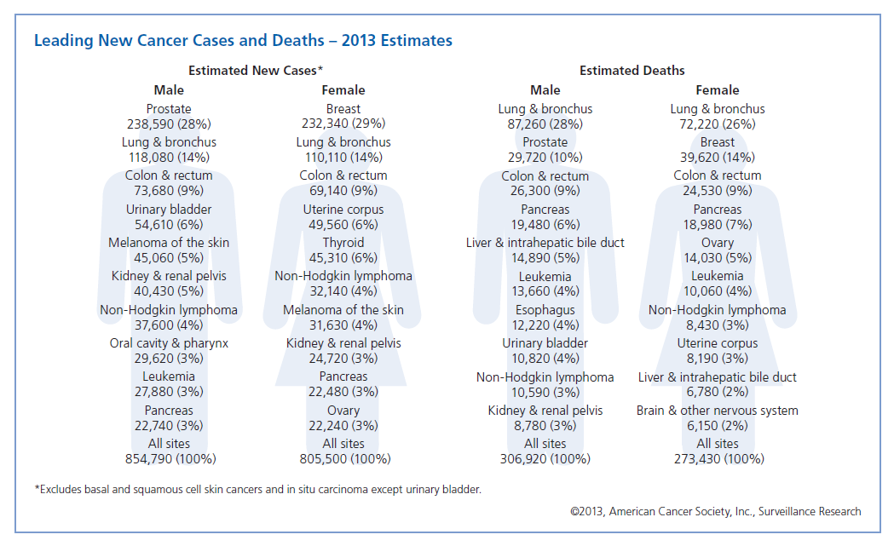

Slide 3
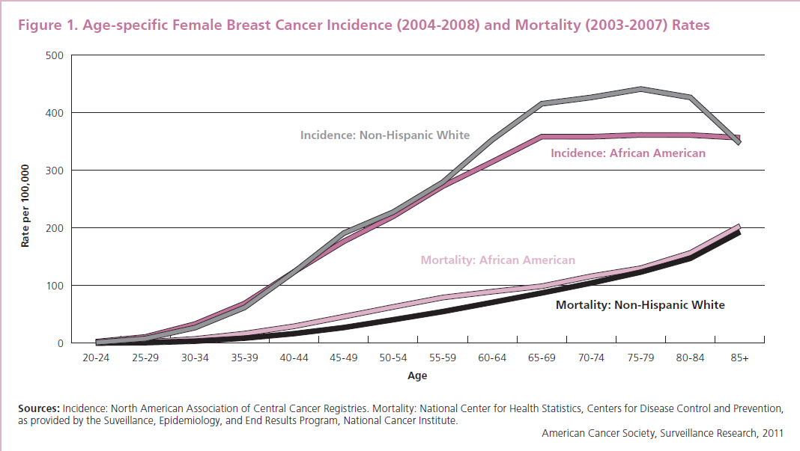

Slide 4
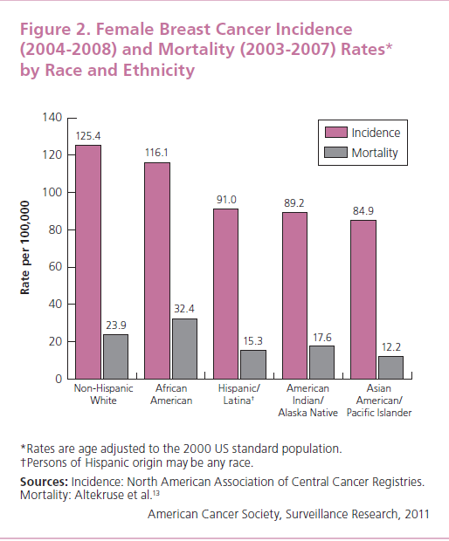

Slide 5
Possible reasons for poorer survival in African Americans
Factors related to poverty, such as poorer access to screening and optimal treatment
Tend to have more aggressive tumor characteristics at diagnosis, such as more advance stage and grade at diagnosis, and triple negative tumors (ER-, PR-, HER2-), which have poor prognosis.
More common comorbidities
Lifestyle differences, such as obesity.

Slide 6
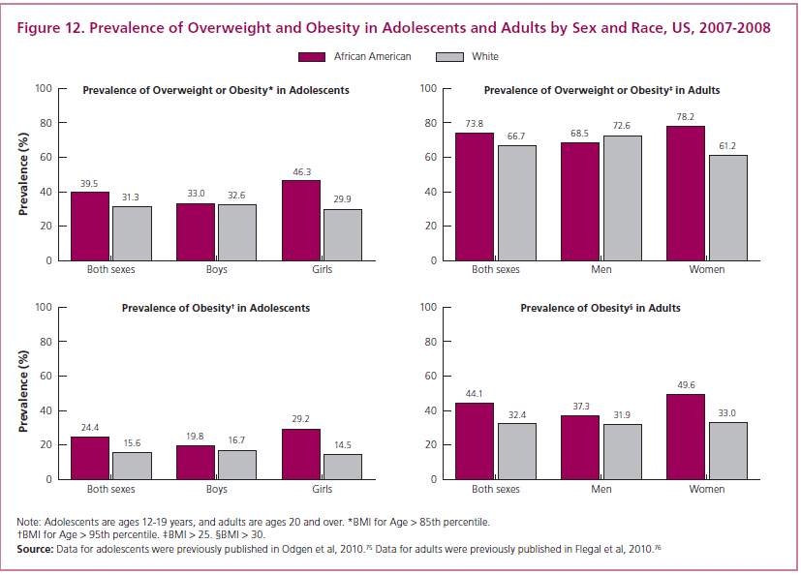

Slide 7
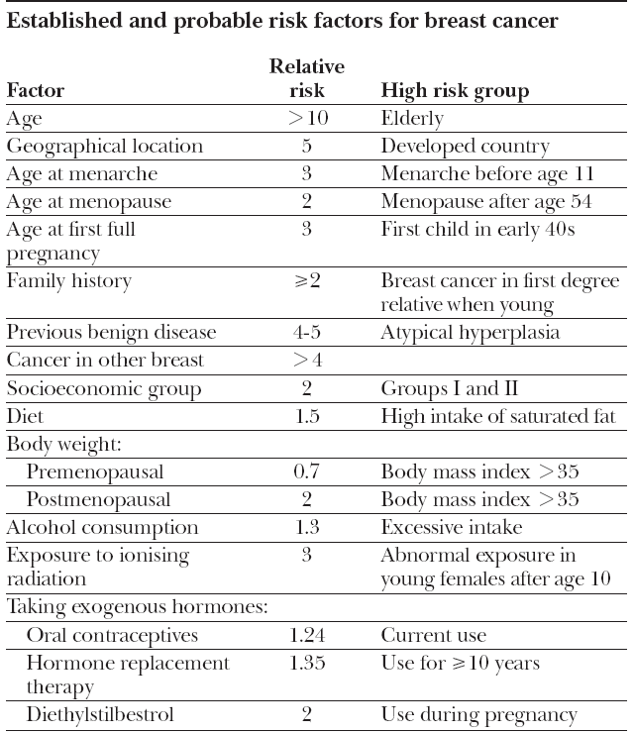

(McPherson et al., BMJ, 2000)

Slide 8
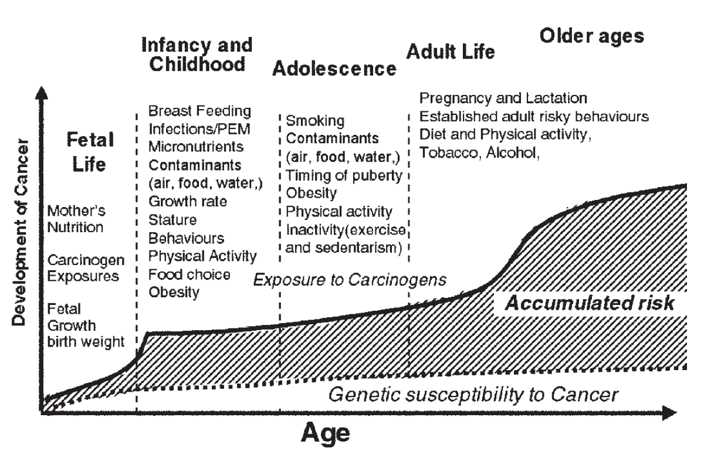
Life-course breast cancer risk
Obesity
Obesity
Diet
(Uauy and Solomons, J Nutr 2005)

Slide 9
Body size and BC: background
Epidemiologic studies have shown:
Height:
  Increased risk for tallest girls and rapid growth during adolescence
  Increased risk for adult height
  BMI:
  Increased risk for higher birth weight
  Decreased risk for higher BMI during adolescence and young adulthood
  Decreased risk for premenopausal women
  Increased risk for postmenopausal women
Current evidence mostly based on studies in white women.

Slide 10
The complex relationship of BMI on breast cancer risk
“One would want to be born light, to grow slowly but steadily into a chubby, short child, and to maintain one’s fat mass until one reached menopause, at which point, one would want to shed the excess pounds immediately in order to keep the risk of breast cancer low”
(Michels and Willett, N Engl J Med 2004)

Slide 11
Body size and breast cancer risk in women of African ancestry in the Women’s Circle of Health Study

Slide 12
OVERALL PRINCIPAL INVESTIGATORS:
Ambrosone/Bandera
2002-2008
2006-present
NYC Site
(Ambrosone)
New Jersey Site
(Bandera)
Mount Sinai School of Medicine
Study Management
Case and control recruitment
Data and biospecimen collection
Data coding and QC
The Cancer Institute of NJ
Study Management
Case and control recruitment
Data and biospecimen collection
Data coding and QC
Controls:
Community
Recruiting
Cases:
(hospital-based)
through hospitals
in Manhattan,
Bronx, Brooklyn,
and Queens
Controls:
Random Digit
Dialing
Cases:
(population-based)
NJ State
Cancer Registry
(Pawlish)
Roswell Park Cancer Institute
(Ambrosone)
Data management
Data and biospecimen
processing and analysis.
UMDNJ-SPH
Medical records
acquisition/
extraction
Tissue acquisition
(Demissie)

Slide 13

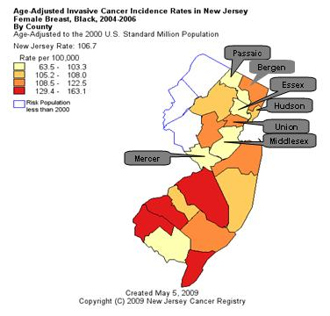
The Women’s Circle of Health:
Methods in New Jersey Site
Population-based case-control design
Cases (21-75 yrs.)
  primary, histologically confirmed, all major hospitals in seven counties in NJ (Bergen, Essex, Hudson, Mercer, Middlesex, Passaic, and Union). Monmouth and Burlington added in 2002.
Controls (21-75 yrs.)
  randomly selected using RDD from same seven counties.
  Community recruiting.
Burlington
Monmouth

Slide 14
The Women’s Circle of Health:
Data Collection: In-Person Interview
Informed consent. For cases, also release for medical records, pathology data, and tumor tissue, as well as permission to conduct follow-up.
Questionnaires: developmental history, usual diet (FFQ), lifetime physical activity, hormone use, reproductive history, smoking, medical and family history, etc.
Anthropometric measurements: standing height, weight, waist and hip circumferences, body composition (lean and fat mass)
Saliva sample (Oragene kit)

Slide 15
Women’s Circle of Health Study:
Study Team
Principal Investigators:
  Christine Ambrosone, PhD, RPCI
  Elisa V Bandera, MD, PhD (PI), CINJ
Collaborators:
  Urmila Chandran, MPH, PhD, CINJ
  Gary Zirpoli, MS, RPCI
  Susan McCann, PhD, RPCI
  Gregory Ciupak, MS, RPCI
  Zhihong Gong, PhD, RPCI
  Karen Pawlish, PhD, NJDOH
Funding: NCI (P01 CA151135, R01 CA100598, K22 CA138563, and P30CA072720), US Army Medical Research and Material Command (DAMD-17-01-1-0334), the Breast Cancer Research Foundation, and a gift from the Philip L. Hubbell family.
The New Jersey State Cancer Registry is supported by the National Program of Cancer Registries of the Centers for Disease Control and Prevention (5U58DP000808-05.)

Slide 16
Body size in early life and breast cancer risk in African American women and whites
Relative height and weight (compared to peers)
  at age 7-8 y
  at menarche
  at age 15-16 y
BMI at age 20 y
Weight changes since age 20 y
Bandera et al. “Body size in early life and breast cancer risk among women of African and European ancestry”
(In Preparation)

Slide 17
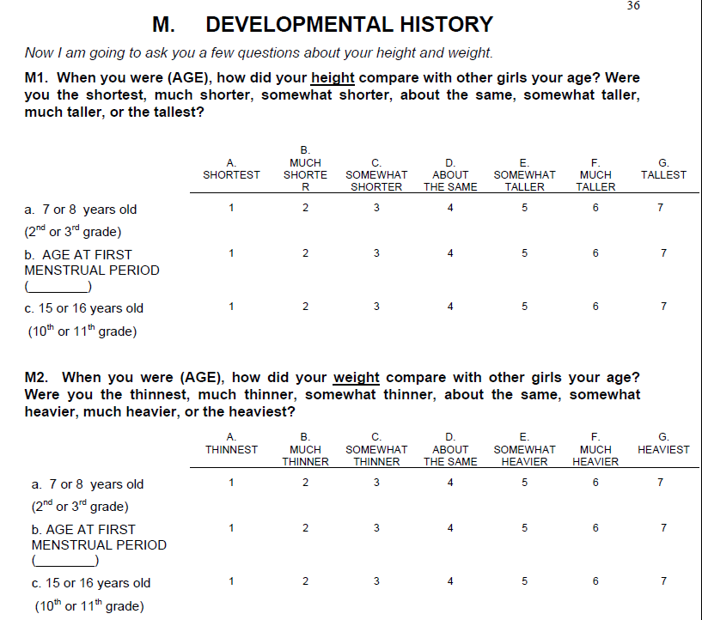

Slide 18
Covariates considered
age, ethnicity (Hispanic or Non-Hispanic)
country of origin (“US born”, “Caribbean born”, “Other”)
education
age at menarche
age at menopause (only for postmenopausal women)
menopausal status (if not stratified by this variable)
parity (continuous)
age at first birth (“0-19”, “20-24”, “25-30”, “≥31”)
breastfeeding status (ever/never)
family history of breast cancer
history of benign breast disease
oral contraceptive use
hormone replacement therapy (HRT) use
BMI at other times

Slide 19
Major findings:
Body size during childhood and adolescence and postmenopausal breast cancer risk in AA
 | OR | 95% CI
Relative height at age 7-8 y
Shortest/much shorter | 1.68 | 1.02-2.74
About same | REF
Tallest/much taller | 1.16 | 0.75-1.79
Relative weight at menarche
Thinnest/much thinner | 0.97 | 0.64-1.46
About the same | REF
Heaviest/much heavier | 0.45 | 0.20-1.02
Further adjusted for BMI at age 20
Notes:
Not a clear association with early life body size and premenopausal breast cancer.

Slide 20
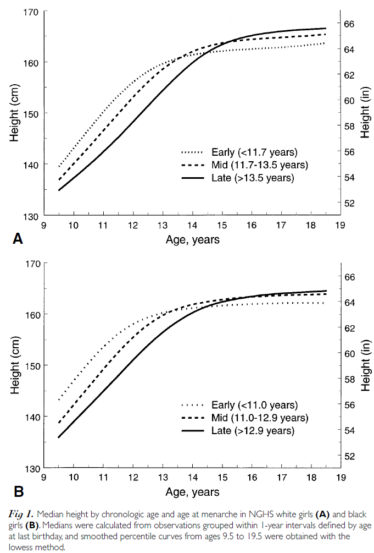
Height, adiposity, onset of menarche, and breast cancer: complex and not well understood!
Childhood tallness
Childhood adiposity
Earlier menarche
Increased
breast cancer
risk
Shorter adult height
Decreased
breast cancer
risk
Biro et al., J Pediatr 2001)

Slide 21
Body fatness and breast cancer risk in women of African ancestry
Current BMI
Body fat distribution
  Waist-to-hip ratio
  Waist circumference
  Hip circumference
Body composition
  Percent body fat
  Lean mass
  Fat mass
Bandera et al. “Body fatness and breast cancer risk in women of African ancestry” (submitted)

Slide 22
Current BMI and breast cancer risk in AA women (WCHS, 2006-2012)
 | Pre-menopausal |  |  | Post-menopausal
 | OR | 95% CI |  | OR | 95% CI
Current BMI
Underweight/Normal (<25) | 1.0 |  |  | 1.0
Overweight (25-29.99) | 1.05 | 0.70-1.57 |  | 0.93 | 0.59-1.47
Obese (>30) | 0.93 | 0.54-1.56 |  | 1.00 | 0.58-1.72
Further adjusted for waist circumference
Notes:
Not a clear association with early life body size and premenopausal breast cancer.

Slide 23
WHR and breast cancer risk in AA women (WCHS, 2006-2012)
 | Pre-menopausal |  |  | Post-menopausal
 | OR | 95% CI |  | OR | 95% CI
WHR
≤0.82 | 1.0 |  |  | 1.0
0.83-0.87 | 1.20 | 0.82-1.74 |  | 1.59 | 1.04-2.42
0.88-0.92 | 1.07 | 0.72-1.60 |  | 1.24 | 0.80-1.92
>0.92 | 1.38 | 0.89-2.12 |  | 1.48 | 0.97-2.26
P for trend |  | 0.22 |  |  | 0.27
Further adjusted for BMI
Notes:
Not a clear association with early life body size and premenopausal breast cancer.

Slide 24
Waist circumference and breast cancer risk in AA women (WCHS, 2006-2012)
 | Pre-menopausal |  |  | Post-menopausal
 | OR | 95% CI |  | OR | 95% CI
Waist circumference, cm
≤87.8 | 1.0 |  |  | 1.0
87.89-97.75 | 1.26 | 0.85-1.88 |  | 1.13 | 0.73-1.76
97.76-110.25 | 1.47 | 0.88-2.44 |  | 1.51 | 0.92-2.48
>110.25 | 2.25 | 1.07-4.74 |  | 1.23 | 0.64-2.34
Further adjusted for BMI
Notes:
Not a clear association with early life body size and premenopausal breast cancer.

Slide 25
Hip circumference and breast cancer risk in AA women (WCHS, 2006-2012)
 | Pre-menopausal |  |  | Post-menopausal
 | OR | 95% CI |  | OR | 95% CI
Hip circumference, cm
≤103.18 | 1.00 |  |  | 1.00
103.9-111.63 | 1.60 | 1.07-2.39 |  | 0.99 | 0.65-1.51
111.64-123.15 | 1.60 | 0.98-2.60 |  | 1.16 | 0.71-1.89
>123.15 | 2.91 | 1.39-6.10 |  | 0.87 | 0.45-1.71
P for trend |  | 0.01 |  |  | 0.69
Further adjusted for BMI
Notes:
Not a clear association with early life body size and premenopausal breast cancer.

Slide 26
Summary/ Major findings
Childhood body size: Shorter stature was associated with increased postmenopausal breast cancer risk, while being heavier was associated with decreased risk in AA women.
No significant association was found with BMI at age 20 or with weight gain since age 20 for AA women.
Adult BMI was also unrelated to premenopausal or postmenopausal breast cancer.
Adult body fat distribution: Higher waist and hip circumferences were associated with increased risk.
Adult body composition: There was a suggestion of increased risk with higher fat mass and percent body fat in postmenopausal women, but confidence intervals included the null value.

Slide 27
Conclusions
Childhood height may have opposing effects in subsequent breast cancer risk in white and AA women.
Similar inverse association with adolescent weight was found in AA as that observed for white girls in this and other studies.
While general obesity did not appear to impact risk, higher waist and hip circumference may increase premenopausal breast cancer risk.
Overall, we found differences in the impact of early life and adult body size and adiposity on breast cancer in AA women that warrant further investigation.

Slide 28
Conclusions
Our results are in general agreement with the few studies evaluating body fatness and breast cancer risk in AA.
Studies have shown that for a given BMI, AA women tend to have higher lean mass and lower fat than white women. Therefore, waist circumference and percent body fat may reflect adiposity better than BMI for this population.

Slide 29
Life-course breast cancer risk
(Uauy and Solomons, J Nutr 2005)

Slide 30




Urinary estrogenic mycotoxins
in girls’ growth and development

Slide 31
Mycoestrogens and growth and development:
Study Team
Principal Investigator:
  Elisa V Bandera, MD, PhD (PI), CINJ
Collaborators:
  Urmila Chandran, MPH, PhD, CINJ
  Brian Buckley, PhD, EOHSI
  Yong Lin, PhD, CINJ, Biostatistics
  Ian Marshall, MD, RWJMS, Pediatric Endocrinology
  Helmut Zarbl, PhD, EOHSI
Funded by the Cancer Institute of New Jersey and by the NIEHS sponsored UMDNJ Center for Environmental Exposures and Disease, Grant #: NIEHS P30ES005022.

Slide 32
Puberty and breast cancer
Early age at menarche (first period) is a well established risk factor for breast cancer
Studies have shown that women who have their first period before age 11 have three times the risk of developing breast cancer.
The breast during the pubertal period is particularly susceptible to environmental exposures, as cells are rapidly dividing during the normal process of breast development and they are not fully differentiated making them more susceptible to carcinogens.

Slide 33
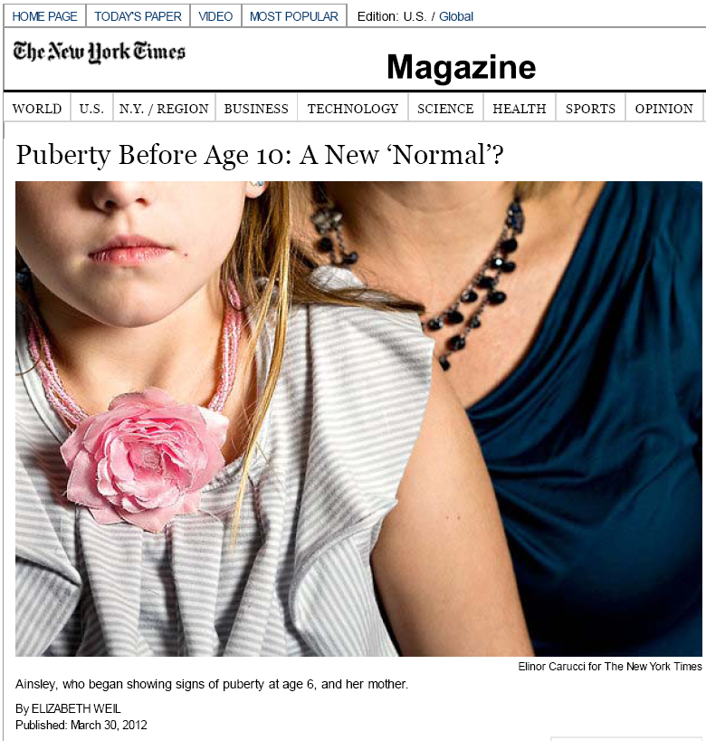

Slide 34
What are mycotoxins?
Mycotoxins are labeled as the most important contaminant in the food chain.
Secondary metabolites (chemicals) of a fungus that produce toxic results in another organism.
Lack of visible appearance of fungus does not negate presence of mycotoxins. Toxins can remain in the organism after fungus has been removed.

Slide 35
Mycotoxin contamination
Fungal infection can occur at any stage in crop production
  In the field.
  During harvesting.
  During storage.
Most likely to occur in high temperature/ humidity conditions, and also under stress to the affected plant, such as drought, flood, or insect infestation.
Spores can lay dormant for months to years, waiting for positive conditions for germination.
Can be heat stable, not destroyed by canning or other processes.
Notes:
35

Slide 36
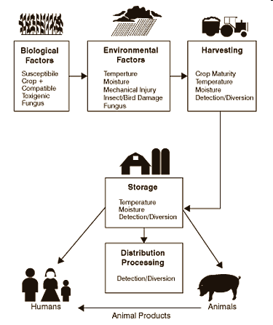
Factors influencing mycotoxin occurrence in the food chain (Pestka and Casale, 1988)
http://www.foodtech-international.com/papers/mycotoxins.htm

Slide 37
Some mycotoxins and mycotoxin producing fungi
(Sinha, 1996; Carlile et al., 2001)
Toxin | Main Producing Fungi | Health Effects
Aflatoxins | Aspergillus flavus, A. parasiticus | Liver damage, liver cancer
Ochratoxins | A. Ochraceus Penicillium verrucosum | Kidney damage
Patulin | P. expansum, P. griseofulvum | Kidney damage
Trichothecenes T-2 toxins Vomitoxin | F. sporotrichioides, F. pose F. graminearum, F. culmorum | Alimentary toxic aleukia Vomiting, antifeedant
Zearalenone | Fusarium graminearum | Gynecological disturbances
Fumonisins | F. Moniliforme | Oesophageal cancer
Ergot alkaloids | Claviceps purpurea | Vasoconstriction, gangrene
http://www.foodtech-international.com/papers/mycotoxins.htm

Slide 38
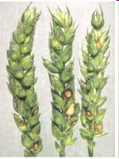
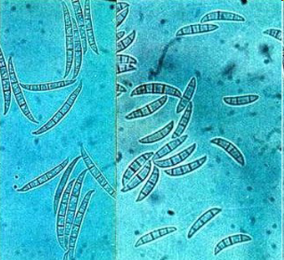
Zearalenone
Mycotoxin produced by fungal contamination of grain, fruits and their products by Fusarium species.
Shown to have acute and chronic health effects including carcinogenicity, genotoxicity, and immunotoxity, as well as reproductive and endocrine effects.
Labeled as mycoestrogen, phytoestrogen, and growth promotant.
Shown to be able to bind to ER-alpha and ER-beta, acting as a full agonist for ER-alpha and a mixed agonist-antagonist for ER-beta, with a much higher affinity than other well-known endocrine disruptors such as BPA or DDT, but with lower affinity than 17-beta-estradiol, estriol, and estrone.

Slide 39

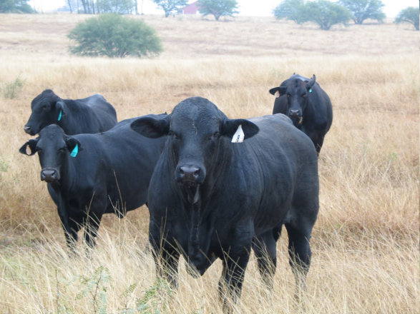
Zeranol
Synthetic derivative of the mycotoxin zearalenone. Federally approved agent commonly used in the US as a non-steroidal anabolic growth promoter in beef production, but banned in other countries, including in the European Union.
The estrogenicity of zeranol is comparable to the natural estrogen, 17ß-estradiol and the syntethic estrogen DES (diethylstilbestrol), and much more potent than genistein and bisphenol-A.
Shown to induce ER-ß expression and stimulate growth of human breast cancer cells.

Slide 41
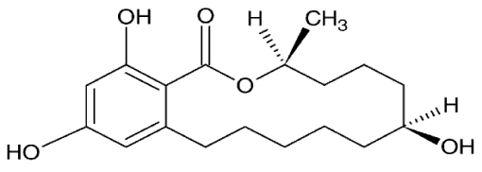
Zearalenone and its metabolites
Zearalenone
(ZEA)
Alpha-zearalenol
(α -ZEL)
Beta-zearalenol
(β-ZEL)
?
Alpha-zearalanol (zeranol)
(α-ZAL)
Beta-zearalanol (teranol)
(β -ZAL)
Zearalanone
(ZAN)

Slide 42
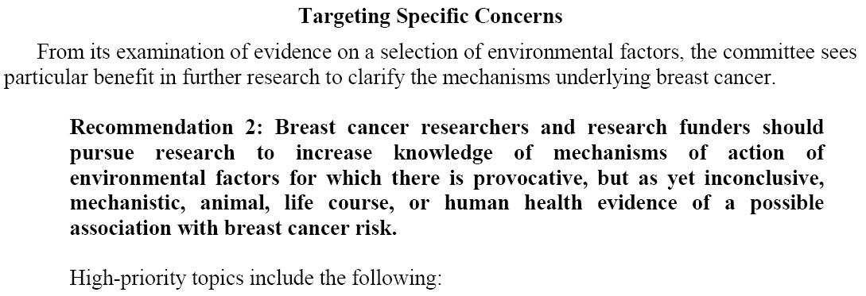
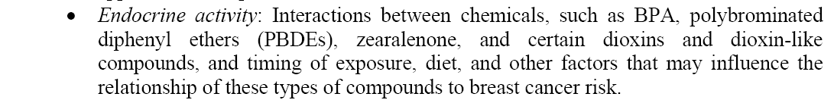
Institute of Medicine 2012
Breast Cancer and the Environment. A Life Course Approach Washington, DC: The National Academies Press

Slide 43
Mycoestrogens and puberty
The peri-pubertal period is particularly susceptible to estrogenic stimulation because endogenous estrogen production is very low.
Little is known about the role of these mycotoxins in the onset of breast development and puberty.
The current evidence is limited to:
  Anecdotal reports of epidemics of precocious puberty in Puerto Rico and Italy, attributed to the use of anabolic estrogens in animal foods, although levels were not assessed.
  Two small studies measuring blood levels in girls with precocious puberty in Turkey and Italy. One found (Massart, J Pediatr 2008) that mycotoxin positive girls (classification based on blood levels) were taller and proportionally heavier than those that were mycotoxin negative.

Slide 44
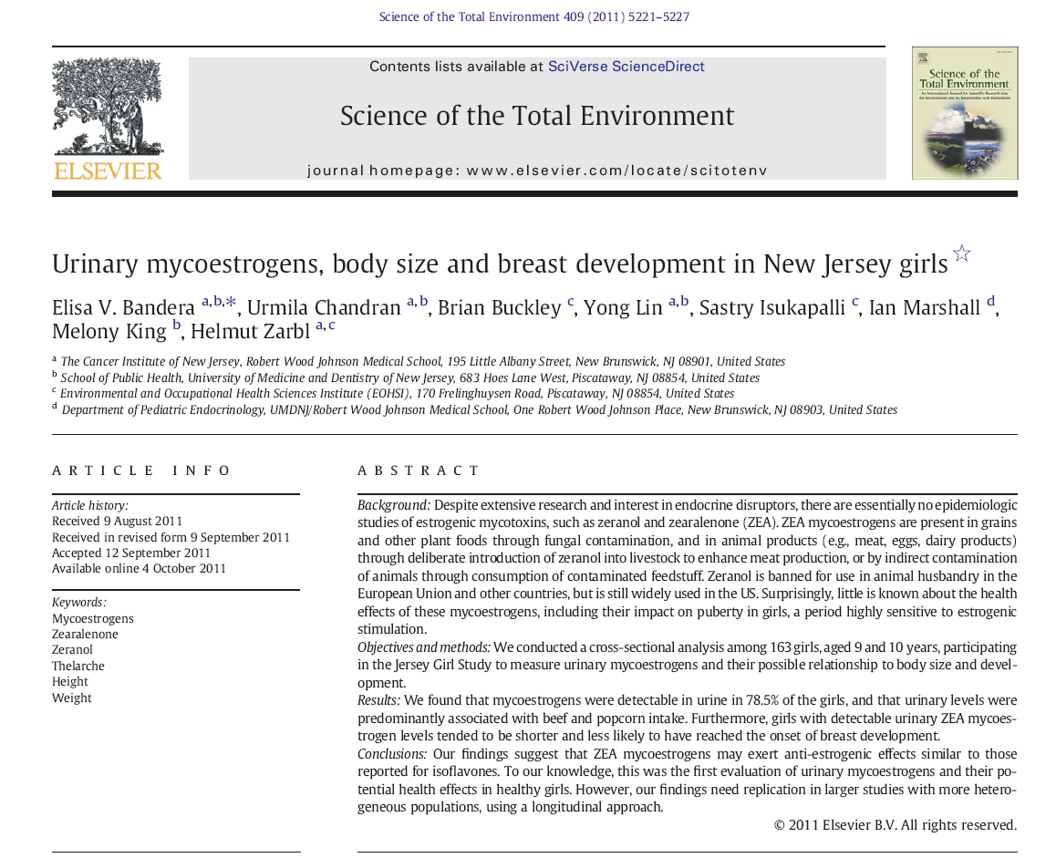

Slide 45
METHODS
Ongoing cohort study of peri-pubertal girls.
Recruitment sources: pediatric practices, media, and community recruitment efforts.
Eligibility criteria: Healthy girls, aged 9-10 years, NJ residents, living with their biological mother, with no cognitive impairments, and both mother and daughter able to speak English.
For these analyses, we used cross-sectional data from the first 163 girls participating in the Jersey Girl Study.

Slide 46
Data Collection
Consent/assent (mail)
Eligibility questionnaire including identifying information (phone)
Appointment (home or clinic)
  Body measurements (weight, height, sitting height, waist and hip circumferences, percent body fat measured by bioelectrical impedance analysis (BIA)).
  Morning urine sample
  Saliva sample
  Mother assessment of puberty by Tanner staging (standard tool)
  Physician assessment of Tanner staging.
Main Questionnaire (no identifiers): self-administered.
24-hour recalls (Three dietary assessments, weekdays and weekend)
Annual follow-up brief questionnaire, including Tanner staging by mom and onset of menarche assessment.

Slide 47
Dietary
Assessment
Three 24-hour recalls conducted in at least one weekend and one week day.
Initially not coordinated around urine collection. Therefore, we have two datasets according to timing of dietary assessment with respect to urine collection:
  Day before urine collection (n=58)
  Three-day average for all girls regardless of timing of diet-urine collection (n=163).

Slide 48
Urine sample collection, processing, and measurements
Collection: Moms provided with plastic urine containers and asked to collect girls’ first morning void and bring to appointment.
Urines transferred in a cooler to CINJ TRS Lab for aliquoting and storage in a freezer at -70 °C.
One of the aliquots transferred to Dr. Brian Buckley’s lab at EOHSI for analysis of zeranol, zearalenone and their main metabolites.
Urinary mycoestrogen (mycoE) values were corrected for urine dilution by specific gravity (SG) using the equation:
SG corrected-MycoE value=MycoE value/[(SG-1)x100]

Slide 49
Data Analysis
Total free mycoE calculated as the sum of zeranol and ZEA metabolites.
Detectable mycoE values were log transformed to approximate normality prior to computing geometric means and 95% confidence intervals (CI).
Age-adjusted means for anthropometric variables and mean intake of relevant food groups by mycoestrogen status were compared using ANCOVA and Kruskal-Wallis test, respectively.
Prevalence ratios (PR) and 95% CIs using Poisson regression were computed for mycoE positive vs. negative girls with onset of breast development (Tanner stage B2+) as the outcome.
Covariates considered included age, BMI, isoflavone intake, beef intake, and recruitment year.

Slide 50
Main Questions
Can these mycoestrogens be detected in urine?
If so, where are they coming from?
Do they have an impact on girls’ growth and development?

Slide 51
Specific-gravity corrected urinary levels of mycoestrogens among girls with detectable levels. The Jersey Girl Study (n=163)
Mycoestrogens (pg/ml) | Detection n (%) | Median | Mean | SD | Min | Max
Zearalenone (ZEA) | 90 (55.2%) | 323.7 | 1,282.1 | 3,139 | 35.2 | 22,341.6
α-zearalanol (zeranol)* | 35 (21.5%) | 169.6 | 196.2 | 207.2 | 8.1 | 1,229.1
α-zearalenol* | 60 (36.8%) | 65.0 | 411.2 | 1,185 | 3.1 | 7,157.4
ß-zearalenol | 39 (23.9%) | 157.1 | 213.1 | 176.3 | 21.6 | 1,020.7
ß-zearalanol | 17 (10.4%) | 206.2 | 397.9 | 641.3 | 22.5 | 2,757.3
Zearalanone | 29 (17.8) | 167.0 | 221.3 | 291.4 | 41.6 | 1,570.8
Total ZEA mycotoxins | 128 (78.5%) | 309.6 | 1,315.8 | 3,656 | 33.3 | 29,882.7
*Most estrogenic.
Levels reported in Massart, J Pediatr 2008 (in serum):
Mean ZEA: 933 pg/ml
Mean α-zearalenol: 106 pg/ml

Slide 52
Specific Gravity-Corrected levels of mycoE (pg/ml) according to selected characteristics (n=163)
 | n | % | Total mycoE Median (Min-Max)
Age at recruitment 9 yrs. 10 years. p value | 95 68 | 58.3 41.7 | 211 (0-11,902) 231 (0-29,883) 0.90
Girls’ race White African American Asian p value | 146 7 5 | 92.4 4.4 3.2 | 205 (0-29,883) 370 (0-1,083) 307 (122-1,835) 0.38
County of residence Mercer Middlesex Other counties p value | 63 29 71 | 38.7 17.8 43.6 | 218 (0-29,883) 326 (0-4,859) 181 (0-22,893) 0.09

Slide 53
Specific Gravity-Corrected levels of mycoE (pg/ml) according to selected characteristics (n=163)
 | n | % | Total mycoE Median (Min-Max)
Mothers’ education High school level Bachelor’s degree Graduate education p value | 34 63 66 | 20.9 38.7 40.5 | 235 (0-22,893) 220 (0-11,248) 214 (0-29,883) 0.31
Family income <$100,000 >$100,000 p value | 40 111 | 26.5 73.5 | 316 (0-22,893) 202 (0-29,883) 0.28

Slide 54
Specific Gravity-Corrected levels of mycoE (pg/ml) according to selected characteristics (n=163)
 | n | % | Total mycoE Median (Min-Max)
Body Mass Index* Underweight Healthy weight Overweight Obese p value | 9 115 20 19 | 5.5 70.6 12.3 11.7 | 302 (0-1,253) 217 (0-29,883) 237 (0-6,130) 126 (0-5,294) 0.77
*Based on BMI for age and gender percentiles according to CDC definition: Underweight (< 5th percentile); Healthy weight ( 5th - <85th percentile); Overweight (85th - < 95th percentile); Obese (> 95th percentile)

Slide 55
Urinary ZEA (geometric means and 95% CI in pg/ml) according to intake of beef and popcorn*
ZEARALENONE (ZEA)
 | Negative |  | Positive
 | n (%) |  | n (%) | Geometric Mean (95% CI)
Beef Yes No p value | 2 (10.5) 17 (43.6) |  | 17 (89.5) 22 (56.4) (0.02) ¹ | 760 (377-1,530) 325 (215-492) (0.04) ²
Popcorn Yes No p value | 1 (16.7) 18 (34.6) |  | 5 (83.3) 34 (65.4) (0.65) ¹ | 1,927 (443-8,386) 383 (265-553) (0.01) ²
*For girls who had dietary data for day before sample (n=58)
¹p value based on Chi-square test or Fisher’s Exact test as appropriate
²p value based on t-test

Slide 56
Urinary ZEA (geometric means and 95% CI in pg/ml) according to intake of beef and popcorn*
TOTAL MYCOESTROGENS
 | Negative |  | Positive
 | n (%) |  | n (%) | Geometric Mean (95% CI)
Beef Yes No p value | 1 (5.3) 7 (18) |  | 18 (94.7) 32 (82) (0.25) ¹ | 1,112 (587-2,108) 339 (233-492) (0.002) ²
Popcorn Yes No p value | 0 (0) 8 (15.4) |  | 6 (100) 44 (84.6) (0.58) ¹ | 2,365 (670-8,349) 422 (301-593) (0.002) ²
*For girls who had dietary data for day before sample (n=58)
¹p value based on Chi-square test or Fisher’s Exact test as appropriate
²p value based on t-test

Slide 57
Anthropometric factors (age-adjusted means±SE) according to mycoestrogen status
 | MycoE Negative (n=35) | MycoE Positive-Low* (n=64) | MycoE Positive-High (n=64) | p value**
Body Mass Index Weight (kg) Height (cm) Fat Mass (kg) Percent Body Fat (%) Waist Circumference (cm) Hip Circumference (cm) Waist-to-Hip Ratio | 18.61 (0.53) 38.36 (1.44) 143.14 (1.22) 8.94 (0.90) 21.57 (1.52) 68.10 (1.50) 78.71 (1.31) 0.86 (0.01) | 18.40 (0.39) 36.65 (1.06) 140.28 (0.90) 8.40 (0.67) 21 (1.13) 66.90 (1.10) 78.38 (0.96) 0.85 (0.01) | 17.82 (0.39) 34 (1.06) 137.38 (0.90) 7.00 (0.67) 18.75 (1.12) 64.63 (1.11) 76.23 (0.97) 0.85 (0.01) | 0.42 0.001 <0.0001 0.07 0.24 0.07 0.01 0.45
*Based on median value of total mycoestrogens (310 pg/ml)
**Based on ANCOVA analyses
Similar results in stratified analyses by pubertal status (prepubertal y/n).
Notes:
Repeated these analyses in p

Slide 58
Food consumption based on three-day average (age-adjusted means±SE) according to mycoestrogen status
 | MycoE Negative (n=8) | MycoE Positive-Low* (n=25) | MycoE Positive-High (n=25) | p value**
Beef (daily servings/1000 kcal) | 0.12 (0.34) | 0.29 (0.64) | 0.97 (1.24) | 0.03
Total grains (daily servings/1000 kcal) | 4.47 (1.22) | 3.74 (0.84) | 3.78 (1.61) | 0.28
Total corn products (daily servings/1000 kcal) | 0 | 0.07 (0.24) | 0.10 (0.20) | 0.17
Popcorn (daily servings/1000 kcal) | 0 | 0.01 (0.05) | 0.08 (0.18) | 0.10
Total isoflavones (daily mg/1000 kcal) | 2.54 (6.34) | 1.12 (2.76) | 1.83 (5.35) | 0.99
% calories from fat | 38.70 (33.33) | 31.57 (6.54) | 30.79 (6.26) | 0.60
Total calories | 1531.3 (302.9) | 1593.7 (483.7) | 1846.9 (489.2) | 0.14
Day Before
*Based on median value of total mycoestrogens (460 pg/ml)
**Based on Kruskal-Wallis test
Notes:
Repeated these analyses in p

Slide 59
Notes:
Both not statistically significant

Slide 60
Prevalence ratios (PR) and 95% CI for onset of breast development according to mycoestrogen status
Breast Development | B2+ n (%) | B1 n (%) | Crude PR (95% CI) | Adjusted PR* (95% CI)
MycoE- | 24 (23.8%) | 11 (17.7%) | 1.00 | 1.00
MycoE+ | 77 (76.2%) | 51 (82.3%) | 0.88 (0.67-1.14) | 0.79 (0.60-1.04)
*Adjusted for age, BMI, year of urine collection, and total isoflavone intake in mg/1000 kcal.
Note: Tanner Stage B2+ marks the onset of breast development

Slide 61
Strengths and Limitations
LIMITATIONS
Small sample size
Dietary information before the day of urine collection was only available for a small subset of girls
Only one urine sample was measured
STRENGTHS
First study to evaluate urinary levels of mycoestrogens in girls
First study evaluating mycotoxins and growth and development in girls in the US

Slide 62
Conclusions
Mycoestrogens were detected in urine of girls in NJ, particularly zearalenone. Zeranol levels were negligible.
Main source seems to be beef and popcorn.
Compared to mycoE-negative, girls with mycoE positive urine tended to be of shorter stature and less likely to have reached the onset of puberty, even after controlling for BMI.

Slide 63
Conclusions
Our findings suggest that ZEA may have anti-estrogenic effects, perhaps by competing with endogenous estrogens, similar to effects reported for isoflavones.
While our results are not conclusive, they raise important questions that should be tested in larger, more diverse populations using a longitudinal design.

Slide 64
Future Plans
NIEHS R01 Application: “Urinary mycoestrogens and pubertal markers in girls” (PI: Elisa Bandera)
Co-investigators: Lawrence H Kushi, Brian Buckley, Gayle Windham, Louise Greenspan, Ian Marshall, Yong Lin.
Aiming to conduct longitudinal analyses in the CYGNET Study, an ongoing cohort study based at Kaiser Permanente Northern California, by measuring mycoestrogens in urine samples collected in year 1 follow up (after they completed dietary recalls) in 409 girls and evaluate their role on:
age at thelarche and menarche
body size, body composition
height at age 15-17 y
growth rate (age at take off and age at peak height velocity).
We will conduct follow-up in the Jersey Girl Study (n=200) to better infer causality and examine other endpoints, including final height and onset of menarche.
We will also compare levels and food sources in California and NJ

Slide 65
Thank you!!

